Slide 1



Simulación de propiedades
Miriam Marqués Arias
Notes:
1
1

Slide 2
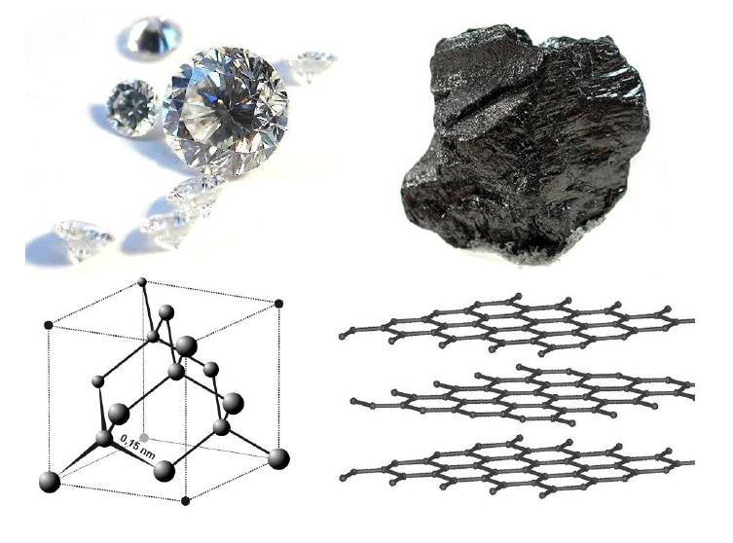
Estructura Propiedades

Slide 3
Intervalo de presión en el universo

Slide 4
Un nuevo mundo bajo presión
Líquidos sorprendentes sólidos, gases metales exóticos…….. por modificación de distancias interatómicas y ángulos de enlace.
Transiciones de fase a nuevas estructuras cristalinas con propiedades físicas y químicas inesperadas y novedosas
Elementos se convierten en superconductores, metales se convierten en aislantes
Las moléculas se rompen
Nuevas reacciones químicas son posibles (hidruros de elementos de transición)

Slide 5
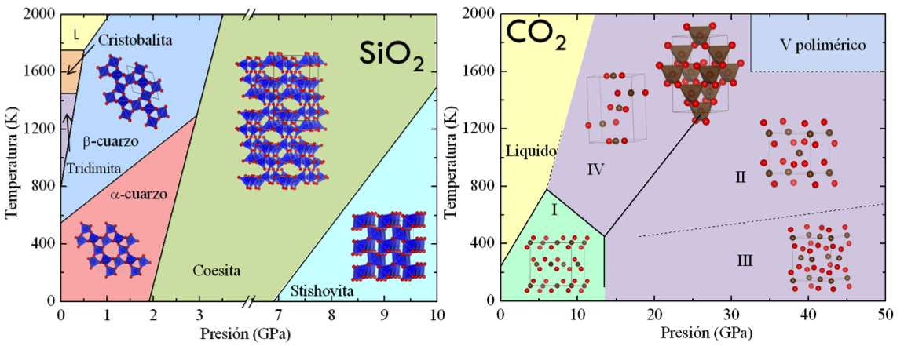
Transiciones de fase

Slide 6
Una nueva tabla periódica

Slide 7
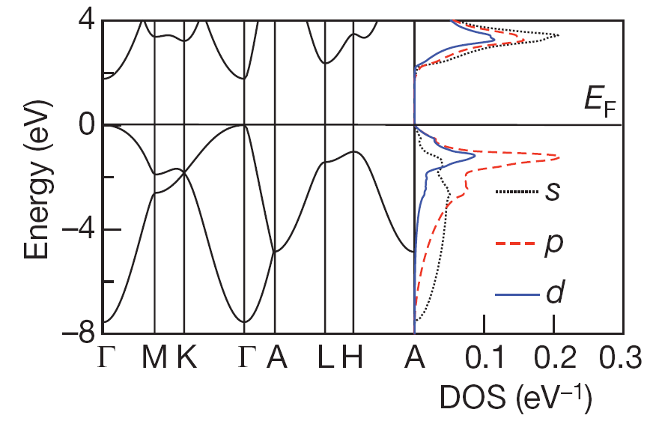
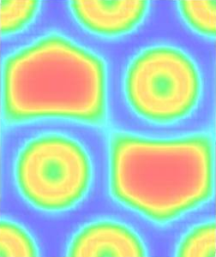
Na: fase hP4
hP4 : aislante con band gap directo (Eg=2.1 eV)
Cuencas de ELF: unidades localizadas sin conexión. Puede esto ayudarnos a entender la conductividad?
(W. Kohn, Phys Rev A 133,171: Theory of the insulating state”)
Qué es un metal?

Slide 8
Simulación computacional?
EXPERIMENTO:
INPUT
ESTÍMULO
“Invisible”
System
OUTPUT
RESPUESTA
MODELO:
Descripción simplificada de un sistema real y complejo
Captura la física esencial responsable del comportamiento del sistema
Obvia los detalles irrelevantes sin impacto significativo en la respuesta
El resultado del modelo tiene que estar de acuerdo con los experimentos, si no puede ser demasiado simple
Los modelos permiten extrapolar la respuesta del sistema en condiciones no accesibles por los experimentos

Slide 9
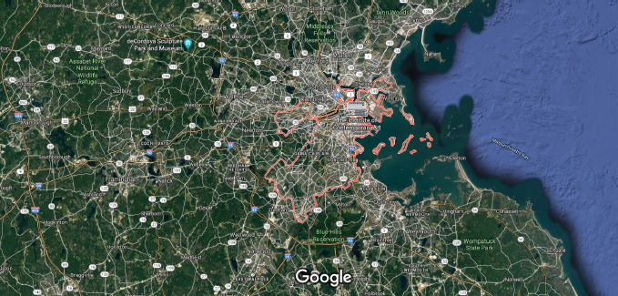
Simulación computacional?
MODELO:

Slide 10

Simulación computacional?
MODELO:
Distancias, direcciones?
Conectividad O.K.
Qué nos interesa?

Slide 11
Simulación computacional?
Experimentos
Teoría
SIMULACIONES
COMPUTACIONALES
Presentes en nuestra vida diaria (simulaciones en economía, previsión metereológica, simuladores de vuelos…)
Método general para resolver modelos que no pueden resolverse analíticamente por su complejidad
Se basan en algoritmos (series de instrucciones)

Slide 12
Simulación computacional?
Modelo: ecuaciones que gobiernan el comportamiento
Simulación: resultado del modelo con cierta precisión
Experimento: medida de propiedades con cierta precisión
Experimento computacional: el ordenador sirve para resolver numéricamente las ecuaciones definidas por el modelo
Permiten testear diferentes modelos
Necesitamos herramientas para el análisis de los resultados de la simulación
En materiales: estudian el modo en que los componentes del sistema interaccionan entre ellos, con el entorno y frente a factores externos (presión, temperatura)

Slide 13
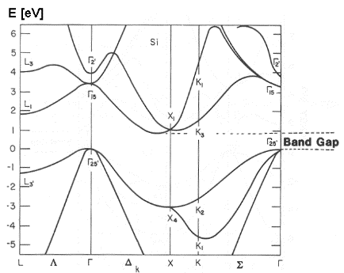
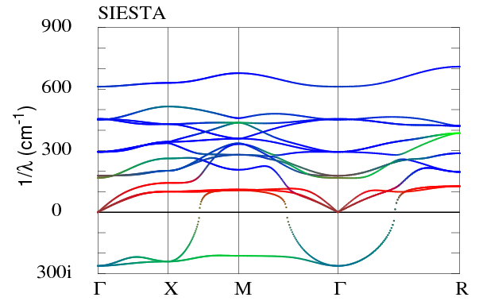

Goal: Describe properties of matter from theoretical methods firmly rooted in fundamental equations
sstructural
electronic
PROPERTIES
magnetic
vibrational
optical

Slide 14
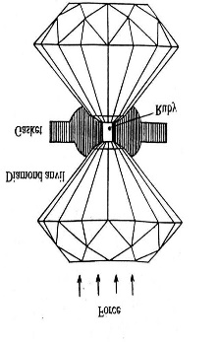
EXPERIMENTS
+ characterization
techniques
PROBLEMS:
Small size of the sample
No hydrostaticity
Limited range of pressures
Non recoverable structures
Lack of crystallinity
Pressure sensors
Transition mechanisms
SIMULATIONS
ideal samples
any conditions
It allows:
Complement experiments
Interpret and predict
PROBLEMS:
approximations
experiment-theory comparison

Slide 15
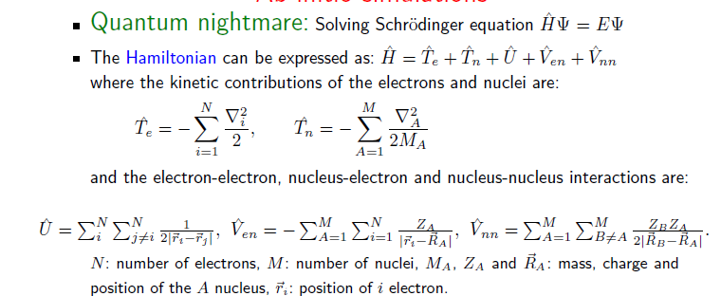

Ab initio simulations

Slide 16
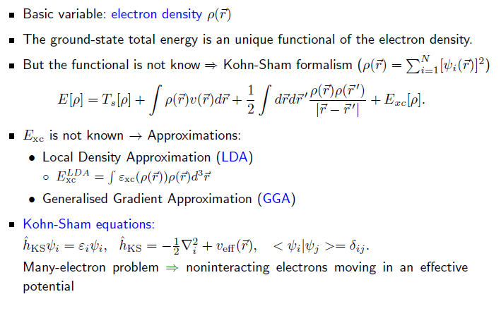
Density functional theory

Slide 17
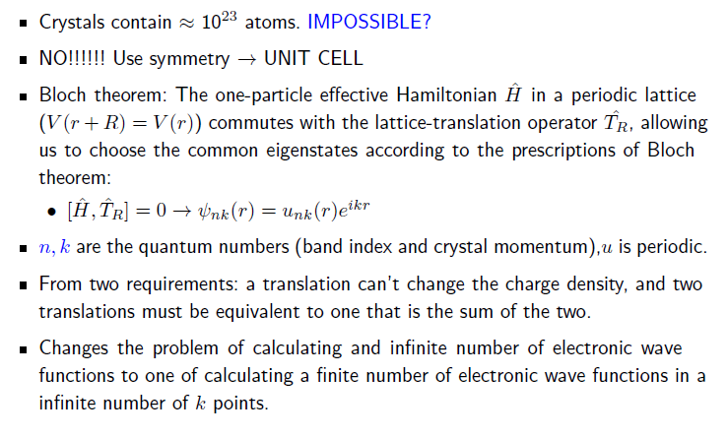
In a crystal?

Slide 18
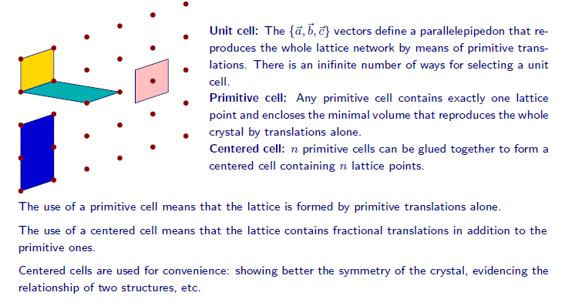
Periodic crystals

Slide 19
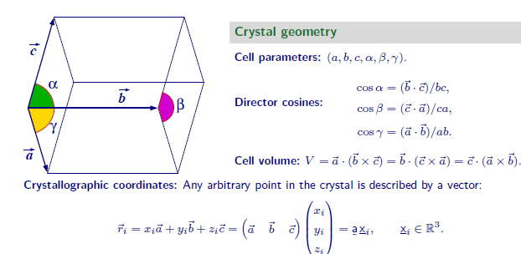
Periodic crystals

Slide 20
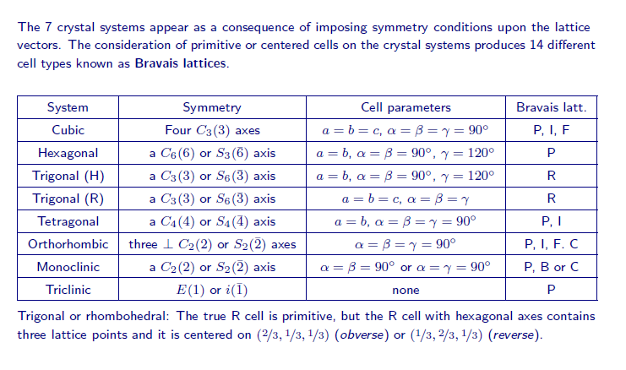
Periodic crystals

Slide 21
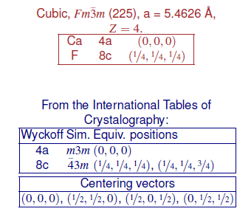
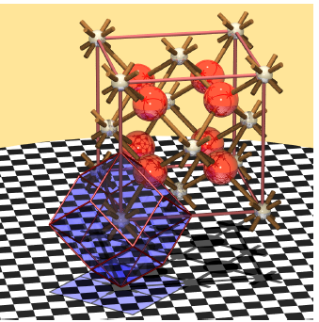
Calcite: fluorite structure

Slide 22
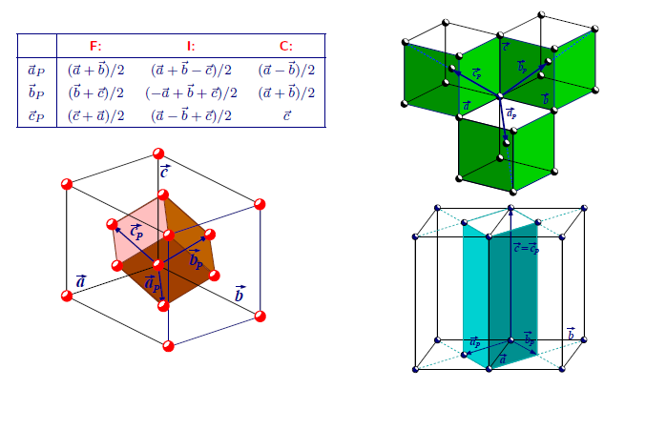
Primitive cell

Slide 23
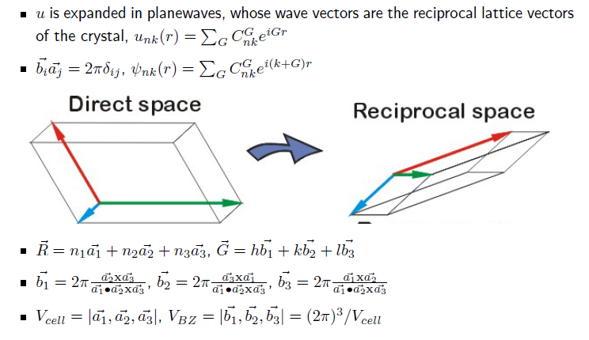
Basis sets: Plane waves

Slide 24
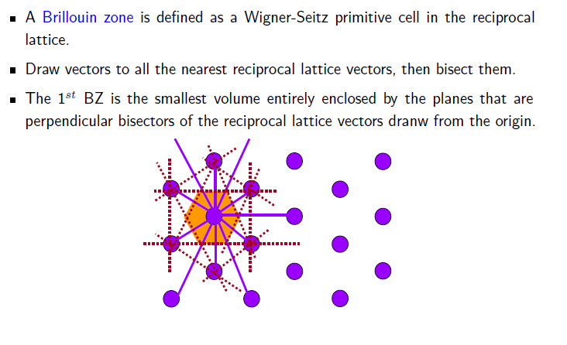
Brillouin zones

Slide 25
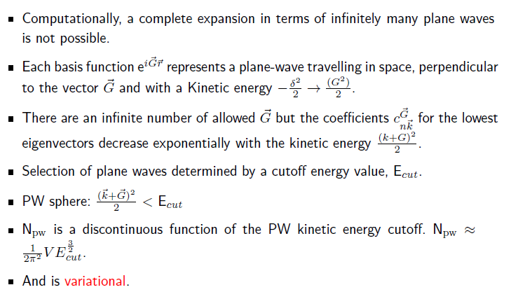
Cutoff: finite basis set

Slide 26
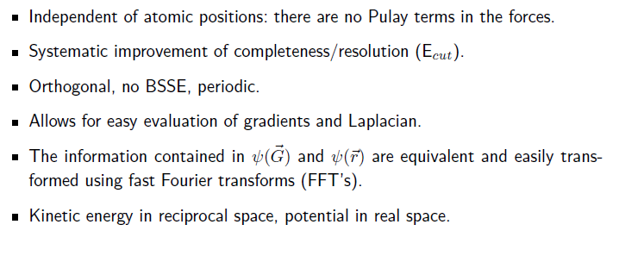
Advantages of plane waves

Slide 27
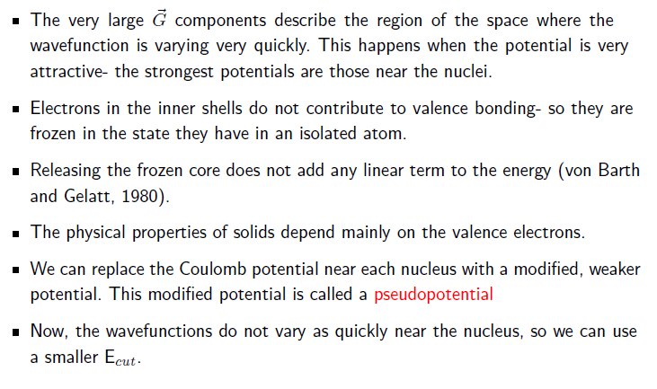
Pseudopotentials

Slide 28
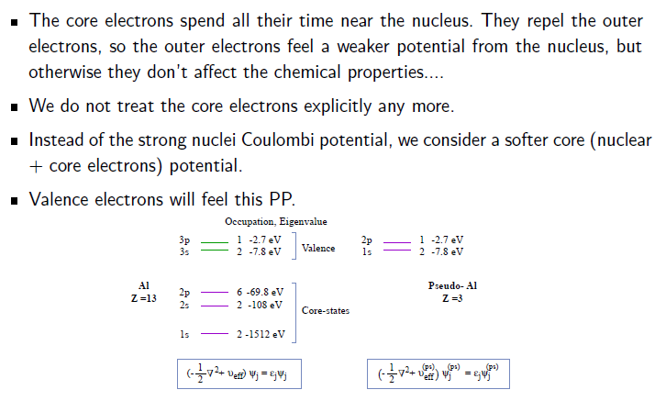
Pseudopotentials

Slide 29
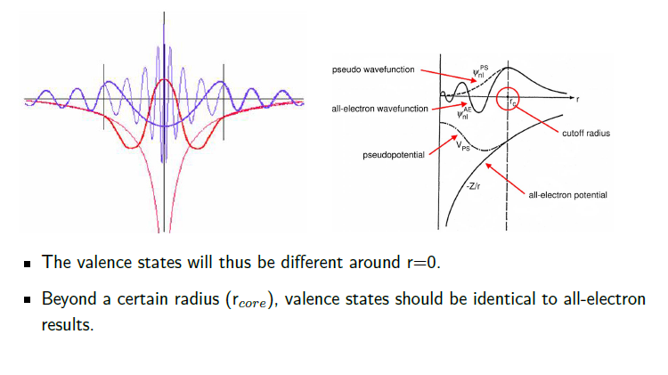
Pseudopotentials

Slide 30
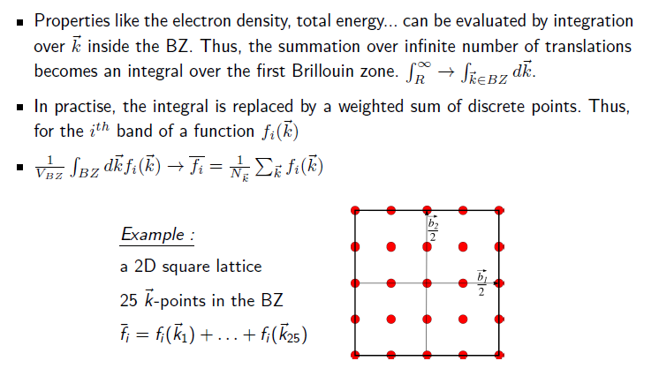
Brillouin zone integration

Slide 31
Brillouin zone integration

Slide 32
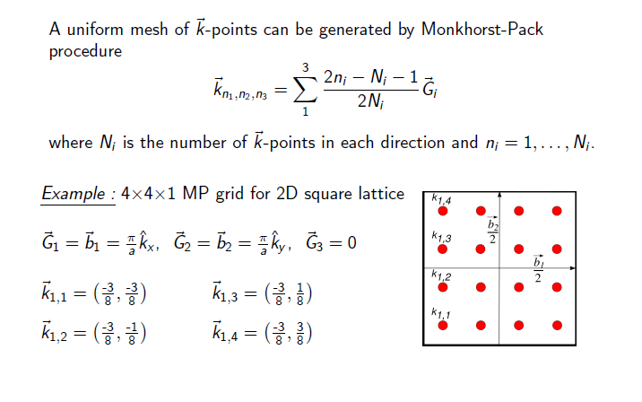
Monkhorst-Pack grid

Slide 33
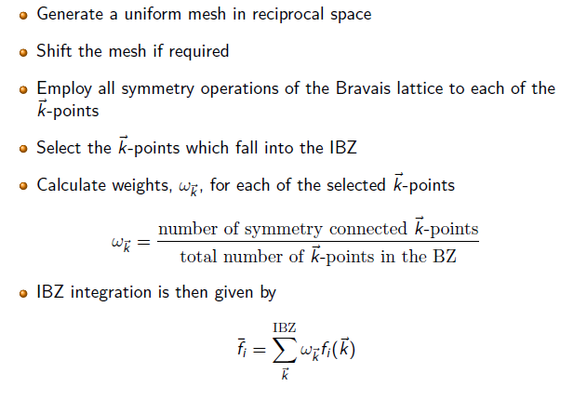
Integrations in the IBZ

Slide 34
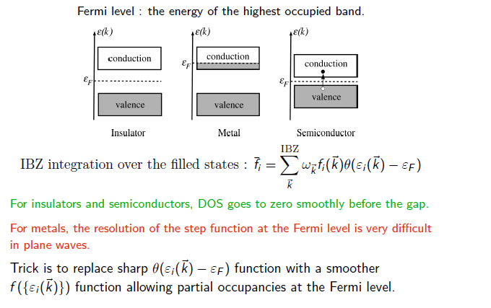
Smearing methods

Slide 35
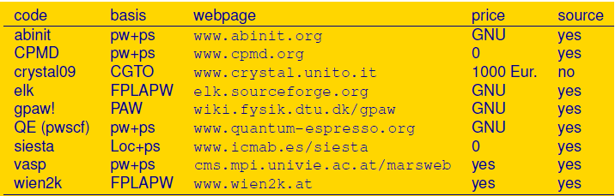
Electronic structure codes

Slide 36
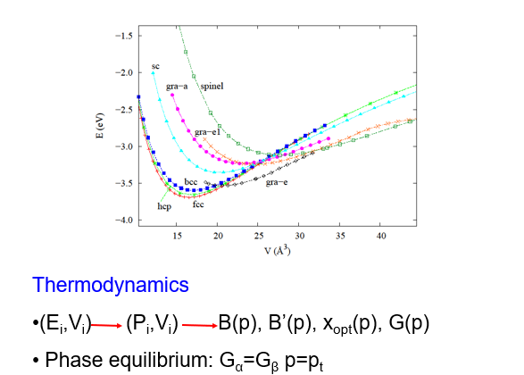
Total energy & derivatives

Slide 37
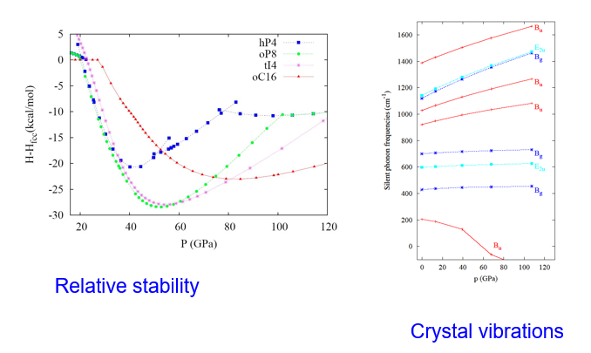
Total energy & derivatives

Slide 38
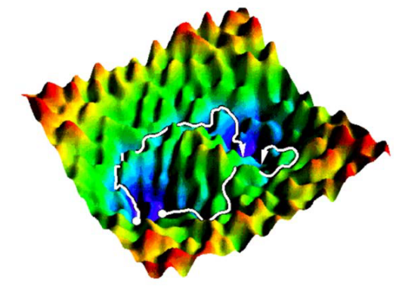
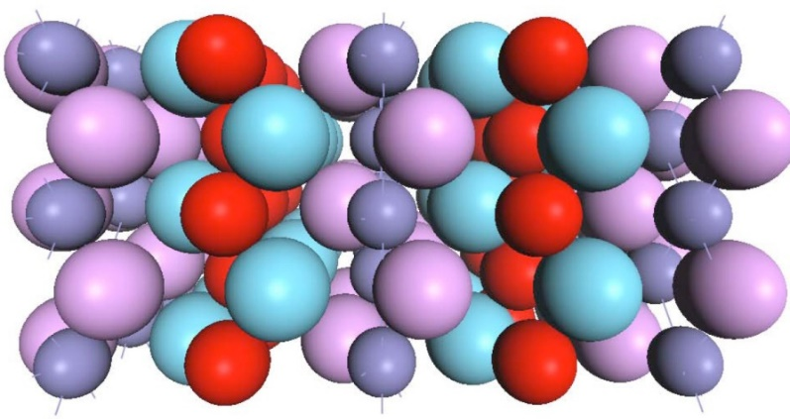
Structure searching
“One of the continuing scandals in the physical sciences is that it remains in general impossible to predict the structure of even the simplest crystalline solids from a knowledge of their chemical composition” (Maddox, Nature 1988)
What structure will a collection of atoms adopt?

Slide 39
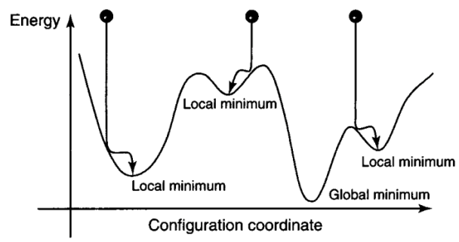
Potential energy surfaces
Crystal structure prediction: minimization of Gibbs free energy
G= U + pV –TS. Normally, H= U +pV is minimized.
d= 3N+3 (N= number of atoms).

Slide 40
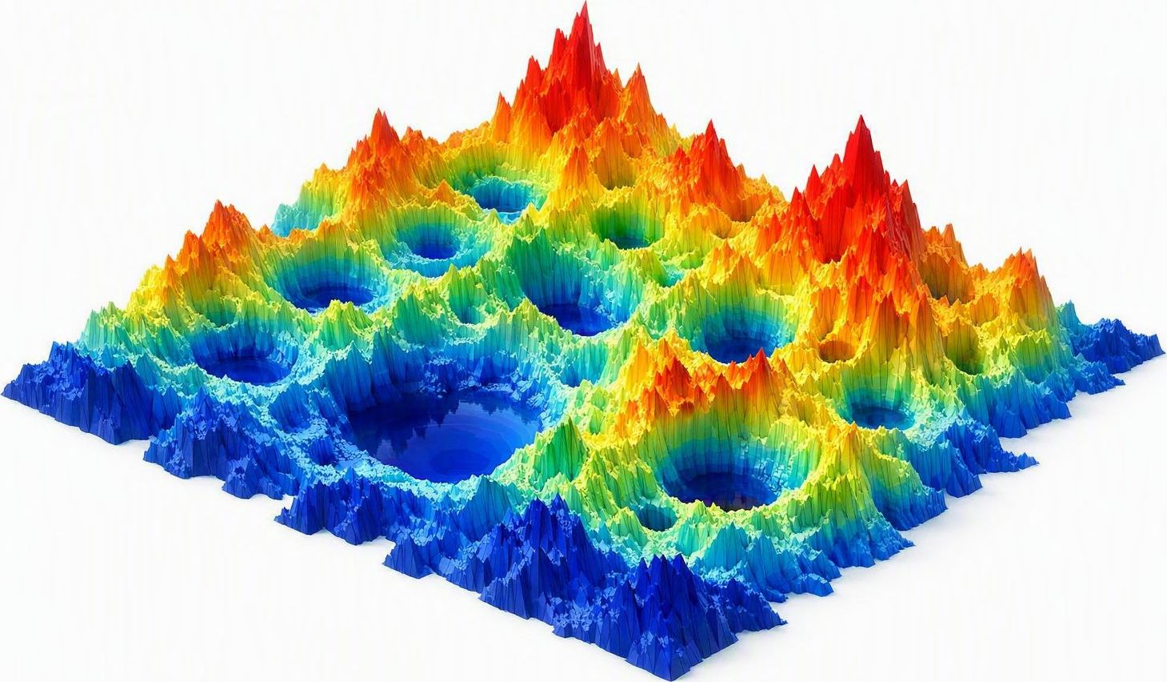
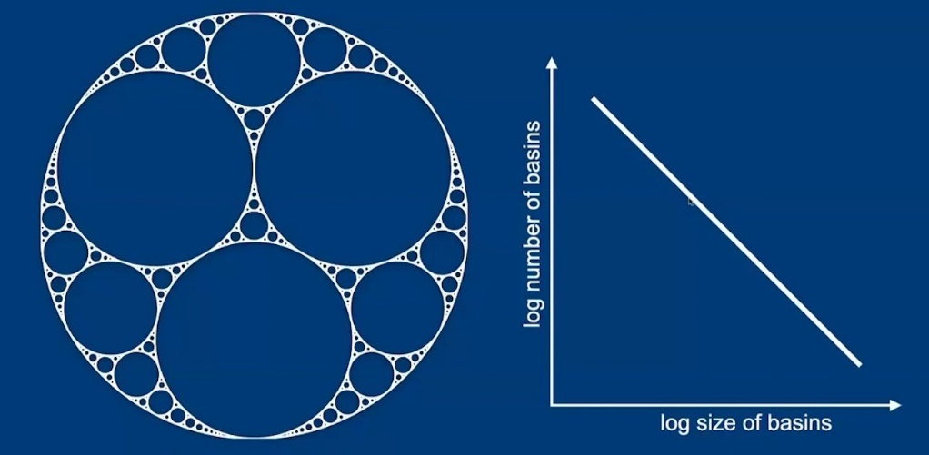
Potential energy surface = a fractal?
A big region of the PES contains almost no minima: it corresponds to very high-energy structures with unphysical short distances and fragmented units.
Going from one minimum to another minimum of lower energy is more likely when the barrier between basins is small.
Basins with lower-energy minima tend to have larger hyper-areas than higher-energy minima.
Very low-energy minima usually correspond to symmetrical structures.

Slide 41
Semilocal methods
They need a good initial starting guess.
Exploration on the neighbourhood of this low-energy
structure and subsequently found structures.
Simulated annealing
Minima hopping
Basin hopping
Metadynamics

Slide 42
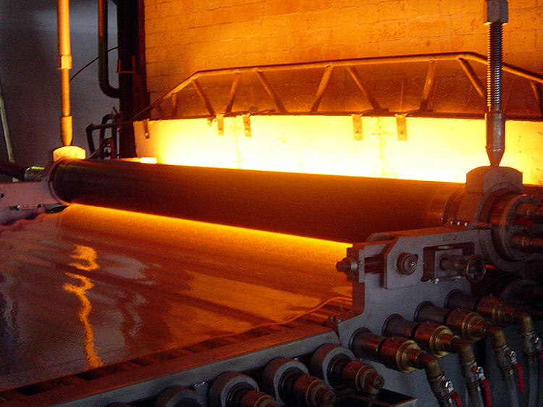
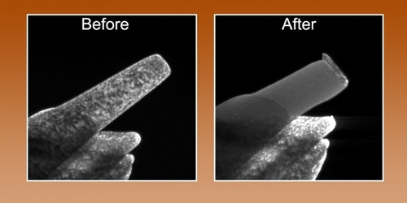
Simulated annealing
Mimics the metallurgy process to reduce defects & obtain large single crystals. Heating & cooling in a controled way.
When a metal melts, atoms in a disorded state in which atomic diffusion and kinetic barriers crossing are allowed.
An abrupt decrease of T leads to crystals with defects.
But ,if cooling is slow, atoms arrange in the global minimum.

Slide 43
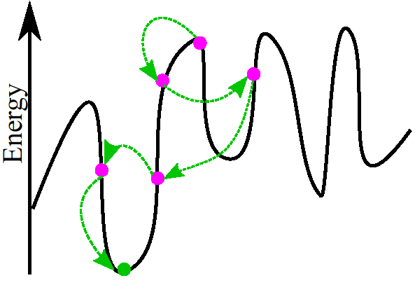
Simulated annealing
A candidate structure is continuosly perturbed through random atomic displacements, atomic mutations, changes of lattice parameters using a Monte Carlo scheme.

Slide 44
Simulated annealing
Move accepted if, E_{f}< E_{i} or ε < P, P=exp(-ΔE/K_{B}T).
Simulation starts at high T (most of new configurations accepted, kinetic barriers overcomed easily).
Then, temperature is reduced, fewer high-energy configurations accepted….an hopefully, the global minimum will be found.
PROBLEMS:
system stuck in a local minimum or the wrong funnel……. especially if there are surrounded by high energy barriers.
EFFICIENCY depends strongly on:
Type & magnitude of moves. Large enough to jump local minima, but small to enable learning.
Temperature annealing process.

Slide 45
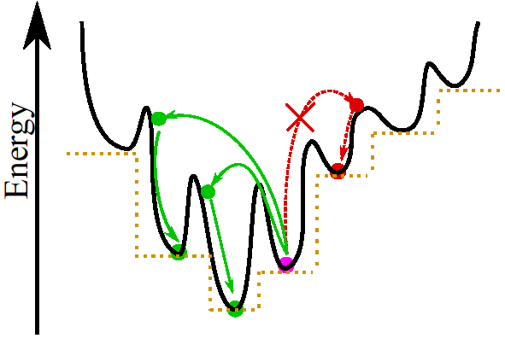
Basin hopping
It starts at a random configuration, relaxed to its local minimum.
After a random move, the new configuration is also relaxed to its local minimum.

Slide 46
Basin hopping
Metropolis criterion, E_{f}< E_{i} or ε < P, P=exp(-ΔE/K_{B}T) on the minimized energies.
Temperature can be maintained or constantly reduced.
Original PES transforms into a staircase function representing the energies of the local minima.
Barriers between local minima are smaller and jumping easier.
EFFICIENCY depends strongly on:
Type & magnitude of moves.
Choice of temperature.

Slide 47
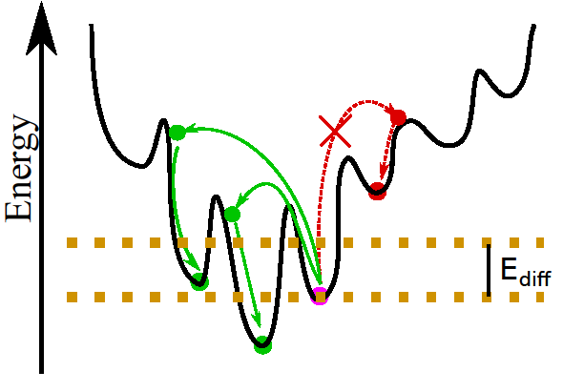
Minima hopping
It uses molecular dynamics to overcome barriers.
It starts at a local minimum. The MD simulation is stopped when U reaches another minimum.

Slide 48
Minima hopping
START from a local minimum “M_{in}”
ESCAPE TRIAL
Molecular dynamics+ Relaxation to “M”
Check if escaped from “M_{in}”
ACCEPT NEW MINIMUM
“M_{in}” = “M”
Ediff=Ediff*α₁
(α₁ <1)
REJECT NEW MINIMUM
Ediff=Ediff*α₂
(α₂ >1)
_{FALSE}
_{TRUE}
If E(“M”)-E(“M_{in}”) < E_{diff}

Slide 49
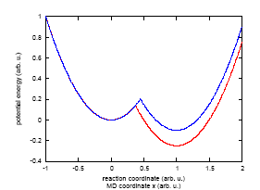
Minima hopping
It exploits the Bell-Evans-Polayani principle, it moves from one minimum to another by crossing low barriers which significantly increases the probability of hopping into a low energy local minimum.
Exothermic reactions have a low activation energy.
Reactant and product are neighboring minima and chemical reactions are transition of barriers connecting them.
Low E_{kin} in MD for hops into low neighboring minima

Slide 50
Minima hopping
Inner Loop
Perform MD escape trials followed by local geometry relaxation.
E_{kin} continuously adjusted.
Outer Loop
Accepting or rejecting. Dynamic Ediff: 50 % accepted
Eventually accept high energy structures.
EFFICIENCY depends on E_{kin.}
Too high visiting lots of undesirable minima
Too low big number of MD simulations to escape the current basin of attraction

Slide 51
Metadynamics
Ideally, standard NPT MD simulations allow to simulate phase transitions (structure prediction & kinetics).
But, they face a time scale problem, only transitions with activation barriers < k_{B}T are observable with reasonable t_{s.}
Solid-solid phase transitions generally first-order high barriers & slow.
Periodic boundary conditions NO heterogenous nucleation; transition proceeds in a collective & concerted way with large barrier.
It can lead to unrealistic kinetics & skipping of phases.

Slide 52
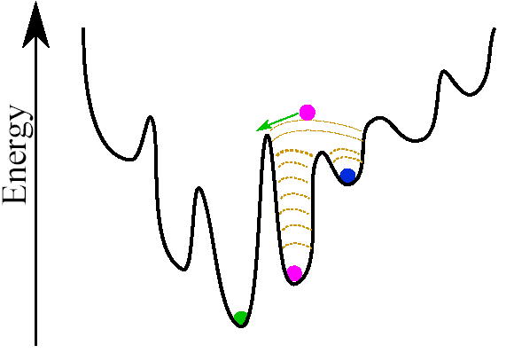
Metadynamics
Solution to decrease barrier: adding a suitable potential to the original Gibbs energy landscape.
Search for the lowest-energy path connecting 2 minima in the space of a suitable order parameter (supercell box m.).

Slide 53
Metadynamics
G modified by a history-dependent term: sum of Gaussians placed at visited points to discourage dynamics from visiting them again.
Basin of atraction filled with Gaussians that increase G. When G becomes high enough to overcome the barrier, the system enters a new basin of atraction of a new structure.
EFFICIENCY depends on:
Width & amplitude of Gaussians.
Too large may lead to wrong phase transitions
But too small, may require too many metadynamics steps.

Slide 54
Global methods
They do not need a good initial starting guess.
Initial randomly generated structures
Random structure searches
Evolutionary algorithms
Particle swarm optimization technique

Slide 55
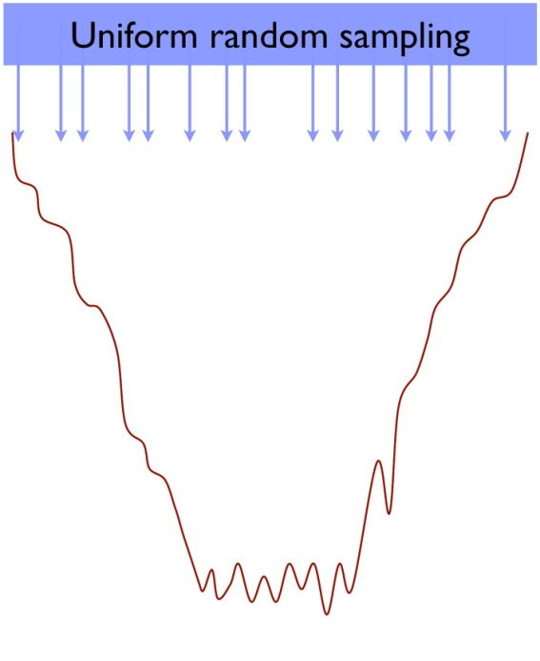
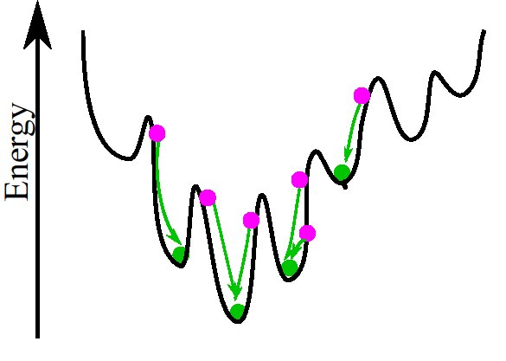
Random searching (AIRSS)
The simplest approach if nothing is known about the system
Exploration of the whole PES by calculating the Gibbs free energy of a set of random structures.

Slide 56
Structure searching (AIRSS)
input: pressure, volume, number of atoms
The recipe
Make a random unit cell
Throw a given number of atoms, of given type into the unit cell
Relax carefully under quantum-mechanical forces and stress
Repeat
Look for the lowest energy or more “interesting” structures

Slide 57
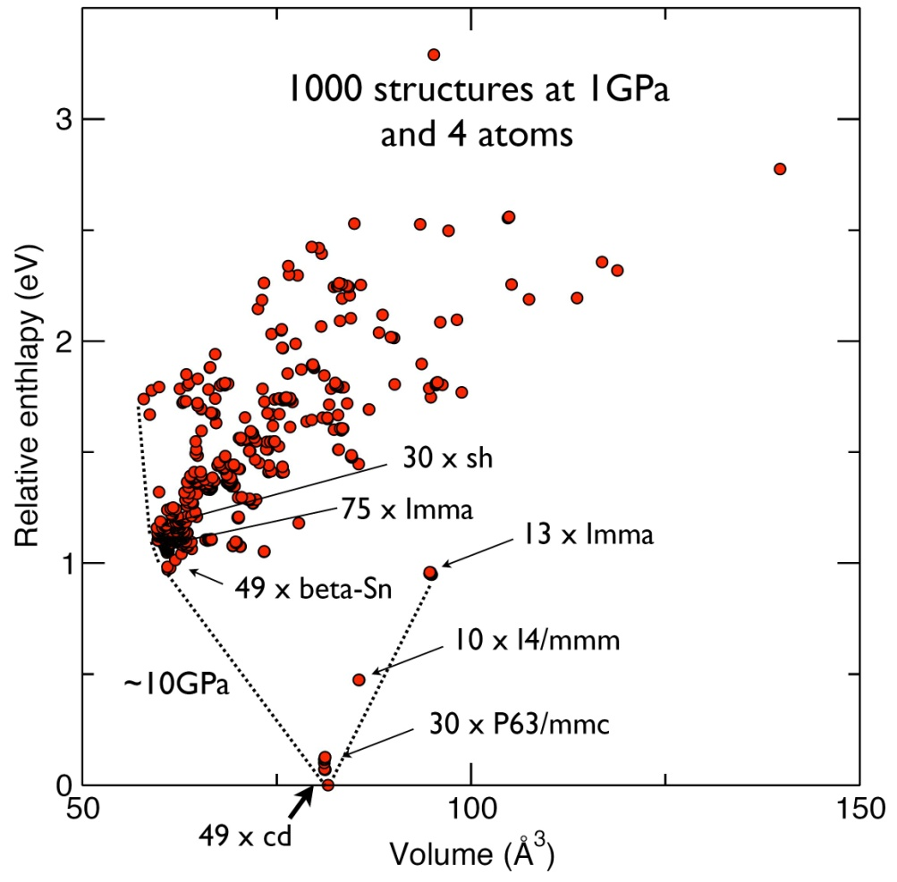
Structure searching (AIRSS)
Example: Silicon

Slide 58
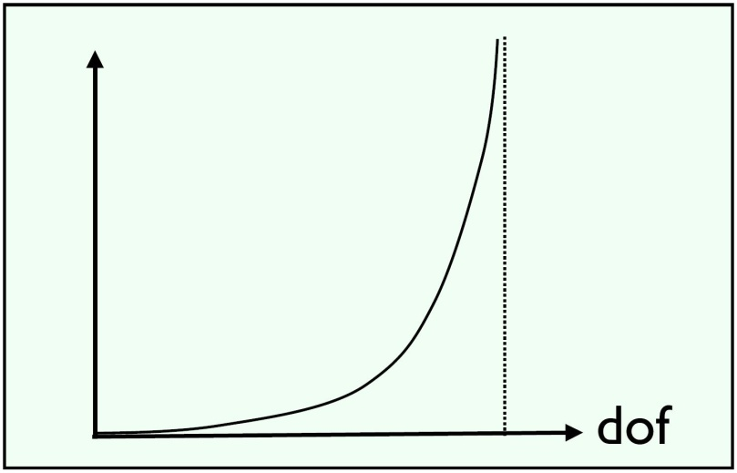
Structure searching (AIRSS)
Problem: Exponential wall
The number of metastable states is expected to increase exponentially with the system size
Solution: Use of constraints
Based on: chemical ideas, symmetry, experimental data.

Slide 59
Evolutionary algorithms
Inspired by natural evolution of a population where offspring resemble parents & procreation is a reward for success.
Different computational codes: XtalOpt, GASP, USPEX….
Initial (random) population of structures. Constraints: estimated volume, minima d_{s}, symmetry, lattice parameters, seeding with plausible structure, using building blocks…..
After relaxing structures, a fingerprint & fitness are assigned to each structure.
Identical structures are eliminated to prevent cancer growth.
Select lowest-energy structures as parents for new generation.
Standard variation operators: heredity, lattice mutation, permutation, atomic mutations.
The best structure survives into the next generation & random structures also added to preserve diversity.

Slide 60
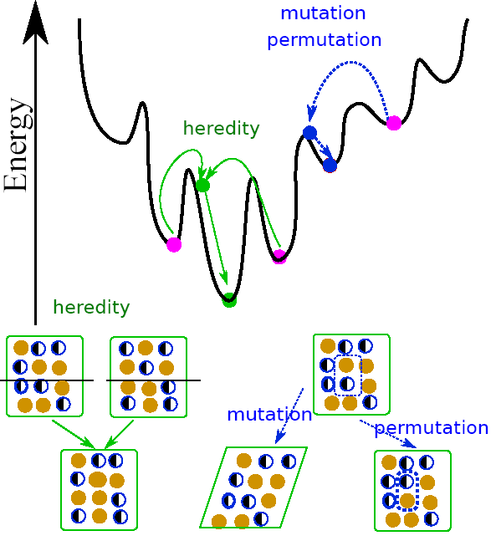
Evolutionary algorithms
Procedure repeated until lowest E structure does not change.

Slide 61



Particle swarm optimization
Swarm intelligence: information exchanges between individual particles, self-improving evolution, evolution guided by optimal particle.

Slide 62
Particle swarm optimization
Similar to evolutionary methods, but no evolution operators such as heredity or mutation.
First population (swarm) randomly generated with constraints.
Local optimization & discarding of identical structures.
A fraction of the lowest E structures used to produce 60% of the structures in the new generation. (40% random).
Movement of the particles influenced by their individual past experience (pbest^{t}, v^{t}) and that of the swarm (gbest^{t}).
As the evolutionary methods, it learns from history and zooms in the most promising region of the configurational space.

Slide 63
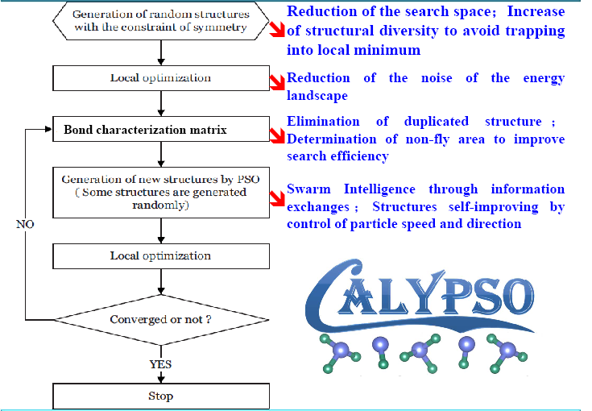
Particle swarm optimization
Algorithm

Slide 64
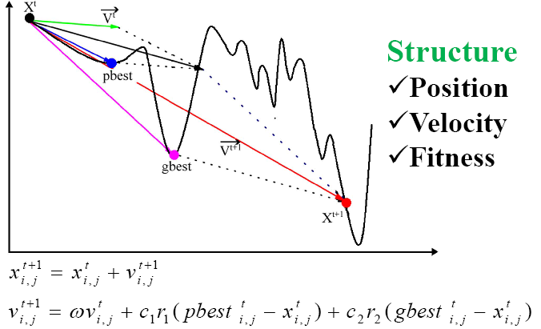
Particle swarm optimization
Algorithm

Slide 65

Convex hull and stability

Slide 66


Convex hull and stability
2D 3D
H2, S, Se, H2S (H:2/3,Se:0, Se:1/3) estables
Phase diagrams in Materials Project, choice of: elements, máximum energy above hull, exchange-correlation…..at 0 GPa

Slide 67

Convex hull and stability
AIAIRSS calculations
100, 300, 700 Ga
400.000 structures
HCNO: stable
regla del octeto
Isoelectrónicos a diamante
Deficientes en hidrógeno
L. J. Conway PNAS 2021

Slide 68
The Electron Localization Function
Reconciliation of chemistry and quantum chemistry
Quantum Chem.
System:Global
Concepts: rigorous,
quantitative
Classical Chem.
System:Atoms, Bonds
Concepts: empirical,
qualitative
ELF
Mathematical definition of bond
Quantitative bond properties (q,v)

Slide 69
The Electron Localization Function
In an attempt to better understand electron localization from a theoretical standpoint, Becke and Edgecombe developed in 1990 the electron localization function (ELF).
It can be interpreted in terms of an excess of local kinetic energy due to the Pauli repulsion.
Pauli
repulsion
Notes:
69
69

Slide 70


The Electron Localization Function
What does it look like?
  ELF is maximal in Lewis entities
  Bonds
  Lone pairs
  Shells
K(Cl)
L(Cl)
M(Cl)
LiCl
Notes:
70
70

Slide 71

The Electron Localization Function
Each bond, lone pair=maximum of ELF
Each maximum has an associated region of space (basin)
  Non overlapping
  They fill up the volume
Each region has its own properties, which
  are additive
  recover the crystal value
  E.g. volume, charge associated to a bond.
Number, position and type of critical points (maxima, minima,etc) determine the topological features.
The saddle point that connects two basins is called the Bond Interaction Point (bip).
Notes:
71
71

Slide 72
Alkali metals at HP
It is becoming strikingly clear that the free-electron model of simple metals is not applicable when metals are compressed at intermediate pressures.
New structures appear: open, incommensurate structures
Unusual properties: decreased conductivity and melting points, superconductivity
This challenging state of matter has been explained in terms of FSBZ interactions, s→p or s→d electronic transitions, and more recently related to an increase of valence electron density in interstitial regions.
Notes:
72
72

Slide 73

Alkali metals: structural transformations under pressure
Notes:
73
73

Slide 74


K: hP4 phase
c/a=3.266
c/a=1.36
Crystal structure: hexagonal, SG P6₃/mmc, two different sites (Wyckoff 2a (0,0,0) and 2c (1/3,2/3,1/4))

Slide 75


K: hP4 phase
Localization regions in interstitial voids
Core-like topology
Same structure as A₂X compounds!
Electrons in same position as anions!
Close packing preserved if are considered!
COMPOUND→IONIC-LIKE
ELECTRONS→PSEUDOANIONS
ELF=0.3
ELF=0.9
Experimental potassium at P=27 GPa

Slide 76

K at 58 GPa?
tI4 structure predicted by variable-cell simulations
behaviour of alkali-metal chalcogenides?
cation sublattice of anticotunnite structure:
SG: Pnma, Pearson oP8, K1 and K2 atoms locate on 4c sites .
subgroup of the Ni2In-type structure

Slide 77



K: oP8 phase
Similar calculated oP8 and experimental diffraction pattern. Excellent Rietveld refinement.

Slide 78


K: electride phases
K→Alkali chalcogenide
Same structure as A₂X (anticotunnite)
Same structure as A₂X (Ni₂In)
25 GPa
(ELF ≈ 0.95)
Chalcogenide
position
57 GPa
(ELF ≈ 0.95)
Chalcogenide
position
hP4 phase of K.
oP8 phase of K.

Slide 79


K: origin of phase transitions
DRIVING FORCE OF DISTORTIONS AT INTERMEDIATE PRESSURES? GREATER LOCALIZATION
c/a collapse
3.2→1.35
10 GPa: Normal metal.
25 GPa: phase transition towards strong interstitial localization (ELF=0.95)
25 GPa. If no transition took place, localization would be a lot weaker

Slide 80

K: origin of phase transitions
57 GPa: Elongated basins appear showing a flow of electronic localization towards other sites and instability of the phase vs distortion
57 GPa with oP8 distortion. Distorted phase favors strong localization (ELF value close to 0.95)
oP8 distortion

Slide 81


K at higher pressures?
Above 85 GPa, the electronic flow completes, metallic ELF maxima.
Predicted transitions to tI4 and oC16 structures.
Recovery of the dhcp arrangement above 250 GPa.

Slide 82
Li at high pressures
Our experiments:
x-ray diffraction studies (P= 5-130 GPa, T=77-300K)
  Extremely difficult: chemical reaction/Li penetration into diamonds
cI16 ^{60 GPa} Li-VI ^{65 GPa} Li-VII ^{95 GPa} Li-VIII
Structures of Li-VI, Li-VII and Li-VIII (first time observed)?
  Proposed as oC88, oC40 and oC24.
After refinement:
oC24 has the Cmca-24 structure proposed previously.
oC40: cell parameters and Cmca space group
oC88: cell parameters and Cmma space group. oC92?

Slide 83
oC40 Li
Our calculations:
AIRSS approach (random structure searching + DFT calculations)
CASTEP code, PBE PP, cutoff energy: 350 eV……..
Stringent reoptimization of the lowest-enthalpy structures
oC40 structure:
20-atom primitive cells, initial expt. lattice parameters
Using the experimental symmetry as a constraint
Searches within P21/c (subgroup of Cmca), Pc, randomly-selected space groups with 4 and 2 symmetry operations and no symmetry (P1).

Slide 84
oC40 Li
Initial structures
Lowest enthalpy structure
P21/c
Cmca-40
Pc
4 symm. ops.
C2cb-40
2 symm. ops.
P1
C2cb-40 struct. is a subgroup of Cmca-40 struct.

Slide 85

oC40 Li
From H-P curves:
C2cb-40 is the most stable phase between 67-90.5 GPa.
Hypothetically:
C2cb-40^{91GPa} Cmca-24
C2cb-40 ^{90.5 GPa} Pbca-24 ^{94 GPa} C2cb-24 ^{110GPa} Cmca-24

Slide 86

oC40 Li
Dynamical stability?
Phonon calculations with the Quantum-ESPRESSO code.
Imaginary frequency for a B_{3u} mode of the Cmca-40 struct.
Phonon dispersion curves of the C2cb-40 structure: dynamically stable

Slide 87


oC40 Li
Semiconductor?
Indirect band gap along ΓZ similar to the Γ-direct band gap
Gap increases with pressure, 1.15 eV at 95 GPa
Larger gap than the other structures (0.276 eV for the C2-24)

Slide 88


oC40 Li
Modulated layers. 5 neq. Li atoms, 3 ELF attractors.
M1: 2 e⁻_{s}, M2: 2 e⁻_{s}, M3: 1e⁻ Li₅ABC.
New elemental structure, not found previously.

Slide 89
oC88 Li
oC88 structure
44-atom primitive cells, initial expt. lattice parameters.
Searches within the P2/c, Pc, C2 space groups and randomly selected space groups with 2 symmetry ops.
Additional searches in oC92 and oC84 structures
Lowest enthalpy structure: C2mb space group.
More stable than the rest of the phases (except cI16) in its experimental range of existence
Stabilized by dynamical effects? Metastable?
Reasonable agreement with diffraction data

Slide 90

oC88 Li
Complicated structure.
low DOS at E_{FERMI}, but no band gap.

Slide 91

Vibrational effects on Li
Raman
Very low frequency modes in oC88.
Intense and rich spectrum in oC40 and intense mode in oC24.

Slide 92



Vibrational effects on Li
Gibbs free energies calculated using QHA approx.
G= U + PV + k_{B}T∫g(ω)ln[2sinh(ħω/2k_{B}T)]dω.

Slide 93

Vibrational effects on Li
Neglecting ZPE at OK

Slide 94

Vibrational effects on Li
With ZPE at OK

Slide 95

Vibrational effects on Li
oC88 becomes stable at finite T

Slide 96
Incommensurate structures
Common host structure
I
Tetragonal I4/mcm
16 atoms
Notes:
96
96

Slide 97


Incommensurate structures
Different guest structures
I
Notes:
97
97

Slide 98


Incommensurate structures
Different guest structures
I
Notes:
98
98

Slide 99


Incommensurate structures
Different guest structures
I
Notes:
99
99

Slide 100

Incommensurate structures
Different guest structures
I
Rb-IV: I4/mmm, 2a (0,0,0)
a_{guest} = a_{host}
c_{host}/_{guest}= 1.631
Notes:
100
100

Slide 101




Computational approach
I
Empty tI19 host lattice
3g/2h approx.
7g/4h approx ($\sqrt{2}\sqrt{2}$ )
c_{H}/c_{G} chosen to cover the respective experimental range
4g/3h (56 atoms), 3g/2h (38 atoms), 8g/5h (96 atoms), 5g/3h (58 atoms), 7g/4h (78 atoms), 9g/5h (98 atoms), 2g/1h (20 atoms)
Unit cells for K-IIIb are twice as large
c_{H}/c_{G}: 1.3333, 1.5, 1.6, 1.6666, 1.75, 1.8, 2
Na-V approximants with tetragonal guest lattices
Notes:
101
101

Slide 102

Potassium
bcc fcc at 11 GPa
17.5 GPa < tI19 < 39 GPa
oP8 tI4 at 51 GPa
tI4 oC16 at 96 GPa
9
I
K-IIIa < 23 GPa
23 GPa < Rb-IV > 38 GPa
K-IIIa > 38 GPa
Notes:
102
102

Slide 103

Potassium
Approximants with c_{H/}c_{G} from 1.5 (3g/2h structure) to 1.8 (9g/5h structure)
9
I
Optimal c_{H}/c_{G} at each P
Parabollic fits H--c_{H}/c_{G}
Minimum c_{H}/c_{G} (24 GPa)
c_{H}/c_{G} = 1.5---1.66
6-8 GPa offset calculated vs measured c_{H}/c_{G} curves
Notes:
103
103

Slide 104


Na-V structure (ELF)
Guest ELF maxima
ELF(bip)=0.85
1.058 e⁻/max
0.02961 e⁻/bohr³
Host ELF maxima
ELF(bip)=0.35
1.695 e⁻/max
0.02994 e⁻/bohr³
I
Guest ELF maxima
ELF_{av}=0.94
HHost ELF maxima
ELF_{av}=0.965
At 160 GPa
Notes:
104
104

Slide 105


K-IIIa (ELF)
Guest ELF maxima
ELF(bip)=0.49
0.721 e⁻/max
0.01826 e/bohr³
Host ELF maxima
ELF(bip)=0.15
1.165 e⁻/max
0.01680 e/bohr³
I
Guest ELF maxima
ELF_{av}=0.89
HHost ELF maxima
ELF_{av}=0.95
Notes:
105
105

Slide 106





xSiO₂ + yCO₂ -> Si_{x}C_{y}O_{2x+2y}
18-26 GPa & 296-980 K

Slide 107


Is there any SiCO compound?
From database analysis
Candidate structure UB₂O₆ & (C2/c, Z=4)
Correct Si_{1-x}C_{x}O₂ stoichiometry & BO₃ units
After optimization…
Distorted CO₄ + SiO₆ units
unstable vs decomposition into CO₂-III and SiO₂-stishovite

Slide 108
Global Si_{x}C_{y}O_{2(x+y)} searches
Our calculations:
Searches with the USPEX code + DFT calculation
VASP code, PBE PP, cutoff energy: 600 eV...
Stringent reoptimization of the lowest-enthalpy structures
x,y =1-3; Z = 1-4. Selected pressures from 0 to 100 GPa
Initial population:
random + C(Si)O₂-derived + CO₄, SiO₄, CO₃, SiO₆ units
Generations with 40Z structures (heredity & random)
Convergence reached on 30-60 generations.

Slide 109
Global Si_{x}C_{y}O_{2(x+y)} searches
ΔH < 0
Stable Si_{x}C_{y}O_{2(x+y)}
ΔH = H(Si_{x}C_{y}O_{2(x+y})-xH(SiO₂)-yH(CO₂)
α-quartz coesite stishovite CaCl₂-type α-PbO₂-type
SiO₂
0 4.8 8.5 55 85 100
Pa-3 P4₂/mnm β-cristobalite
CO₂
0 13 18.2 100
GPa

Slide 110
Global Si_{x}C_{y}O_{2(x+y)} searches
SiC₂O₆,
Thermodynamically stable
P2₁/c structure, Z=2
On pressure increase,
Minima ΔH region in the experimental range of stability.
Lowest H structures consisting of SiO₆ and CO₃ units.

Slide 111






1935
1968
…
R. Howie et al. 2020
Metallic hydrogen
Superconducting hydrogen
Low pressure
High pressure
H-H
rH−H​(H₂​)≈0.74 Å
rH−H​ ≈0.9 -1-1.2 Å
MolecularMol Insulating
Metallic
High temperature superconductor
High temperature Superconductor
ICMCS Seminar

Slide 112


1935
1968
2004
2015
2026
…
…
R. Howie et al. 2020
Metallic Hydrogen
Superconducting
Hydrogen
Superconducting
Hydrides
Start of
“Hydride Era”
The Field
Today
All hydrides still require pressures 80-200 GPa for high Tc
Understand how Tc can be promoted whilst required pressure is decreased
Notes:
However, this is where hydrides come in
Almost 40 years later, the same neil Ashcroft proposed the idea of chemical precompression in hydrides
That is, that doping the hydrogen with a well selected element would exert chemical pressure on the hydrogen, reducing H-H distances, meaning the metallisation would be lowered AND the physical properties of metallic hydrogen would be preserved and able to be accessed in the lab!
And this really did open up the possibility of studying hydrogen-based superconductivity for researcvhers

Slide 113

CChemical pre-compression: Group 2 tetrahydrides
DFT predicted structures
Fm-3m in theory symmetry breaks to R-3m
Quasi-molecular hydrogen units within octahedral interstices
H- in tetrahedra interstices

Slide 114
La IA revoluciona la búsqueda de estructuras cristalinas
Nature (2023) · Google DeepMind – GNoME
“Scaling deep learning for materials discovery”
2,2 millones de nuevos compuestos predichos; 380.000 estables (~10× lo conocido).
Estructuras cristalinas descubiertas (acumulado)
Eje Y: nº de estructuras · Eje X: periodo (cifras aproximadas)
2,2 millones
Nature (2025) · Microsoft Research – MatterGen
“A generative model for inorganic materials design”
IA generativa que diseña estructuras con propiedades a medida.
≈1 millón
Nature (2023) · A-Lab, Berkeley – Síntesis autónoma
“An autonomous laboratory for the accelerated synthesis of novel materials”
41 de 58 compuestos nuevos sintetizados en 17 días.
Más de 700 materiales de GNoME ya validados experimentalmente.
≈300 mil
≈48 mil
≈80 mil
Pre-2010
ICSD exp.
2011–15
Materials Project
2016–20
OQMD / DFT
2021–22
OQMD 1M+
2023
GNoME
Fuentes: Merchant et al., Nature (2023) – GNoME; Szymanski et al., Nature (2023) – A-Lab; Zeni et al., Nature (2025) – MatterGen. Cifras del histograma aproximadas/acumuladas.

Slide 115
¿Cómo funciona GNoME?
1. Generar candidatos
Sustituir en estructuras conocidas + composiciones nuevas
2. Red neuronal de grafos
Predice energía y estabilidad de cada candidato
3. Filtrar por estabilidad
Se conservan los cercanos a la convex hull
4. Verificar con DFT
Cálculo cuántico confirma los más prometedores
5. Resultado
2,2 M predichas · 380 k estables
Aprendizaje activo: los resultados de DFT reentrenan la red en cada ronda → eficiencia ~10×
¿Qué es una red neuronal de grafos (GNN)?
Cada cristal se representa como un grafo: los átomos son nodos y los enlaces, aristas.
Por “paso de mensajes” cada átomo aprende de su entorno y la red capta la geometría 3D.
Así predice la energía de formación en milisegundos, sin resolver la mecánica cuántica (DFT) en cada caso.
NaCl: grafo real (coordinación 6)
Cl
Cl
Cl
Na
Cl
Cl
Cl
cada Na ↔ 6 Cl (octaédrica)
Claves del método
Solo los candidatos prometedores pasan a la costosa verificación con DFT.
Hallazgos: ~528 posibles conductores de litio y ~52.000 materiales en capas.
Red neuronal asociada
E
entrada
capas ocultas
energía form.
NaCl (tipo sal de roca): cada Na⁺ se rodea de 6 Cl⁻. La GNN procesa el grafo y predice la energía de formación.
Fuente: Merchant et al., “Scaling deep learning for materials discovery”, Nature (2023). Esquema simplificado.

Slide 116
¿Cómo funciona MatterGen?
1. Ruido inicial
Átomos, posiciones y celda generados al azar
2. Difusión inversa
Una red elimina el ruido paso a paso (denoising)
3. Generar cristal
Aparece una estructura nueva y ordenada
4. Guiar por propiedades
Ajuste fino: banda, módulo, magnetismo
5. Resultado
Material nuevo, estable y sintetizable
Generación condicional: en vez de cribar millones de candidatos, MatterGen diseña directamente materiales con las propiedades deseadas.
¿Qué es un modelo de difusión?
Parte de ruido aleatorio y aprende a revertirlo hasta formar un cristal coherente.
Genera a la vez los tipos de átomo, sus posiciones y los parámetros de red.
Con ajuste fino orienta la generación hacia una propiedad objetivo.
Difusión: de ruido a cristal
ruido
intermedio
cristal
Claves del método
Generativo, no solo de cribado: crea estructuras desde cero.
Hallazgos: ~2× más probables de ser nuevas y estables y ~15× más cerca del mínimo de energía (DFT) que modelos previos.
Red de difusión (denoiser)
x₀
entrada
capas ocultas
cristal limpio
La red de difusión revierte el ruido paso a paso hasta obtener un cristal ordenado (esquema simplificado).
Fuente: Zeni et al., “A generative model for inorganic materials design”, Nature (2025), Microsoft Research. Esquema simplificado.

Slide 117
¿Cómo funcionan los potenciales efímeros (EDDP)?
1. Estructuras al azar
Se generan al azar muchas estructuras: átomos, posiciones y celda
2. DFT en una muestra
Calculamos con DFT la energía de unas pocas de ellas
3. Potencial efímero
Con esos datos entrenamos un potencial rápido, a medida del sistema
4. Relajar
Ese potencial relaja y descarta miles de estructuras a bajo coste
5. Validar e iterar
Confirmamos las mejores con DFT y reentrenamos el potencial
La idea clave: el potencial se entrena para una búsqueda concreta y luego se descarta, así se acelera la búsqueda aleatoria sin perder la fiabilidad del DFT.
¿Qué es un potencial efímero?
Es un potencial interatómico aprendido: estima la energía de una estructura mucho más rápido que el DFT.
Se entrena a medida para el sistema que estudias; no sirve como modelo general.
Como es tan barato de entrenar y usar, se crea para la búsqueda y luego se descarta (de ahí, “efímero”).
Ciclo de búsqueda acelerada
Aleatorias
(AIRSS)
DFT
(muestra)
Potencial
efímero
Relajar
Aprendizaje activo: DFT ↔ potencial, se reentrena cada ciclo
Potencial efímero: ensemble de redes pequeñas
Claves del método
Combina dos ideas: la exploración al azar de AIRSS y la rapidez de un potencial aprendido, y así llega a sistemas más grandes.
Aprendizaje activo: se van alternando DFT y potencial, que mejora en cada vuelta.
promedio
E
descriptores
3 redes pequeñas (ensemble)
energía
El potencial solo aprende energías; las fuerzas para relajar salen de derivarlo (esquema simplificado).
Fuente: C. J. Pickard, “Ephemeral data derived potentials for random structure search”, Phys. Rev. B 106, 014102 (2022). Esquema simplificado.

Slide 118
Conclusiones
DFT calculations provide an accurate description of the structural and energetic properties of materials, serving as a reliable framework for assessing the stability of the predicted crystal phases.
Crystal structure prediction methods are effective tools for exploring the configurational space and identifying stable or metastable structures.
The combination of global structure search algorithms with DFT calculations is a powerful approach for materials Discovery.
Experimental-theoretical collaboration to interpret results, understand involved mechanism…..
Artificial intelligence is revolutionizing crystal structure prediction by accelerating the exploration of the configurational space, reducing computational costs.

