Slide 1
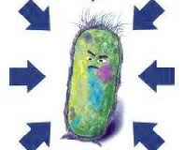

UPDATED 2026
Microbiology
under Pressure
Soft-matter mechanisms, experimental strategy and high-pressure processing applications
Jordi Saldo Periago
Universitat Autònoma de Barcelona
01
Notes:
1,0 min. Abrir la charla explicando que la presentación conserva el hilo de microbiología bajo presión, pero actualiza el foco hacia mecanismos, materia blanda, métodos y aplicaciones. Recordar que las diapositivas están en inglés para facilitar circulación internacional, mientras que la explicación oral será en castellano.

Slide 2
CONTEXT
Why pressure microbiology matters now
“
Pressure is a physical variable that reorganizes hydration, packing and weak interactions before it becomes a microbiological phenotype
Deep biosphere
High-pressure processing
Soft-matter bridge
Most ocean volume is cold, dark and pressurized; pressure-adapted microbes are not rare exceptions
HPP links pressure microbiology with food safety, shelf-life extension and process validation
Cells are hydrated, crowded, deformable systems; pressure exposes this physics clearly
Take-home framing: pressure is not simply “cold heat”; it is a distinct way to perturb biological matter
02
Notes:
1,5 min. Presentar tres motivos: la biosfera profunda ha pasado de curiosidad extrema a sistema relevante; HPP es una tecnología madura pero con preguntas microbiológicas abiertas; y los investigadores jóvenes necesitan un puente claro entre presión, materia blanda y fenotipo microbiano.

Slide 3
CONTEXT
Learning goals and roadmap
Read pressure scales without over-extrapolating between ecology and processing.
Explain why membranes, proteins, hydration and crowding are pressure-sensitive.
Choose experimental platforms while controlling decompression artefacts.
Interpret HPP survival curves and limits in a mechanistic way.
Scales
Soft matter
Cells
Methods
Applications
Open questions
For early-stage researchers: the goal is a reusable mental model, not a catalogue.
03
Notes:
1,0 min. Dar al público el mapa de la clase. Enfatizar que el objetivo no es memorizar especies ni tecnologías, sino aprender a interpretar cualquier experimento de presión con una lógica común.

Slide 4
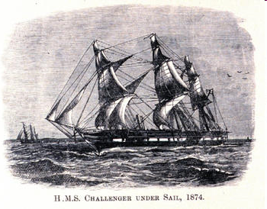
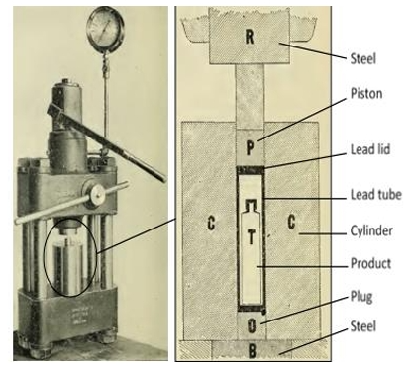
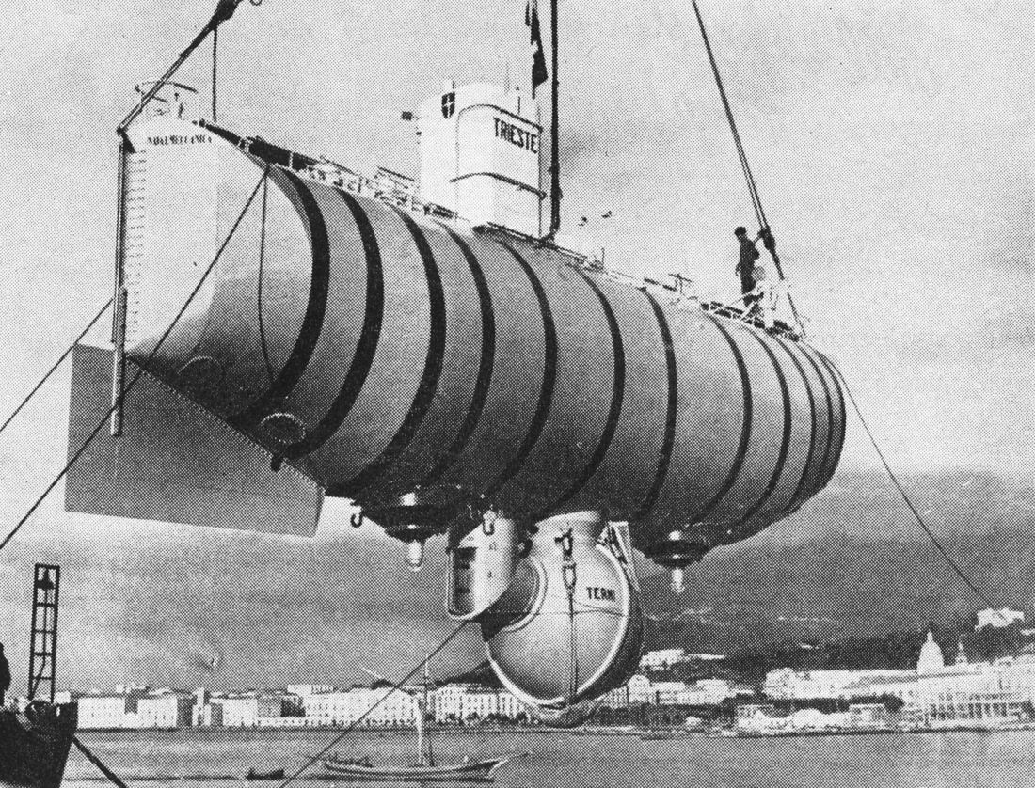
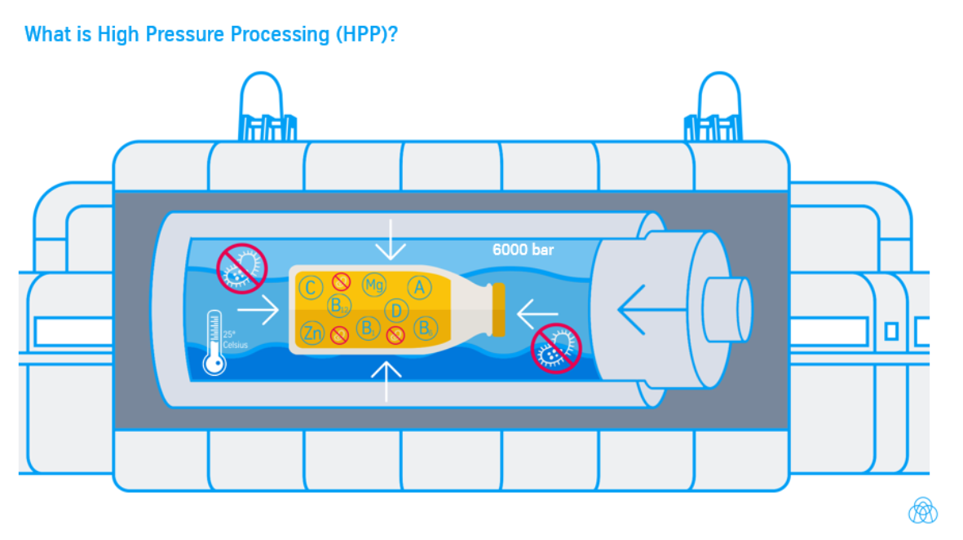
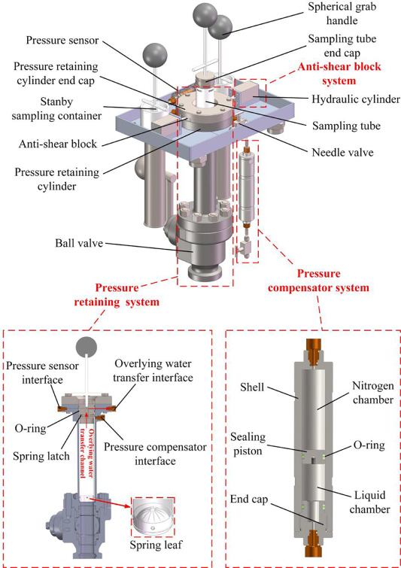
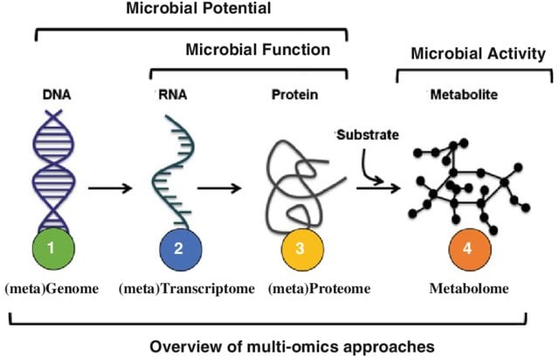
CONTEXT
A short timeline of high-pressure microbiology
1870s
1899
1960
1980s–90s
2000s
2020s
Challenger expedition challenges the azoic view
Hite demonstrates pressure preservation of milk
Trieste reaches Challenger Deep
Commercial HPP and deep-sea microbiology expand
Pressure-retaining tools and high-pressure microscopy
Lipidomics, systems biology and refined validation
What changed?
What should remain?
The field moved from “can anything live there?” and “can pressure preserve food?” to mechanism-rich questions about interfaces, assemblies and pressure histories.
Historical anchors are useful, but the updated lecture should prioritize mechanisms and experimental reasoning for new researchers.
04
Notes:
1,5 min. Recorrer la cronología sin detenerse demasiado. La historia sirve para mostrar que el campo empezó como pregunta de conservación, se consolidó con ecología profunda y hoy se apoya en técnicas in situ y ómicas.

Slide 5
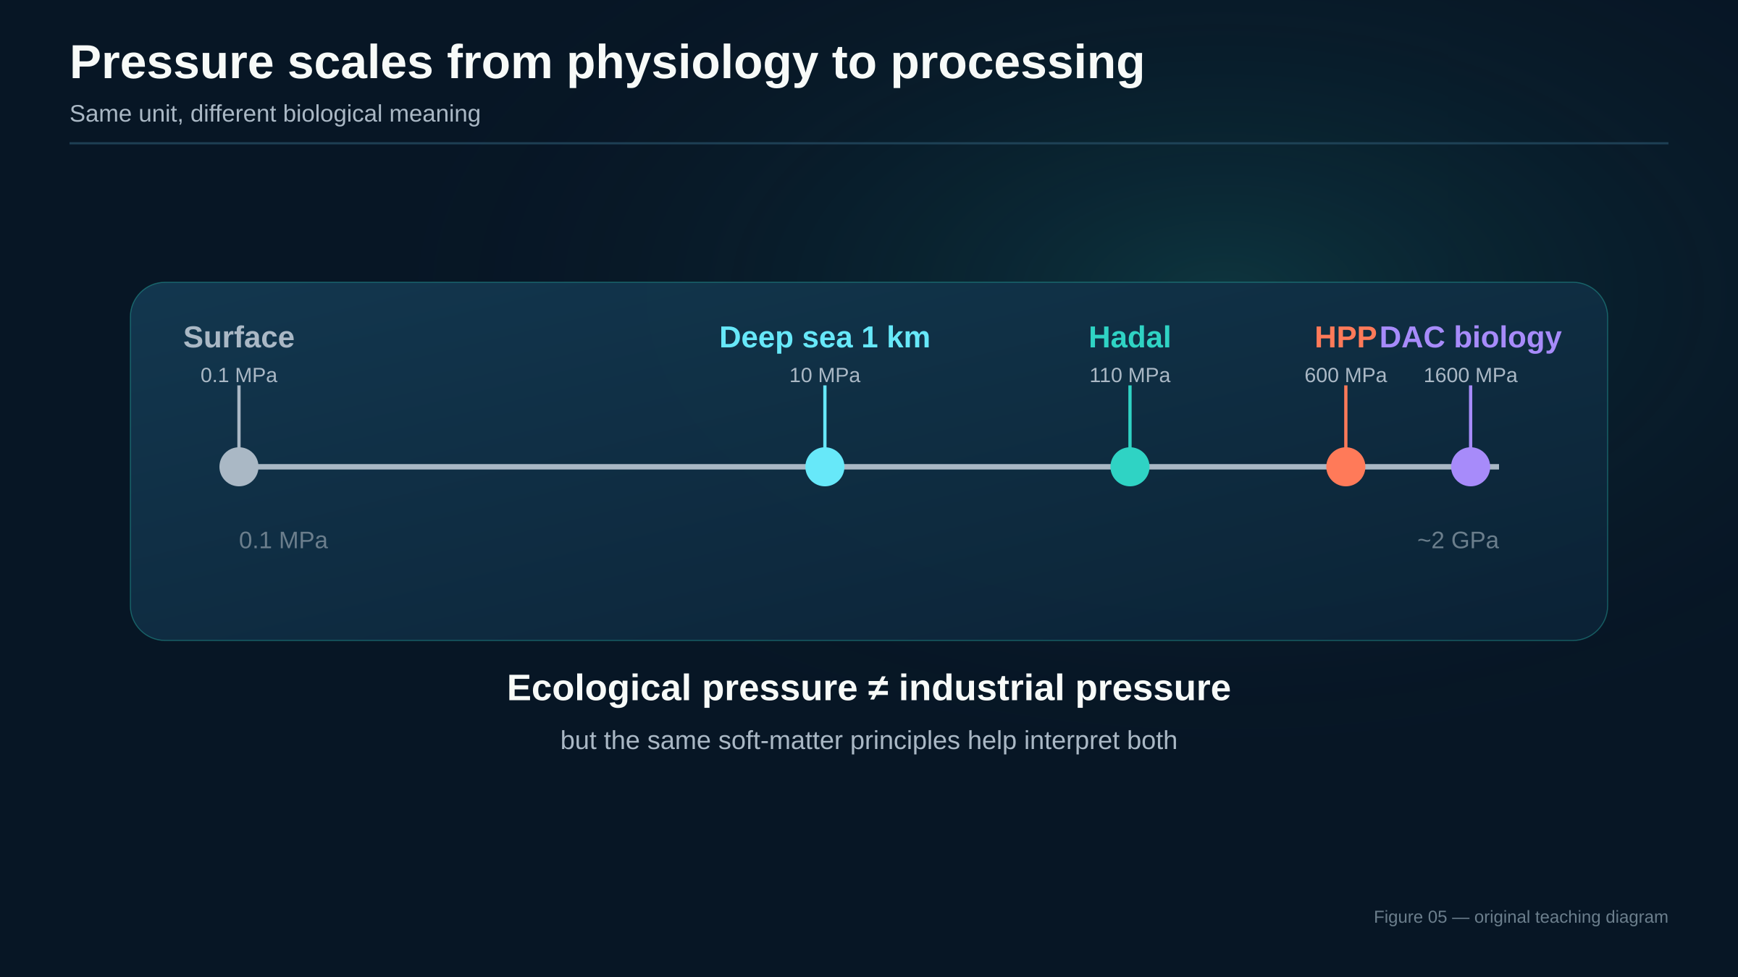
CONTEXT
Pressure scales from cell physiology to industrial processing
Same unit, different biological meaning
Ecological pressure ≠ industrial pressure
but the same soft-matter principles help to interpret both
05
Notes:
1,5 min. Utilizar la escala para evitar una extrapolación ingenua. La zona hadal y el HPP comparten principios de materia blanda, pero los rangos de presión y las preguntas son diferentes.

Slide 6
PRIMER
01
Soft-matter
primer
The minimum physics needed to understand microbial pressure response.
06
Notes:
0,5 min. Transición. Explicar que no se va a dar una clase formal de materia blanda, sino un vocabulario operativo para interpretar células, membranas y ensamblajes.

Slide 7
PRIMER
pressure selects volume-sensitive states
Thermodynamic intuition for non-specialists
Constant temperature
Do not teach it as “temperature backwards”
Pressure shifts equilibria toward states with lower partial molar volume
Temperature changes kinetic energy and heat flow
Pressure changes volume, packing, hydration and equilibria
dG = VdP − SdT
P–T combinations can be synergistic or antagonistic
Simplified lesson: ask where volume, cavities, hydration and interfaces change
Pressure-sensitive systems are often those with voids, interfaces or weak assemblies.
Balny et al. 2002; Oger & Jebbar 2010
07
Notes:
1,5 min. Presentar una intuición termodinámica mínima: a temperatura constante, la presión favorece estados con menor volumen parcial. Aclarar que esto no predice todo, porque hidratación y ensamblajes pueden dominar la respuesta.

Slide 8
PRIMER
what matters biologically
Soft-matter essentials relevant to microbial cells
Interfaces
Hydration
Crowding
Assemblies
membranes, S-layers, biofilm matrices: small energetic changes can alter function.
water structures and solvation volumes help determine pressure response.
cytoplasm is not dilute; diffusion and assembly are context-dependent.
ribosomes, divisomes and respiratory complexes are volume-sensitive networks.
lipids
proteins
nucleic acids
cell wall
cytoplasm
Microbial pressure response is the biology of soft, hydrated molecular assemblies under compression.
Winter & Jeworrek 2009; Oger & Jebbar 2010
08
Notes:
2,0 min. Definir materia blanda de forma funcional: estructuras hidratadas, deformables, con energía térmica comparable a interacciones débiles. Conectar cada concepto con un elemento microbiano.

Slide 9
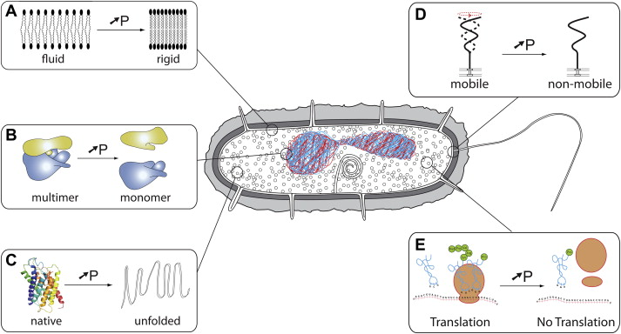
PRIMER
Cell mechanics under hydrostatic pressure
A microbial cell as hydrated soft matter with load bearing interfaces
Pressure is isotropic,
but biological response is not
Oger & Jebba (2010) Research in Microbiology. doi:10.1016/j.resmic.2010.09.017
09
Notes:
2,0 min. Usar la figura como pieza central. Una célula no es una bolsa inerte: membrana, pared, citoplasma y complejos moleculares responden de forma acoplada. La presión se aplica de forma isotrópica, pero el fenotipo no tiene por qué ser isotrópico.

Slide 10
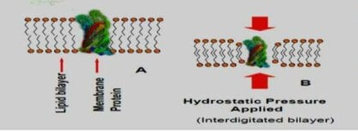
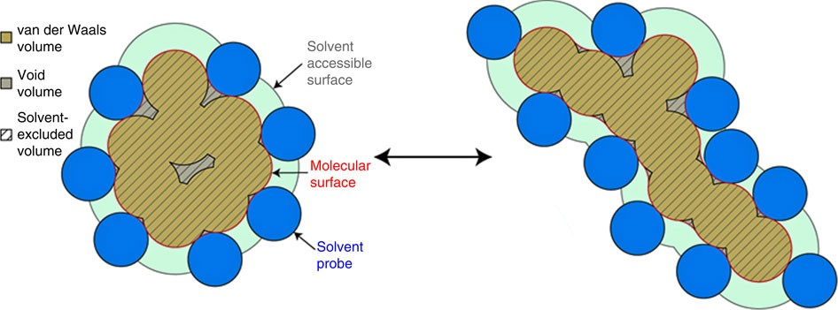
PRIMER
Pressure effects on membranes and proteins
Packing, hydration and conformational landscapes
Membrane soft matter
Lower pressure: larger free volume
Higher pressure: lighter packaging, lower fluidity
Permeability
Transport
Embedded enzymes
Protein / enzyme landscape
Oligomeric state
Active-site geometry
Catalytic rate
Pressure favour lower-volume states but can disrupt cavities, hydration and assemblies
Winter & Jeworrek 2009; Tamby et al. 2023; Ichiye 2018; Chen & Makhatadze 2017
10
Notes:
2,0 min. Explicar que la membrana suele perder volumen libre y fluidez, pero la respuesta real depende de lípidos, temperatura y composición. Para proteínas, no basta con decir desnaturalización: hay cavidades, hidratación, oligomerización y actividad catalítica.

Slide 11
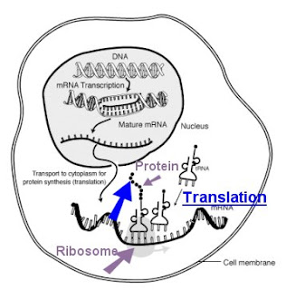
PRIMER
beyond membrane-only explanations
Cytoplasm, hydration and crowding
Diffusion is not guaranteed
Molecular mobility can change as pressure alters hydration and local viscosity
Assemblies have pressure histories
Ribosomes, divisomes and stress granules can respond before the whole cell fails
Recovery is biological
Post-pressure repair and resuscitation affect what the experiment appears to show
Pressure biology is often recovery biology
Balny et al. 2002; Oger & Jebbar 2010
11
Notes:
1,5 min. Romper la idea de citoplasma como solución diluida. En presión, los cambios de hidratación, crowding y difusión pueden modificar rutas metabólicas y ensamblajes, incluso antes de que observemos muerte celular.

Slide 12
CELLS
02
Microbial
responses
How physical perturbations become growth, adaptation, injury or death.
12
Notes:
0,5 min. Transición a microbiología. Ahora que tenemos el lenguaje de materia blanda, aplicarlo a fenotipos microbianos concretos.

Slide 13








CELLS
growth is the readout
Terminology and pressure phenotypes
Growth phenotypes under pressure
A vocabulary for pressure-growth response curve
Piezophilic bacterium
Escherichia coli
0,1 MPa
10 MPa
30 MPa
50 MPa
http://www.jamstec.go.jp
Oger & Jebbar 2010
13
Notes:
1,5 min. Definir piezosensible, piezotolerante, piezófilo y piezófilo obligado. Insistir en que las curvas son esquemáticas y dependen de temperatura, medio y método.

Slide 14
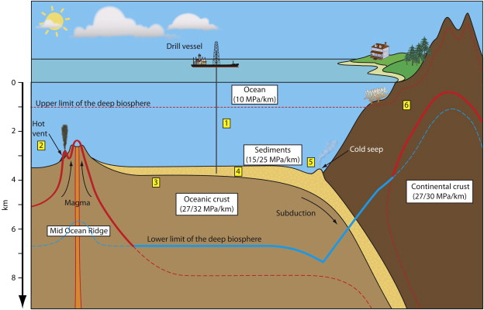
CELLS
habitats and gradients
Where pressure-adapted microbes are found
Deep ocean, trenches, hydrothermal vents and subsurface pores
Epipelagic 0-200 m
Mesopelagic 200-1000 m
Bathypelagic 1000-4000 m
Abyssal 4000-6000 m
Hadal trenches 6000-11000 m
Pressure gradient
~0,1 MPa per 10 m in sea water
Biological consequence
Low temperature + high pressure + low organic carbon select for psycropiezophilic and oligotrophic strategies
Hot deep biosphere
Vent and crustal habitats add strong temperature gradients
14
Notes:
1,0 min. Repasar rápidamente el gradiente oceánico y las zonas. El objetivo es situar los ambientes antes de hablar de estrategias celulares.

Slide 15
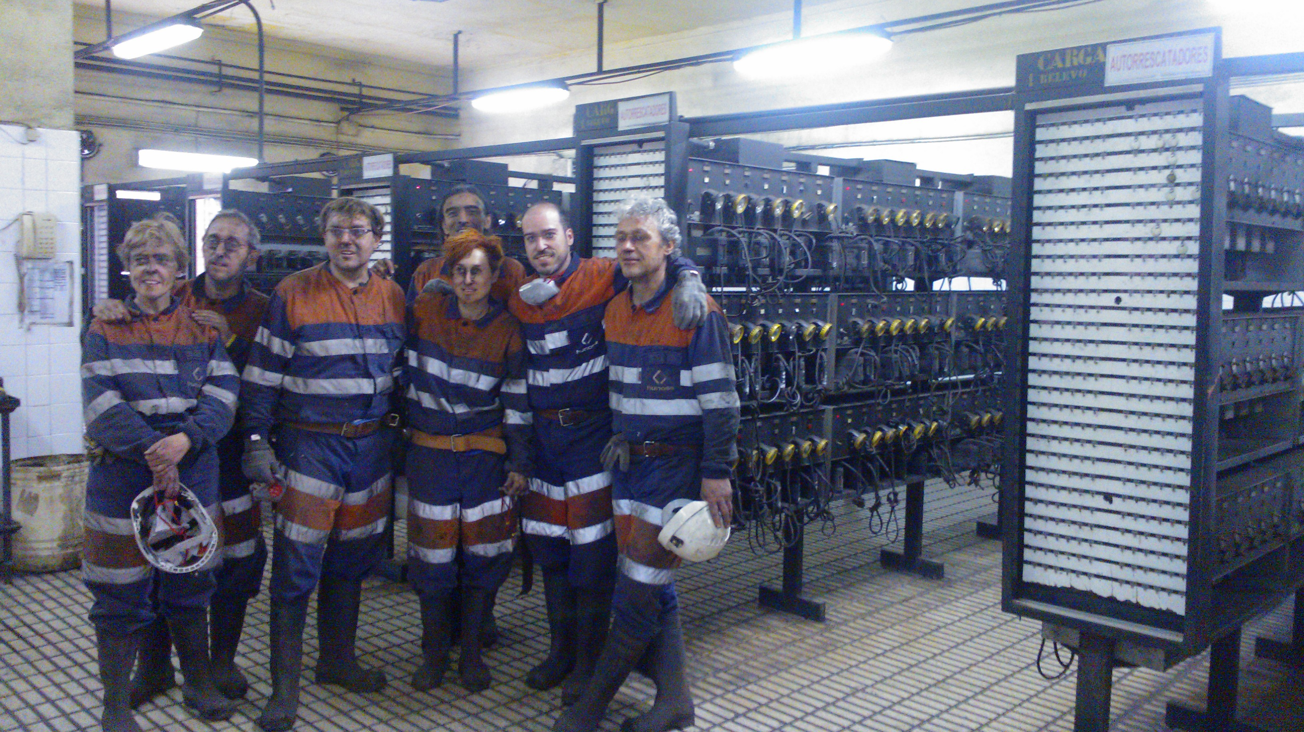
Organisms found at the bottom of a coal mine

Slide 16
CELLS
species as mechanism probes
Representative model organisms and what they teach us
Model
Pressure style
Useful for teaching
Photobacterium profundum SS9
psychropiezophile
membrane and gene regulation under pressure
Shewanella violacea DSS12
facultative piezophile
respiration and cytochrome regulation
Thermococcus / Pyrococcus spp.
thermopiezophilic archaea
proteins, lipids and high P–T limits
Colwellia marinimaniae
hyperpiezophile
hadal adaptation and growth at very high pressure
Teaching move: choose one model per mechanism rather than one mechanism per species.
Kato & Nogi; Jebbar group; Kusube et al. 2017
15
Notes:
1,5 min. No convertirlo en lista taxonómica. Usar cada organismo como una ventana a un mecanismo: membranas, respiración, termopiezofilia o límites hadales.

Slide 17
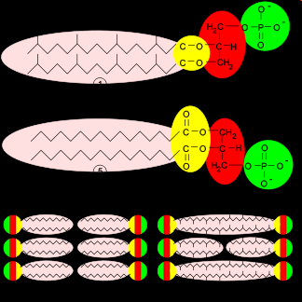
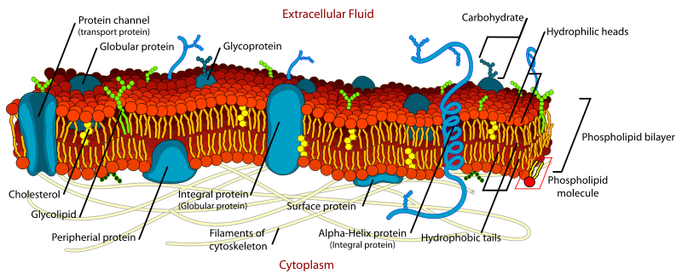
CELLS
lipid chemistry translates into material properties
Membrane adaptation is the first soft-matter story
Bacteria
Archaea
Universal problem
change fatty-acid length, branching, saturation and headgroup composition to tune packing.
ether lipids and tetraether monolayers can stabilize membranes under combined extremes.
keep the membrane functional without making it leaky or rigid.
Membrane adaptation is a materials-engineering solution evolved by cells.
Tamby et al. 2023; Winter & Jeworrek 2009
16
Notes:
1,5 min. Relacionar biología y física: aumentar insaturación, ramificaciones o lípidos tetraéter no es una lista de moléculas; es una manera de mantener permeabilidad, fluidez y función en otro régimen de presión y temperatura.

Slide 18
CELLS
from cavities to ATP
Proteins, respiration and energy metabolism
protein cavities
hydration shell
conformation
complex assembly
electron transfer
ATP yield
Enzyme activity
Respiratory chains
Energy stress
Piezophilic enzymes may balance flexibility and stability differently from mesophilic homologues.
Pressure can alter membrane proteins and redox-complex organisation.
A small decline in energy supply can become a cell-division phenotype.
Mechanistic caution: pressure response is not one target, but a network of volume-sensitive steps.
Ichiye 2018; Oger & Jebbar 2010
17
Notes:
1,5 min. Conectar presión con actividad enzimática y cadenas respiratorias. Subrayar que la presión puede cambiar ensamblajes y rutas de transferencia electrónica sin destruir covalentemente las moléculas.

Slide 19
CELLS
pressure-sensitive information processing
Nucleic acids, ribosomes and cell division
DNA / RNA
Ribosomes
Divisome
base pairing and stacking can be pressure-sensitive; local opening matters.
large macromolecular assemblies translate pressure into growth-rate changes.
cell division can fail before viability is lost; filamentation is a clue.
Look for “growth without division”, “metabolism without colony formation”, and “injury without immediate death”.
These distinctions are especially important when using post-pressure plating as the main readout.
Oger & Jebbar 2010; Kumar & Libchaber 2012
18
Notes:
1,5 min. Explicar que la presión puede estabilizar dúplex de ácidos nucleicos, pero procesos como replicación y transcripción requieren apertura local y ensamblajes dinámicos. Terminar con división celular como fenotipo integrador.

Slide 20
CELLS
visible phenotypes are mechanistic clues
Morphology, motility, biofilms and recovery
compression
membrane stress
motility changes
filamentation
injury / VBNC
recovery or death
Morphology
Motility
Biofilms
elongation and division defects can appear before complete inactivation.
flagella and chemotaxis depend on membranes and energy supply.
EPS and multicellular organisation can change pressure tolerance.
Plate counts are not the whole phenotype
Kumar & Libchaber 2012; HPP recovery literature
19
Notes:
1,0 min. Reforzar que los fenotipos observables no son sólo crecimiento/muerte. Cambios de forma, motilidad y biofilm pueden indicar estrés o adaptación. La recuperación pospresión es parte de la biología.

Slide 21
CELLS
P × T × chemistry × matrix
Pressure
Variable, not recipe
Matrix
pH
Water activity
Salinity
Temperature
Recovery medium
Pressure never acts alone
Experimental design should report the full pressure ecosystem, not only MPa and minutes
20
Notes:
1,5 min. Aclarar que la misma presión en MPa puede tener efectos muy diferentes según temperatura, pH, actividad de agua, salinidad y matriz. Este es un punto clave para unir ecología, HPP y diseño experimental.

Slide 22
CELLS
From physical perturbation to microbiological phenotype
A compact map for interpreting pressure experiments
Pressure perturbation
Hydration / Volume
Membrane + protein assembles
Energy + division bottlenecks
Phenotype
Adapt, arrest, die
The same physical driver can yield growth, dormancy, injury or death depending on the context
21
Notes:
1,5 min. Sintetizar el bloque celular. La presión actúa sobre volumen, hidratación e interfaces; esos cambios alteran ensamblajes, energía y división; el fenotipo final depende de reparación y condiciones de recuperación.

Slide 23
METHODS
03
Experimental
strategy
How to measure pressure response without changing the answer during sampling.
22
Notes:
0,5 min. Transición a métodos. Explicar que en alta presión el aparato no es accesorio: define lo que podemos observar.

Slide 24
METHODS
the measurement chain
Experimental challenge: decompression can change the answer
in-situ state
sampling
pressure history
decompression
recovery medium
observed phenotype
What can be lost
What can be created
What to report
labile transcripts, pressure-dependent assemblies, stressed subpopulations.
decompression injury, oxygen exposure, temperature shocks.
compression rate, hold time, decompression rate, recovery conditions.
The end point is often a pressure-history phenotype, not a pure pressure phenotype
23
Notes:
1,0 min. La descompresión no es un detalle logístico; puede inducir daño, recuperación parcial, cambios de expresión o sesgos de cultivo. Presentar la cadena muestra-presión-descompresión-recuperación como un único experimento.

Slide 25
P
Batch vessel
Process validation
S
Pressure retaining sampler
In situ recovery
✵
High pressure microscopy
Live dynamics
Small volume; Optical access
Growth, morphology, fluorescence
Keeps deep sample under pressure
Sampling / cultivation continuously
μ
High throughput; post-pressure readout
Typical HPP 100-700 MPa
Diamond Anvil cell
Tiny sample; high pressure range
Raman / X-ray; ice phases, survival
Extreme limits
METHODS
new figure
Experimental platforms across the pressure toolbox
Choose the instrument after choosing the biological question
Vass et al. 2010; pressure-retaining sampler literature; DAC studies
24
Notes:
2,0 min. Comparar plataformas por la pregunta que responden: validación de proceso, muestreo realista, dinámica in situ o límites físicos extremos. No hay método universal.

Slide 26
METHODS
new figure
Experimental platforms across the pressure toolbox
Choose the instrument after choosing the biological question
Batch vessel
Process validation
High process throughput; post pressure readout
Typical 100-700 MPa
High pressure microscopy
Live Dynamics
Small volume; optical access growth, morphology, fluorescence
Diamond anvil cell
Extreme limits
Tiny sample; high pressure range; Raman /X-ray, ice phases, survival
Pressure retaining sample
In-situ recovery
Keeps deep sample under pressure, sampling/cultivation continuously
Vass et al. 2010; pressure-retaining sampler literature; DAC studies
24
Notes:
2,0 min. Comparar plataformas por la pregunta que responden: validación de proceso, muestreo realista, dinámica in situ o límites físicos extremos. No hay método universal.

Slide 27
METHODS
maintain the sample’s pressure history
Pressure-retaining sampling and cultivation strategies
Recover without decompression
Culture under pressure
Pair with molecular readouts
captures cells that may not survive atmospheric handling
tests growth optima and obligate piezophily directly
links activity, composition and viable cultivation
Design principle
If the scientific claim is about in-situ physiology, the pressure history must be preserved or explicitly modelled
Pair atmospheric-pressure controls with pressure-retaining workflows to separate decompression sensitivity from true in-situ adaptation
25
Notes:
1,5 min. Destacar que conservar presión durante recuperación e incubación cambia la interpretación ecológica. Explicar que el precio es complejidad, bajo rendimiento y necesidad de controles.

Slide 28
METHODS
seeing pressure response in situ
High-pressure microscopy and spectroscopy
Live morphology
Fluorescence
Spectroscopy
growth, filamentation, motility and division under controlled P–T.
membrane integrity, reporters and stress markers when optics allow.
metabolite or structural signatures in small high-pressure samples.
A small field of view can answer a question that a million colony counts cannot: when does the cell stop dividing?
Limitations: small sample volume, optical constraints, calibration, and pressure/temperature gradients.
Vass et al. 2010; Sharma et al. 2002
26
Notes:
1,5 min. Presentar microscopía de alta presión como una forma de ver dinámica, no sólo antes/después. Comparar con Raman o DAC para preguntas de metabolismo y límites extremos.

Slide 29
METHODS
Omics and systems microbiology under pressure
Make pressure history explicit in every sample
Presurize
Controlled P-T
Sample
Avoid decompression artifacts
Extract
RNA / protein / lipids
Integrate
Model
Multi-ohmics + phenotype
Mechanism - prediction
Pressure is metadata, not just a treatment label
27
Notes:
1,5 min. Explicar que las ómicas bajo presión requieren metadatos y temporalidad. Un gen diferencial sólo tiene sentido si sabemos presión, temperatura, tasas de compresión y descompresión, y fase de recuperación.

Slide 30
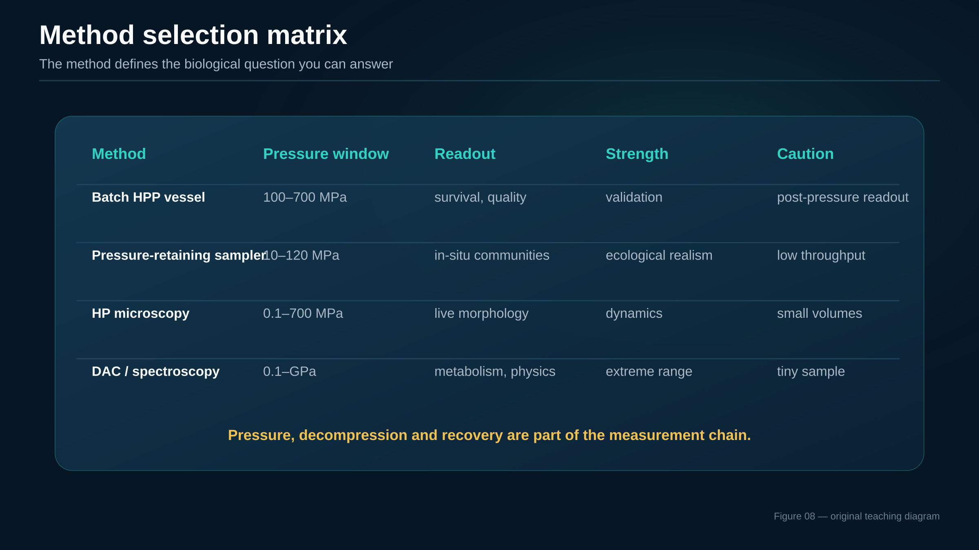
METHODS
method selection
Comparative table of core experimental methods
28
Notes:
1,5 min. Guiar al público por la tabla. Empezar siempre por la pregunta biológica. Si quiero validar un proceso no necesito DAC; si quiero ver metabolismo en hielo VI no necesito un vaso industrial.

Slide 31
METHODS
general principles, not a protocol
Safety and operational good practice
Stored energy
Vessel integrity
Thermal control
Biosafety
treat pressure systems as energy-containing equipment
use rated components, maintenance logs and interlocks
compression heats; decompression cools; both affect biology
contain viable organisms before, during and after treatment
Good microbiology under pressure is reproducible engineering plus reproducible biology
Report compression rate, decompression rate, temperature profile, vessel loading, sample geometry and recovery conditions
29
Notes:
1,0 min. Mantener nivel general, sin entrar en procedimientos específicos. Enfatizar energía almacenada, integridad del vaso, control de temperatura, bioseguridad y trazabilidad del protocolo.

Slide 32
APPLICATIONS
04
Applications
and limits
From microbial inactivation to translation gaps in real matrices.
30
Notes:
0,5 min. Transición a aplicaciones. El objetivo es aplicar el marco mechanístico, no presentar HPP como una caja negra.

Slide 33
APPLICATIONS
one physics, multiple objectives
Application landscape
Food HPP
Pharma / cosmetics
Biotechnology
Ecology
safe, fresh-like products; pathogen and spoilage control
bioburden reduction, formulation stress tests, sensitive matrices
pressure as perturbation tool for enzymes and cells
deep life, subsurface, astrobiology analogues
The same mechanism can be useful or harmful depending on the application
In HPP we want irreversible injury; in deep-sea microbiology we try not to create it
31
Notes:
1,0 min. Presentar el mapa de aplicaciones: alimentos, pharma/cosmética, biotecnología y ciencia ambiental. Subrayar que en cada caso cambia el criterio de éxito.

Slide 34
APPLICATIONS
post-packaging pressure treatment
High-pressure processing in foods
packaged food
pressure vessel
water medium
400–600 MPa
hold + release
chilled shelf life
Main advantage
Main caution
Main design variable
inactivates many vegetative cells with limited covalent chemistry
spores, matrix protection and recovery can dominate validation
pressure, temperature, pH, aw and product structure together
HPP is not just “MPa × minutes”: it is product-specific microbial ecology under compression.
Aganovic et al. 2021; HPP reviews
32
Notes:
1,5 min. Explicar HPP de forma clara: producto envasado, presión isostática, calentamiento por compresión, sensibilidad de células vegetativas y resistencia relativa de esporas. Evitar venderlo como esterilización universal.

Slide 35
APPLICATIONS
multi-target injury
How pressure inactivates microbes
membrane permeability
ion gradients
energy stress
protein assemblies
division failure
injury / death
The lethal event may be a systems-level collapse, not a single broken molecule
This explains shoulders, tails and strong effects of recovery media in survival curves
Rendueles et al.; HPP inactivation reviews
33
Notes:
1,5 min. Evitar una causa única de muerte celular. Presentar una cadena de daño: membranas, energía, proteínas, ribosomas/división, reparación. El mecanismo dominante depende de organismo y matriz.

Slide 36
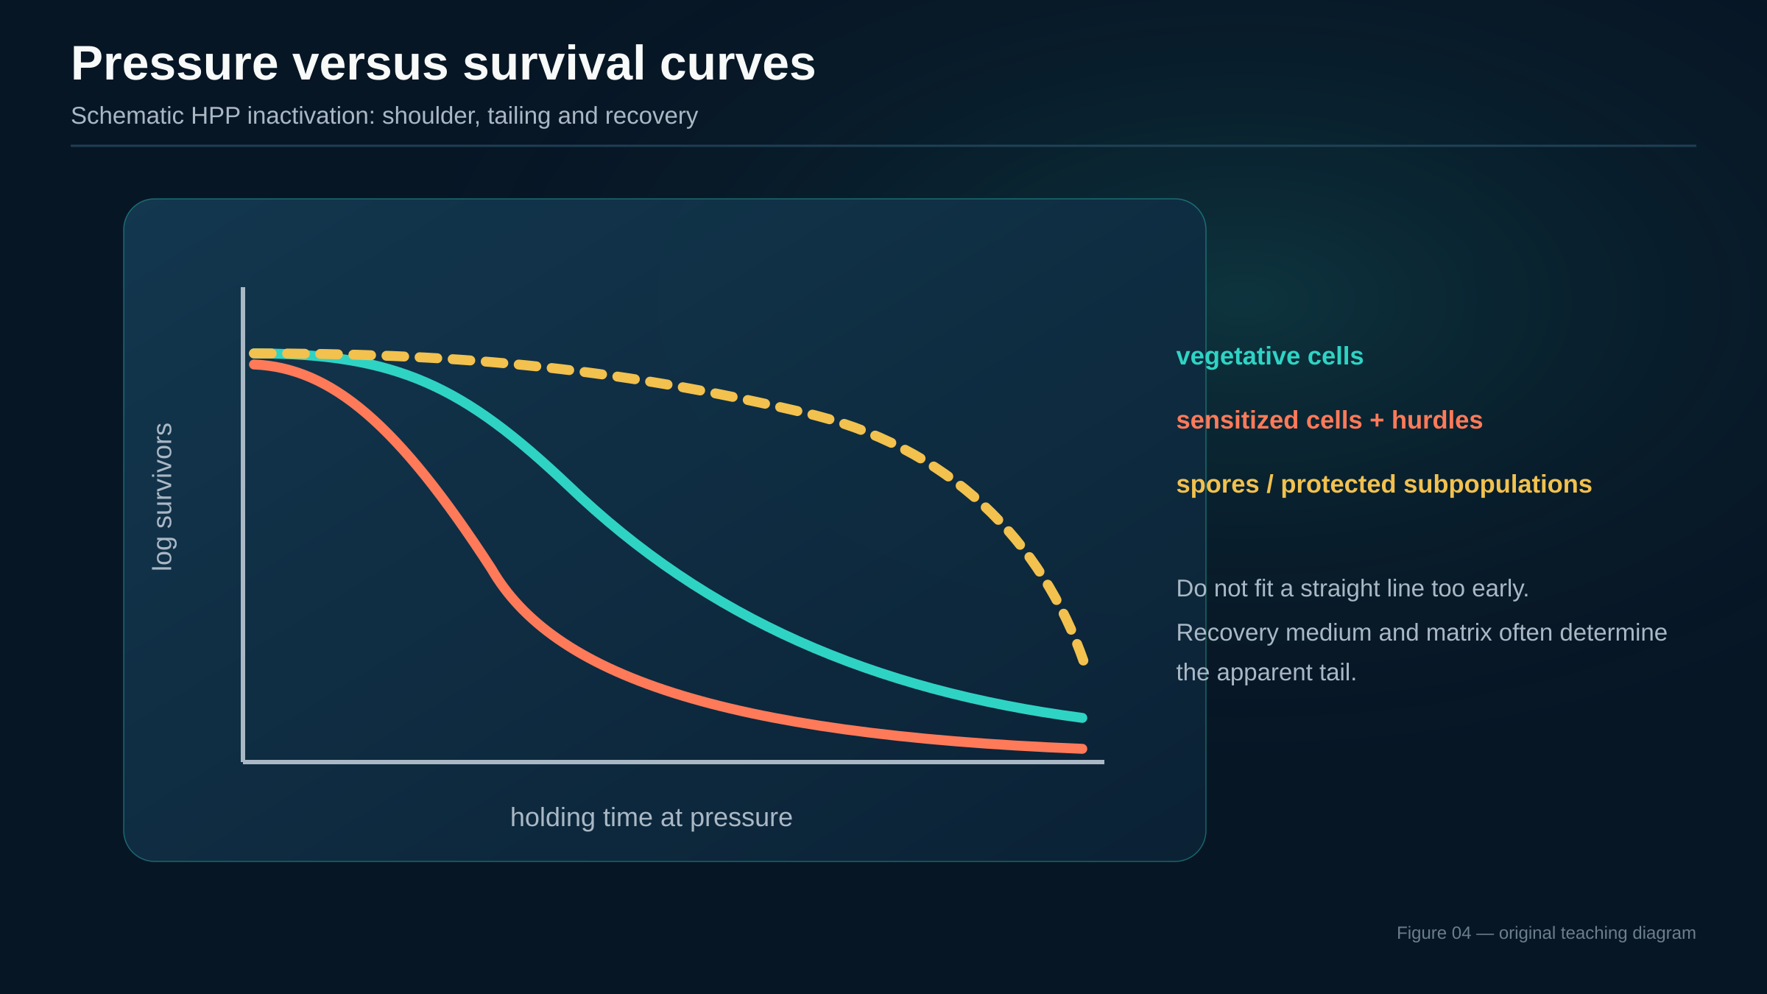
APPLICATIONS
Pressure versus survival curves
Schematic HPP inactivation: shoulder, tailing and recovery
Microbiology under Pressure — updated deck
HPP kinetics and recovery literature
34
Notes:
2,0 min. La gráfica es esquemática y docente. Explicar shoulder, tailing y heterogeneidad. Subrayar que células dañadas pueden necesitar medios selectivos y no selectivos para distinguir muerte de lesión.

Slide 37
APPLICATIONS
why HPP is often pasteurization-like, not sterilization
Spores, persistence and recovery artefacts
Spores are not small vegetative cells
Germination can help
Validation must be conservative
low water content, protective layers and dormancy change pressure response.
pressure-triggered germination may make spores more sensitive to follow-up hurdles.
injured survivors and recovery conditions can change apparent log reductions.
Practical message: HPP is strongest against vegetative cells; spore control usually needs a hurdle strategy.
Use non-selective and selective recovery, appropriate incubation windows and product-specific challenge tests.
35
Notes:
1,5 min. Explicar que las esporas son la gran limitación de HPP a temperatura ambiente. La presión puede inducir germinación o sensibilización, pero la estrategia suele requerir temperatura u otras barreras.

Slide 38
APPLICATIONS
Combined hurdles and intensified processes
Pressure works best when the full environment is designed
Microbial inactivation
Antimicrobials
Pressure
Temperature
Matrix
Recovery mèdium
pH / aw
Do not validate MPa in isolation. Validate the treatment ecosystem
36
Notes:
1,5 min. Presentar la lógica de barreras. La presión no tiene por qué hacerlo todo: pH, temperatura, aw, antimicrobianos y matriz pueden convertir lesión reversible en inactivación robusta.

Slide 39
APPLICATIONS
application logic
Three concrete application examples
Ready-to-eat meats
Juices and purées
Seafood
Focus: Listeria risk reduction and shelf-life.
Key issue: product formulation and post-process contamination.
Focus: fresh-like quality in acidic products.
Key issue: yeasts, moulds and enzyme residual activity.
Focus: pathogen control and shellfish shucking.
Key issue: texture, enzymes and cold chain.
Each product is its own microbial ecosystem under pressure.
37
Notes:
1,5 min. Elegir uno de los tres como ejemplo principal según el público: RTE meats para seguridad de Listeria, juices/purées para acidez y calidad, seafood para valor comercial y separación de carne.

Slide 40
APPLICATIONS
pressure as tool and stressor
Biotech, pharma and cosmetics prospects
Enzyme engineering
Formulation stress tests
Bioburden reduction
pressure probes cavities, flexibility and catalytic robustness
biologics, emulsions and cells can be screened for pressure sensitivity
useful for selected matrices but not a universal sterilization replacement
Translational opportunity: use pressure as a controlled perturbation before using it as a process
This is especially useful for early-stage projects because mechanism and application can be linked in the same workflow
38
Notes:
1,5 min. Mostrar que presión no es sólo procesado alimentario. Puede ser perturbación para estudiar enzimas, estrés para formulaciones, herramienta de descontaminación o forma de seleccionar fenotipos resistentes.

Slide 41
APPLICATIONS
what should make us cautious
Key limitations and translation gaps
Heterogeneity
Comparability
Transferability
subpopulations, physiological state and stress history shape survival
pressure, temperature and decompression protocols are often underreported
deep-sea adaptation and HPP inactivation overlap mechanistically but not operationally
The biggest errors come from treating pressure as a scalar recipe rather than an experimental history
39
Notes:
1,5 min. Subrayar las lagunas: heterogeneidad celular, comparabilidad de protocolos, extrapolación entre escalas y matrices reales. Hacer visible la incertidumbre mejora la calidad de la investigación.

Slide 42
SYNTHESIS
05
Synthesis
and discussion
How to turn pressure microbiology into good research questions
40
Notes:
0,5 min. Transición final. Ahora se resumen preguntas abiertas y formas de pensar experimentos.

Slide 43
SYNTHESIS
questions that connect mechanism and application
Open research questions worth showing to ESRs
What lipid changes matter most?
How much is decompression artefact?
When does injury become death?
composition vs material state
real physiology vs handling
repair thresholds
Can we predict matrix protection?
Which assemblies are pressure bottlenecks?
How can data become comparable?
food structure and solutes
ribosomes, divisome, respiratory complexes
metadata and standards
Good questions define the pressure history before they define the measurement
41
Notes:
1,5 min. Presentar preguntas abiertas como oportunidades de tesis. Todas conectan un mecanismo físico con una lectura microbiológica concreta.

Slide 44
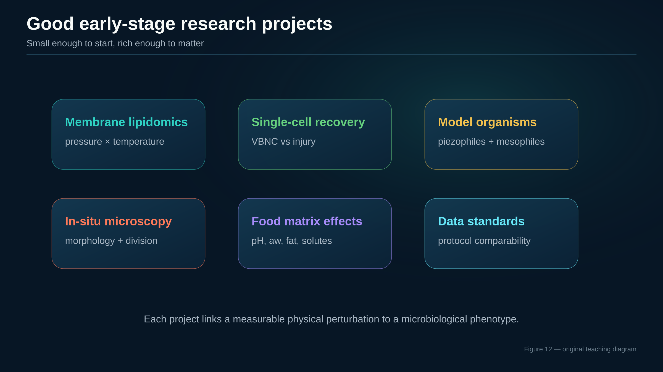
SYNTHESIS
new figure
Good project ideas for early-stage researchers
42
Notes:
1,5 min. Usar esta diapositiva si hay estudiantes buscando proyectos. Insistir en proyectos acotados y publicables: una pregunta, un rango de presión, un organismo o matriz, y controles claros.

Slide 45
SYNTHESIS
four-step heuristic
A practical framework for interpreting any pressure experiment
1. Define pressure history
2. Identify soft-matter targets
3. Choose readouts and controls
4. Interpret recovery explicitly
History
Targets
Readouts
Recovery
compression, hold, decompression, temperature
membrane, proteins, ribosomes, wall, cytoplasm
growth, viability, morphology, omics, kinetics
repair, VBNC, tailing, selective media
A pressure experiment is a story of perturbation, response and recovery.
43
Notes:
1,0 min. Cierre conceptual. Proponer una heurística de cuatro pasos que sirva al público después de la charla.

Slide 46
SYNTHESIS
Take-home messages
Pressure targets hydration, packing, interfaces and weak assemblies before covalent chemistry.
Ecological pressure and industrial HPP overlap mechanistically, not operationally.
Membranes, proteins, energy metabolism and division are central bottlenecks.
Sampling, decompression and recovery conditions can change the answer.
Good HPP microbiology designs the whole treatment ecosystem, not MPa alone.
The best pressure experiments are mechanistic, explicit and reproducible
44
Notes:
1,0 min. Cierre en cinco mensajes. Pausar después de cada mensaje y conectar con ejemplos de la charla.

Slide 47
SYNTHESIS
discussion
Questions
Which bottleneck would you test first?
membrane state
decompression artefact
spore recovery
matrix protection
Thank you
45
Notes:
0,5 min. Abrir preguntas proponiendo cuatro posibles puntos de discusión: mecanismos, métodos, HPP o proyectos ESR. Dejar esta diapositiva en pantalla.

Slide 48
BACKUP
optional deail
Backup: additional species and edge cases
Example
Reported context
Teaching angle
Pyrococcus yayanosii
obligate piezophilic hyperthermophilic archea
high P–T limits and archaeal adaptation
Marinitoga piezophila
thermo-piezophilic bacterium from hydrothermal vent
pressure + temperature + morphology
Colwellia marinimaniae
hyperpiezophile from Mariana Trench context
growth near / above hadal pressures
E. coli under pressure
mesophile model in microscopy studies
division, morphology and non-adapted response
Use edge cases to illuminate mechanisms, not to make universal claims
Notes:
0 min, backup. Usar sólo si alguien pregunta por ejemplos concretos o por límites de presión/temperatura.

Slide 49
BACKUP
Backup: kinetic language and glossary
log reduction
shoulder
decimal decrease in survivors; read with recovery conditions in mind
initial region with little apparent inactivation
tailing
VBNC
persistent survivor fraction or protected subpopulation
viable but non-culturable state; method-dependent interpretation
PATP
UHPH
pressure-assisted thermal processing
ultra-high-pressure homogenization; continuous liquid treatment
Notes:
0 min, backup. Usar si el público necesita vocabulario de HPP o microbiología de supervivencia.

