Slide 1
XP-PCM and applications to high-pressure organic chemistry
Bo Chen
Donostia International Physics Center
12th Spanish high pressure school
June 24, 2026

Slide 2
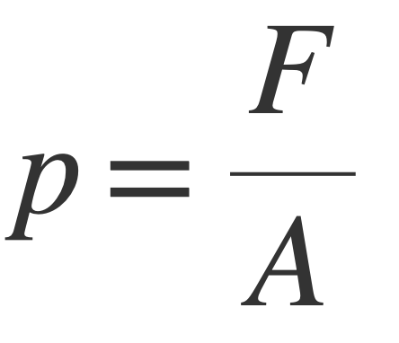
Pressure
Force
Area
Mechanical definition, intuitive
Rarely used in real world measurements -- needs exact force and well-defined area
Can be used in high pressure modeling

Slide 3
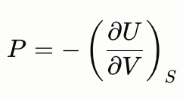
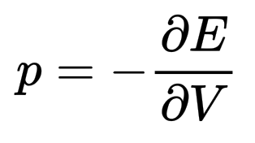
Thermodynamic definition
Internal energy
Constant entropy
Volume
At T = 0 K, entropy change ΔS = 0
Electronic energy
Molecular/cell volume
Widely used in pressure calculation, DFT

Slide 4
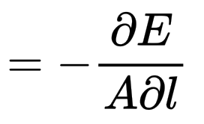
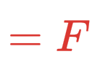
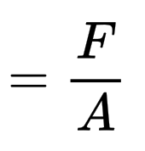




How do they connect?
Hellmann-Feynman theorem

Slide 5
Apply pressure to bulk
Force
Periodic boundary condition
Force
Force
Unit cell
Force
Area
Force

Slide 6
Apply pressure to a single molecule
Why do we want to do this?
Focus on molecular structure, property, reaction
Faster calculation

Slide 7
Mechanochemical models
Generalized Force-Modified
Potential Energy Surface (G-FMPES)
Extended hydrostatic compression force field (X-HCFF)
Spherical surface
van der Waals surface

Slide 8
Electron density compression models
Mechanical force acting on atoms or surfaces
Repulsive potential acting on electron density (cloud)

Slide 9



Origin of contact mechanical force
Zoom in to
atomic level
Atoms get too close so that they repel each other

Slide 10
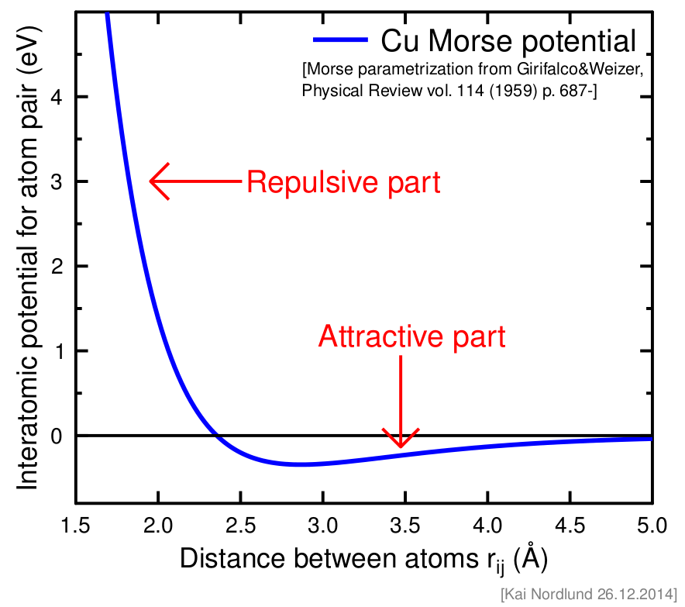
When two atoms get too close, their electron clouds overlap. The Pauli exclusion principle forbids electrons of the same spin from occupying the same space, so they push back — creating repulsion

Slide 11
electron cloud – electron cloud
0
distance from the nucleus
electron cloud – Pauli repulsive potential

Slide 12

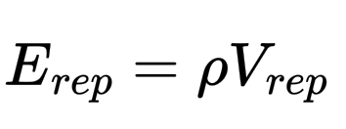
A simple and effective Pauli repulsive potential
electron density

Slide 13
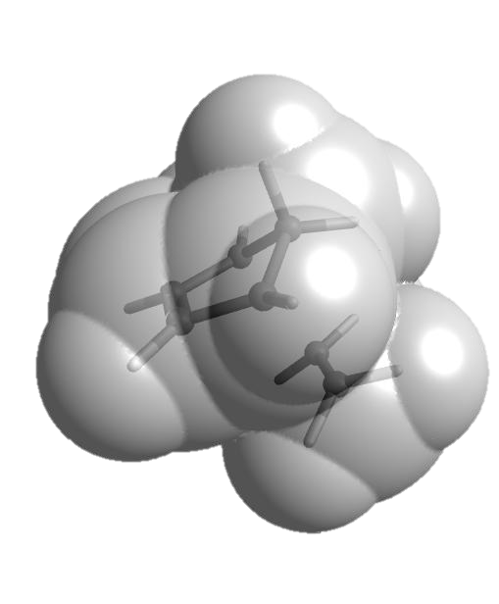
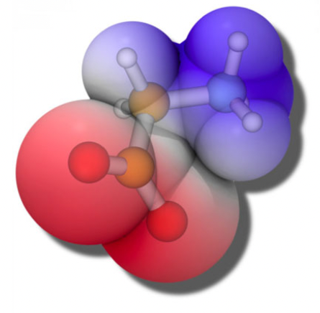
Molecular cavity and volume
van der Waal cavity
Union of atomic spheres with respective vdW radii

Slide 14

eXtreme Pressure Polarizable Continuum Model
(XP-PCM), the Cammi model
ε, ρ
ε', ρ'
Created by Prof. Roberto Cammi University of Parma, Italy

Slide 15

Polarizable continuum model (PCM)
For solvation energy calculations
Implicit solvation
Main interaction: solute-solvent electrostatic interaction
Gas phase Hamiltonian
Electrostatic interaction

Slide 16
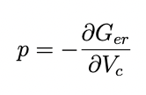
XP-PCM, a high-pressure extension of PCM
Gas phase Hamiltonian
Electrostatic interaction
Pauli repulsion
Amovilli, Mennucci, J. Phys. Chem. B 101, 1051 (1997)
Electronic energy
Continuum model
Cavity volume
Pauli repulsion (step potential) introduced at the molecular cavity boundary
Cammi, J. Comput. Chem. 36, 2246 (2015)
Chen, Hoffmann, Cammi, Angew. Chem., Int. Ed. 56, 11126 (2017)

Slide 17
To obtain a higher pressure in XP-PCM
  Scale down the vdW radii
  Decreased cavity volume
  More electron density outside of the cavity
  Increased Pauli repulsion
  Increased pressure

Slide 18
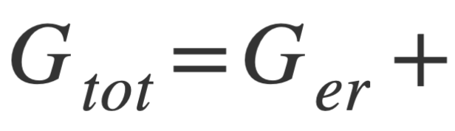
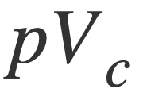

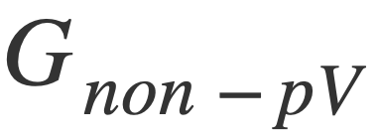
XP-PCM, a high-pressure extension of PCM
volume work
entropic
Continuum model
Pauli repulsion (step potential) introduced at the molecular cavity boundary
for geometry optimization
J. Chem. Phys. 157, 11401 (2022)

Slide 19
Computational High-Pressure Organic Chemistry
1 GPa
100 GPa
Are the general paradigms on structure and reactivity of organic molecules at 1 atm still valid under high pressure?

Slide 20
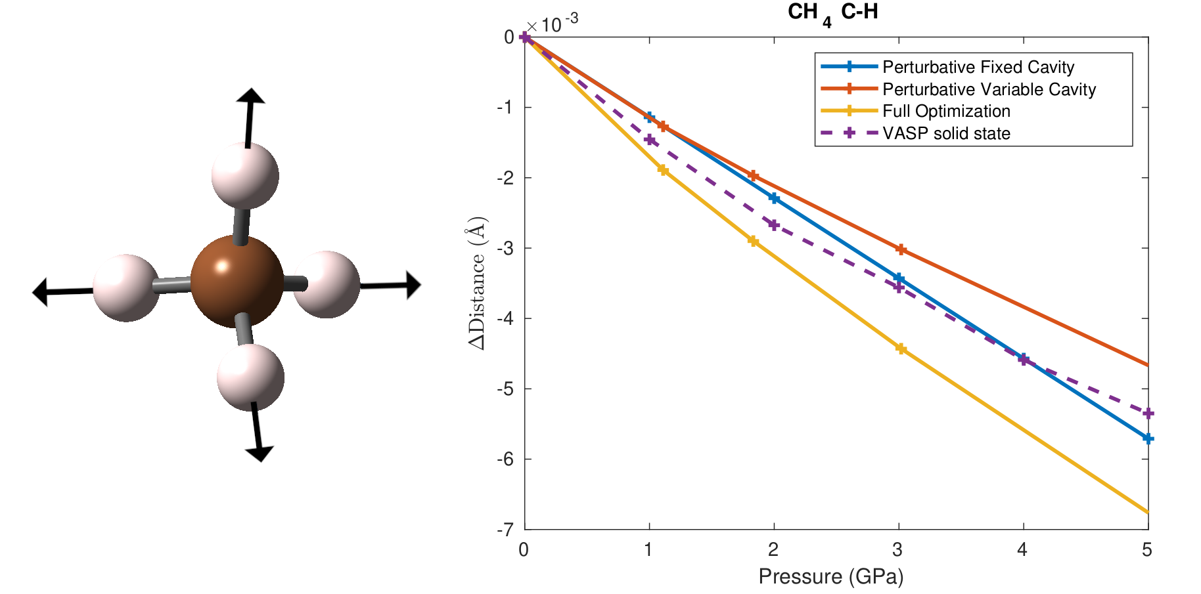
Geometry optimization
Methane
Also benzene, diborane, ferrocene …

Slide 21
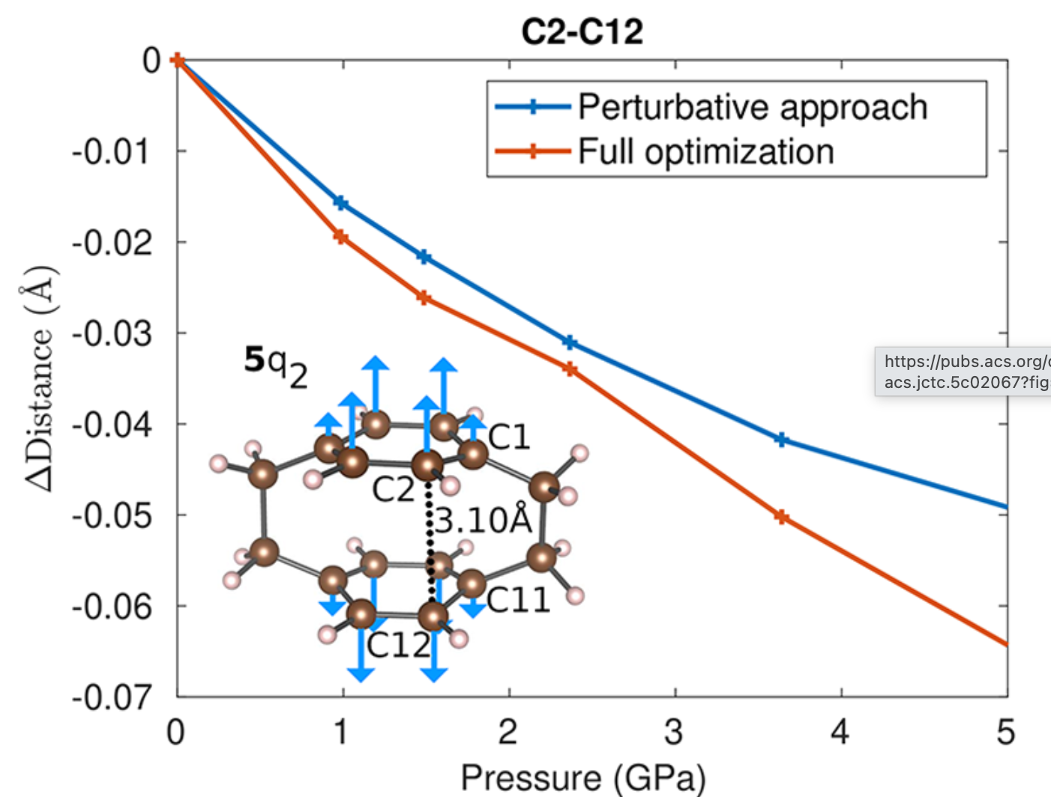
Para-cyclophane

Slide 22
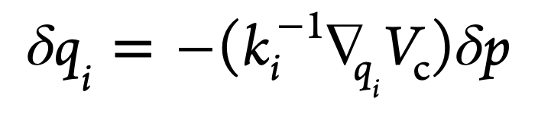
The extent of bond distance response to pressure depends linearly on three factors:
how high the pressure is
how strong the bond is, as measured by the force constant of the corresponding vibrational mode
how much volume reduction shortening the bond results in, as measured by the volume gradient of that vibrational modex
geometric change
pressure change
force constant
volume gradient

Slide 23
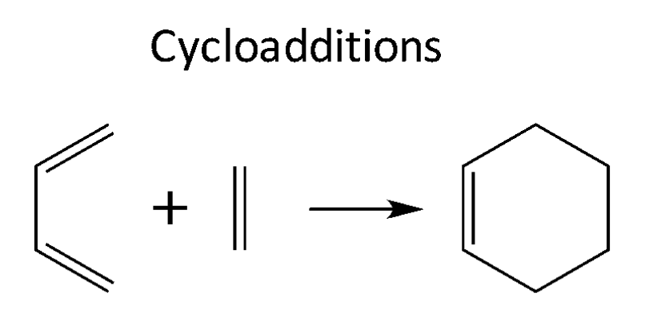
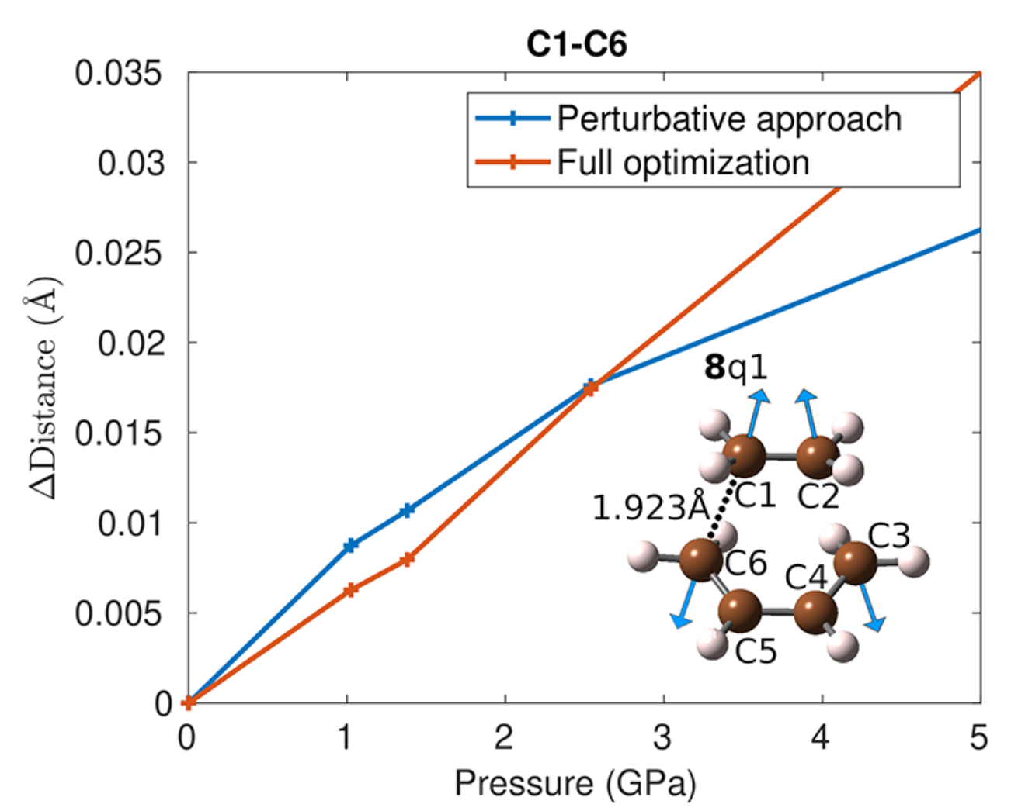
Bond elongates under P
Explanation:
Negative force constant
Hammond’s postulate

Slide 24
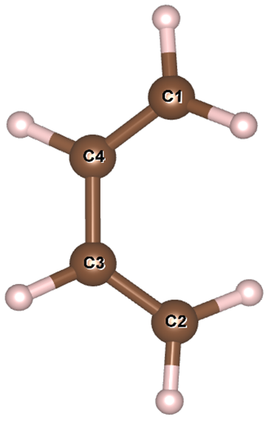
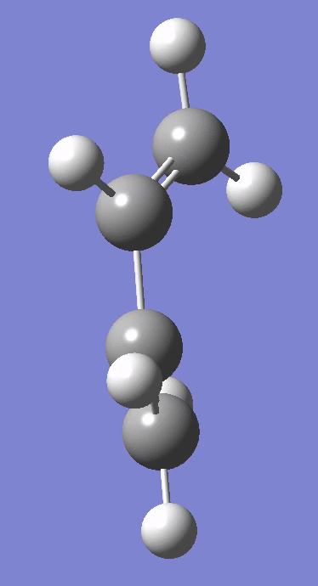
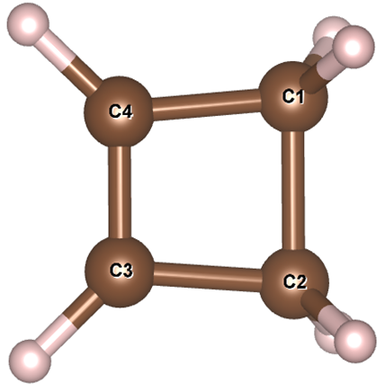
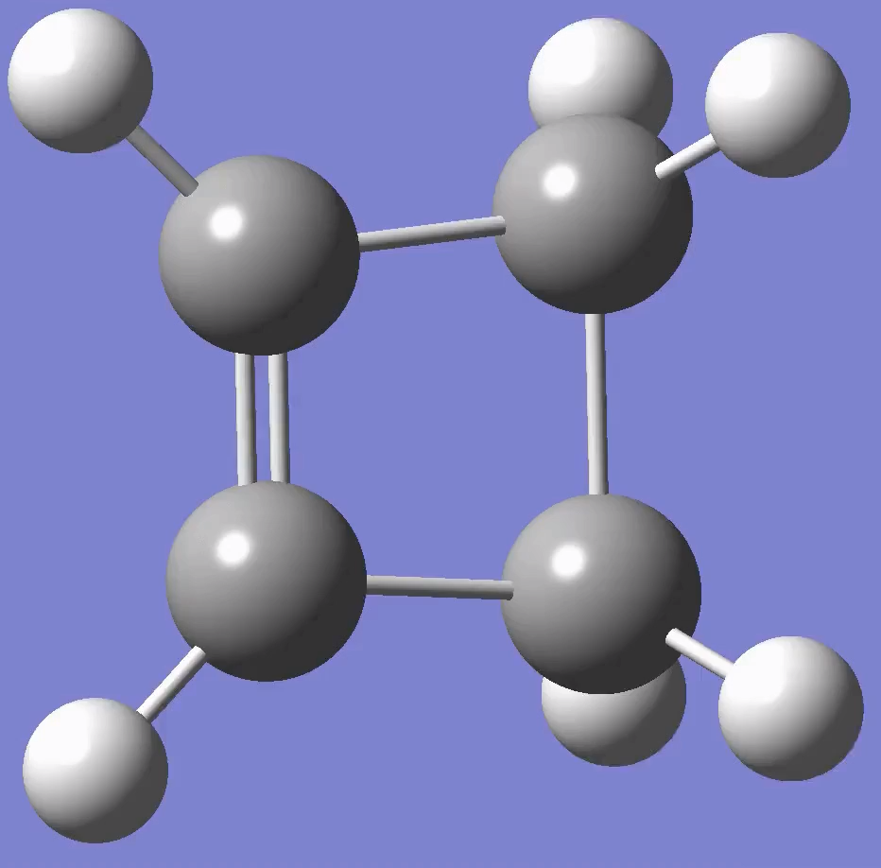

Vibrational frequency
cyclobutene
s-cis-butadiene
p(GPa) | Frequency (cm⁻¹)
0 | 879
1.0 | 885
1.6 | 887
2.6 | 891
4.6 | 898
6.3 | 903
p(GPa) | Frequency (cm⁻¹)
0 | 162
1.0 | 152
1.6 | 155
2.7 | 151
4.5 | 155
6.1 | 142

Slide 25
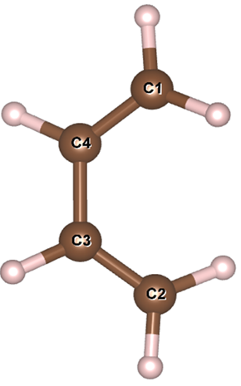
Coupling between normal modes
Anharmonic frequency calculation:
Mode 1 | Index | Cubic force constant(aJ⋅amu^{−3/2}⋅ A^{˚−3})
 | Mode 11 | -0.084
 | Mode 14 | 0.093
 | Mode 17 | 0.121
 | Mode 22 | -0.880
 | Mode 24 | 0.245
s-cis-butadiene
p(GPa) | Frequency (cm⁻¹)
0 | 162
1.0 | 152
1.6 | 155
2.7 | 151
4.5 | 155
6.1 | 142
Mode 1
Harmonic oscillation approximation

Slide 26
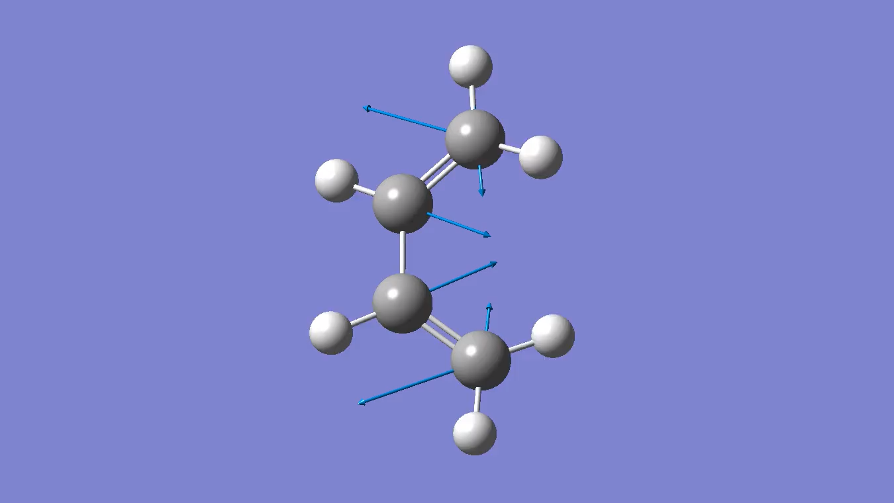
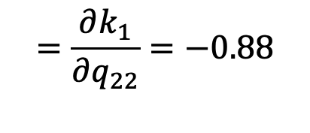
force constant
Cubic force constant:
$$=\frac{∂k_{1}}{∂q_{22}}=−0.88$$
Displacement of mode 22
Under pressure, all C-H becomes shorter, meaning a positive change of q₂₂.
With the negative coupling constant, the frequency of of mode 1 should decrease.
Compression shortens C-H bonds, making the steric congestion around the rotation C-C bonds smaller and leading to easier rotation.
Mode 1
Mode 22

Slide 27
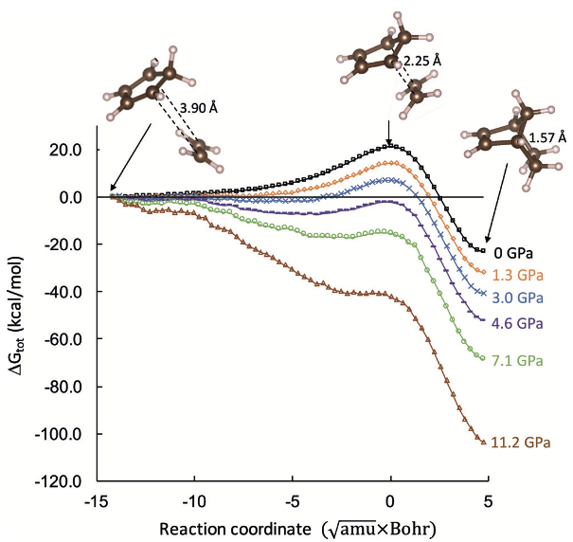
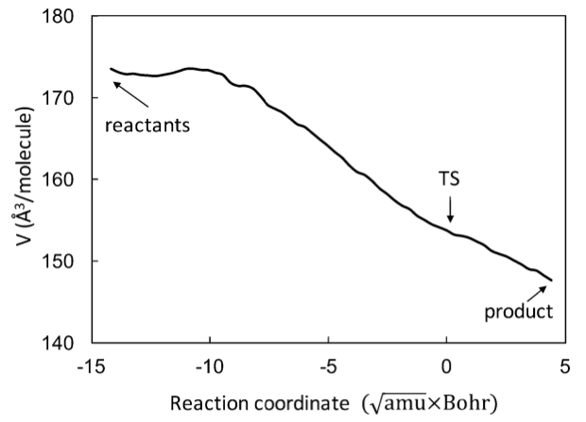
D-A reaction
Barrier decreasing with increasing pressure
Excellent correlation between the volume and energy profiles
Energy profile
Volume profile
Angew. Chem. Int. Ed. 2017, 56, 11126–11142

Slide 28

Butadiene + tetrafluoroethylene
Mohammed Loukili
Competition between [4+2] and [2+2]
1
3
gas phase
2
1
4
1
2
3
2
4
4
3
Science 1968, 159 (3817), 833–838
J. Am. Chem. Soc. 1949, 71 (2), 490–496
J. Fluor. Chem. 1993, 63 (1–2), 69–84

Slide 29
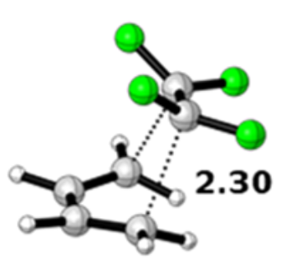
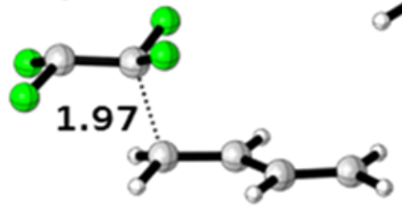
Competing paths
F
F
F
176 Å³
184 Å³
F
Concerted [4+2]: 27 kcal/mol
Stepwise: 23 kcal/mol
Higher barrier
Smaller volume
Lower barrier
larger volume
J. Am. Chem. Soc. 1991, 113 (11), 4334–4335
J. Org. Chem. 2020, 85 (5), 3858–3864
B3LYP/6-311++G(d,p)

Slide 30
Reaction barriers at high pressures
Prediction of a switch of the favored path at 1.4 GPa
XPPCM at B3LYP/6-311++G(d,p)
J. Org. Chem. 2024, 89, 17768-17772.

Slide 31

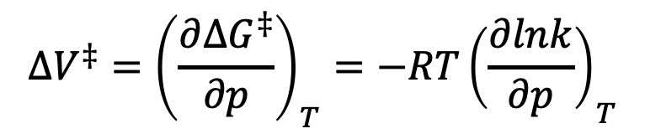














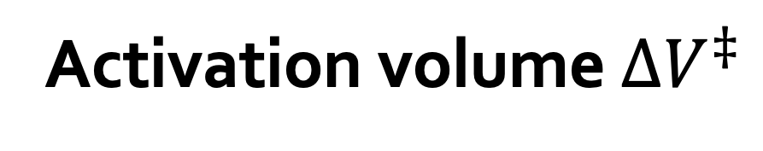











Activation volume $∆V^{‡}$
Reactant
Transition state
Product
$$V_{r}$$
$$V_{TS}$$
$$V_{P}$$
Gibbs energy of activation
Rate constant
$$∆V^{‡}={\left(\frac{∂∆G^{‡}}{∂p}\right)}_{T}=−{RT\left(\frac{∂lnk}{∂p}\right)}_{T}$$
$$∆V^{‡}=V_{TS}−V_{r}$$

Slide 32
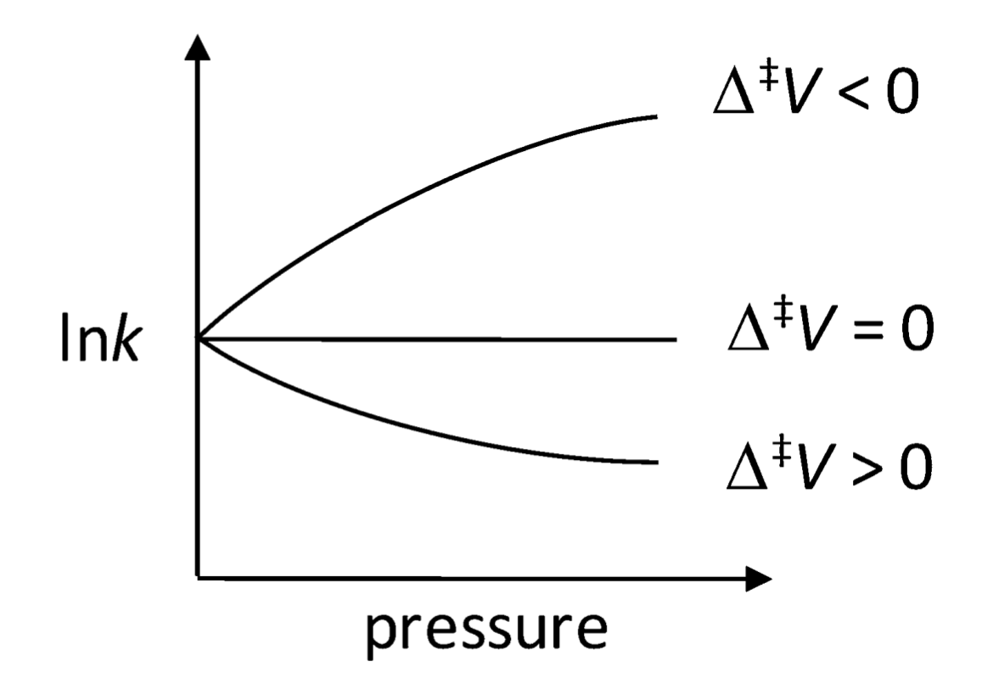
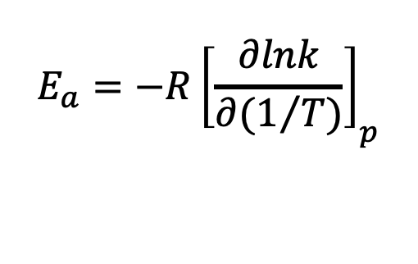
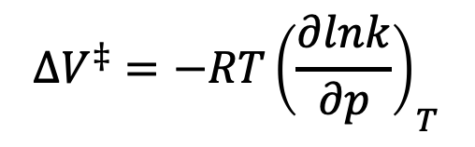
Activation energy vs Activation volume
$$E_{a}=−{R\left[\frac{∂lnk}{∂(1/T)}\right]}_{p}$$
$$∆V^{‡}=−{RT\left(\frac{∂lnk}{∂p}\right)}_{T}$$
Arrhenius plot
E_{a} > 0

Slide 33
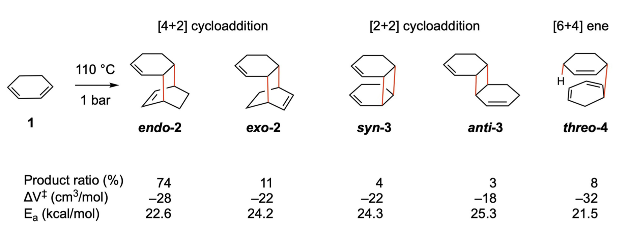
Accurate activation volume calculation
Experiment:
Klärner et. al. Angew. Chem. Int. Ed. 1986, 25, 108-110
Calculation:
Concerted
–28
–28
–32
Stepwise
–21
–21
–21
–21
–21

Slide 34
Activation volume
cm³/mol
–21
–28
–32
Increasing facial overlap
Decreasing volume of the TS
Increasing activation volume

Slide 35
Conclusions
XP-PCM introduces pressure in electronic structure calculation by compressing the electron cloud of the molecule using a repulsive potential.
XP-PCM enables computational organic chemistry under high pressure!

