Slide 1






Theoretical and Experimental Investigation of Ag and Pt-decorated In₂O₃ Gas Sensors
MSc. Gustavo Sanghikian Marques dos Santos (Unesp / UJI)
Supervisors:
Prof. Dr. Diogo Paschoalini Volanti (Unesp – Brazil)
Prof. Dr. Juan Manuel Andrés Bort (UJI – Spain)

Slide 2

Academic Background
São Paulo State University (Unesp – Brazil)
2018 – 2022: Bachelor’s degree in Chemistry
2022 – 2023: Master’s degree in Chemistry
October/2023 – now: PhD Student in Chemistry
Research focused on the synthesis, characterization, and application of semiconducting metal oxides for gas sensing applications (ZnO, Co₃O₄, In₂O₃...).

Slide 3

Academic Background
São Paulo State University (Unesp)
Institute of Biosciences, Humanities and Exact Sciences (IBILCE) – São José do Rio Preto, SP - Brazil

Slide 4
Academic Background
Laboratory of Materials for Sustainability (LabMatSus), led by Prof. Dr. Diogo Paschoalini Volanti

Slide 5

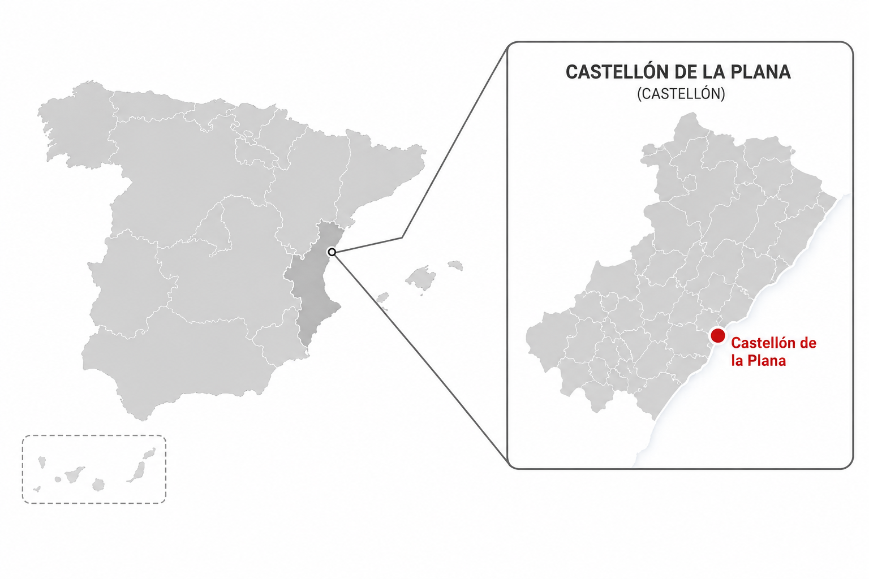

Academic Background
Theoretical and Computational Chemistry (QTC), led by Prof. Dr. Juan Manuel Andrés Bort

Slide 6

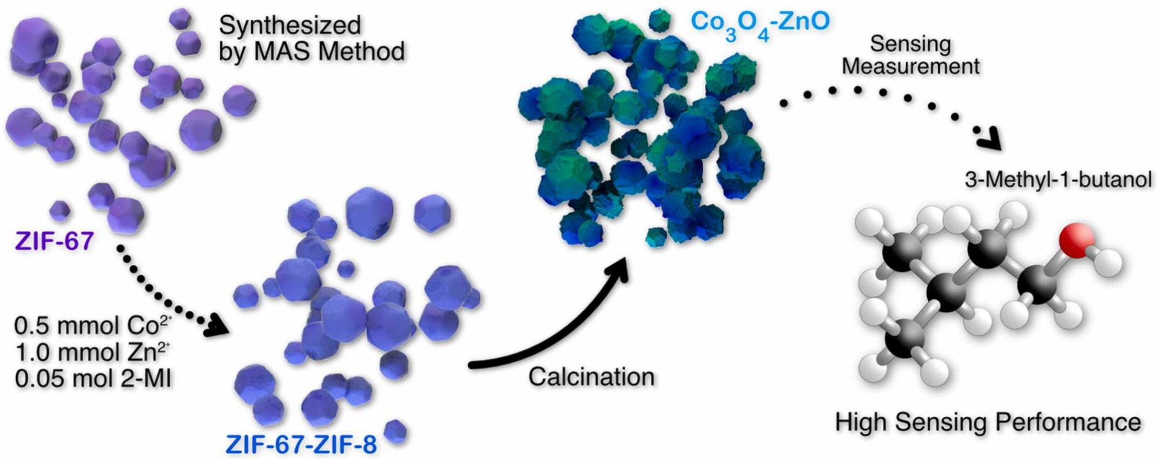
Published Works
[1] Gustavo S.M. Santos, Bruna S. de Sá, Tarcísio M. Perfecto, Diogo P. Volanti, MOF-derived Co₃O₄-ZnO heterostructure for 3-methyl-1-butanol detection, Sensors and Actuators B: Chemical, Volume 408, 2024, 135533, ISSN 0925 4005, https://doi.org/10.1016/j.snb.2024.135533.
Source: Santos et al. 2024 [1]

Slide 7


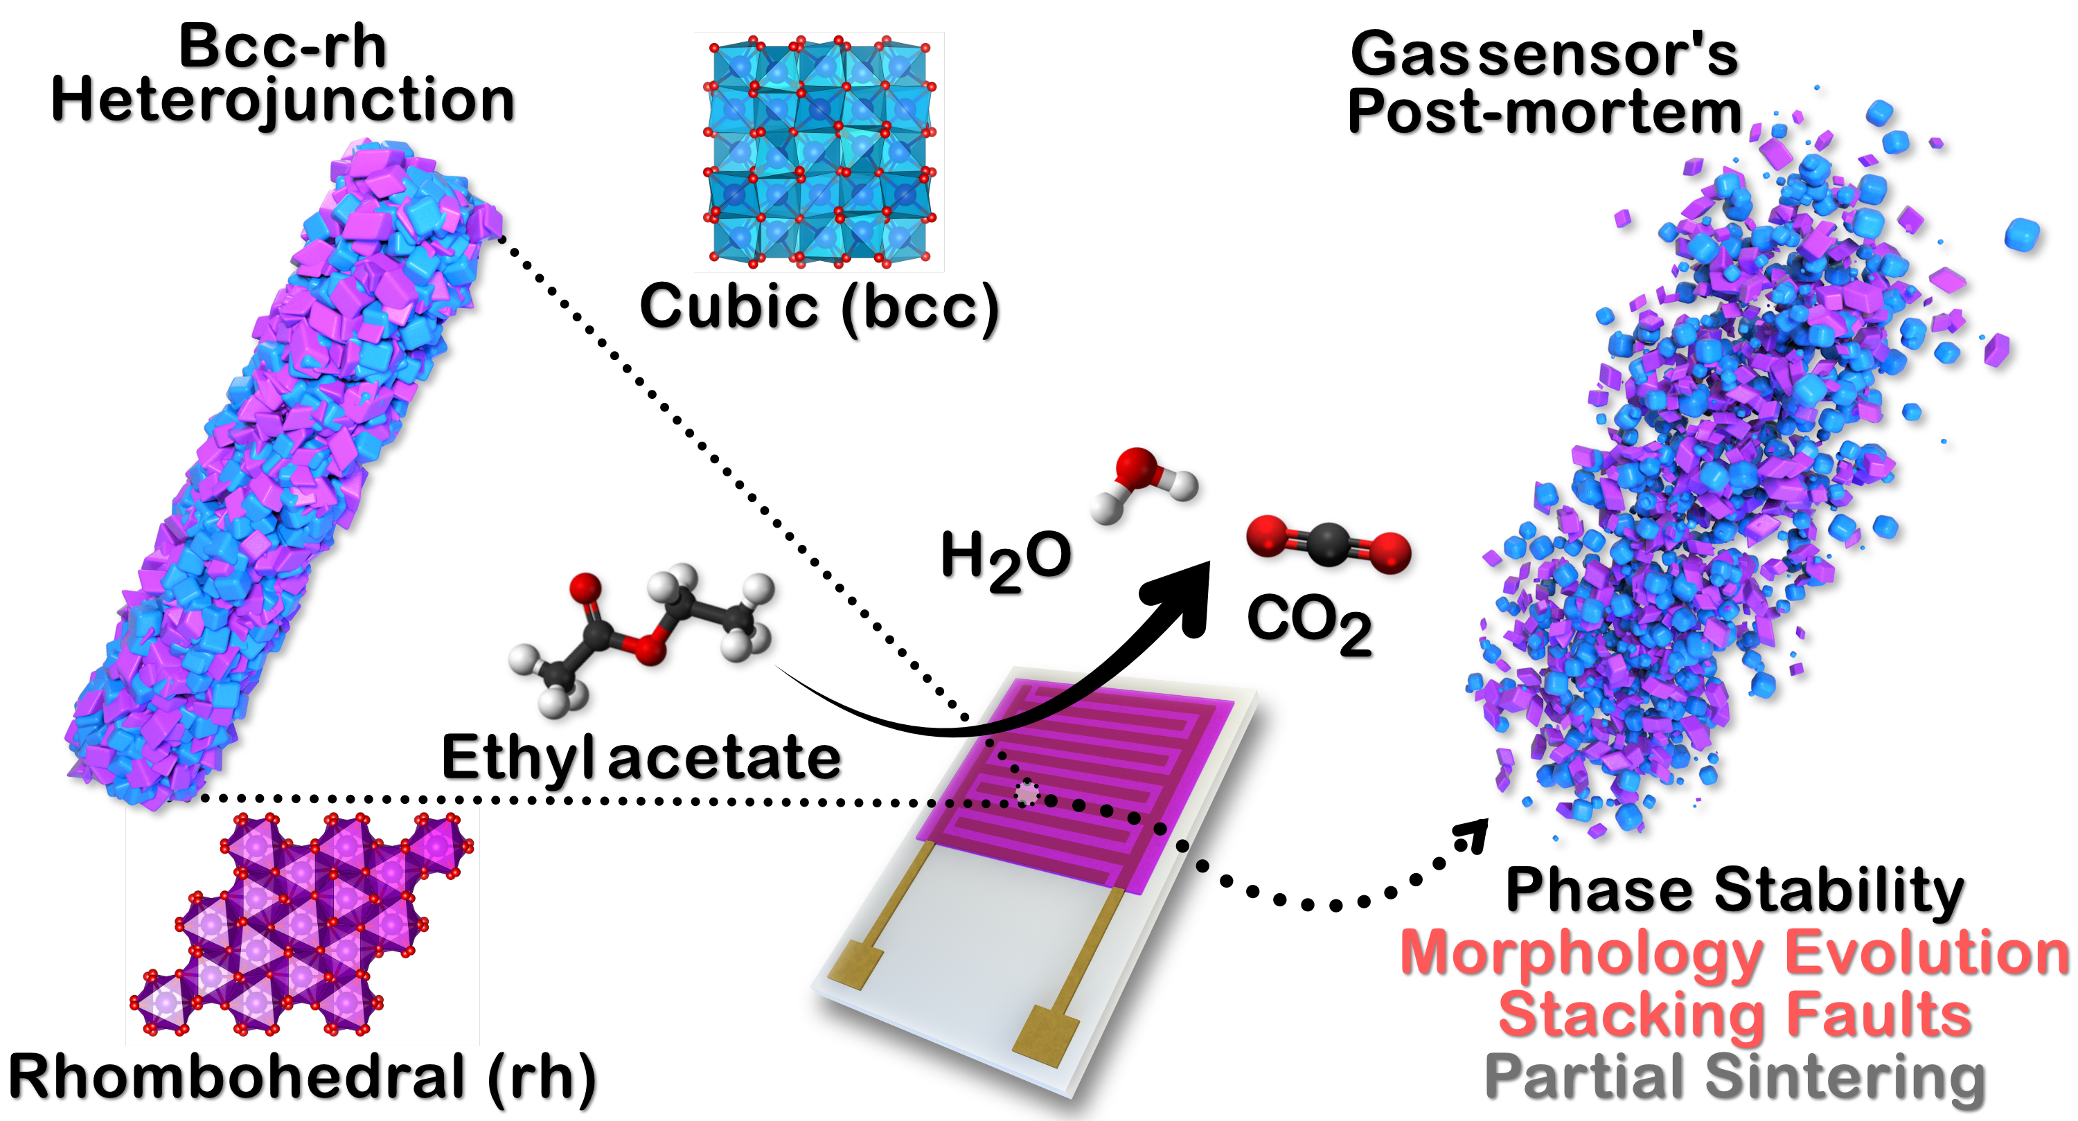
Published Works
Front Cover feature in ACS Applied Nano Materials
June 6, 2025 – Vol. 8, N. 22
[2] Gustavo Sanghikian Marques dos Santos, Reinaldo dos Santos Theodoro, Gabriela Oliveira Gera, Tarcísio Micheli Perfecto, and Diogo Paschoalini Volanti. Ethyl Acetate Detection Using Mixed-Phase In₂O₃ Nanorods ACS Applied Nano Materials 2025 8 (22), 11458-11469 DOI: 10.1021/acsanm.5c01487
Santos et al., ACS Applied Nano Materials, 2025.

Slide 8
Published Works
Ethyl Acetate Detection Using Mixed-Phase In₂O₃ Nanorods

Slide 9
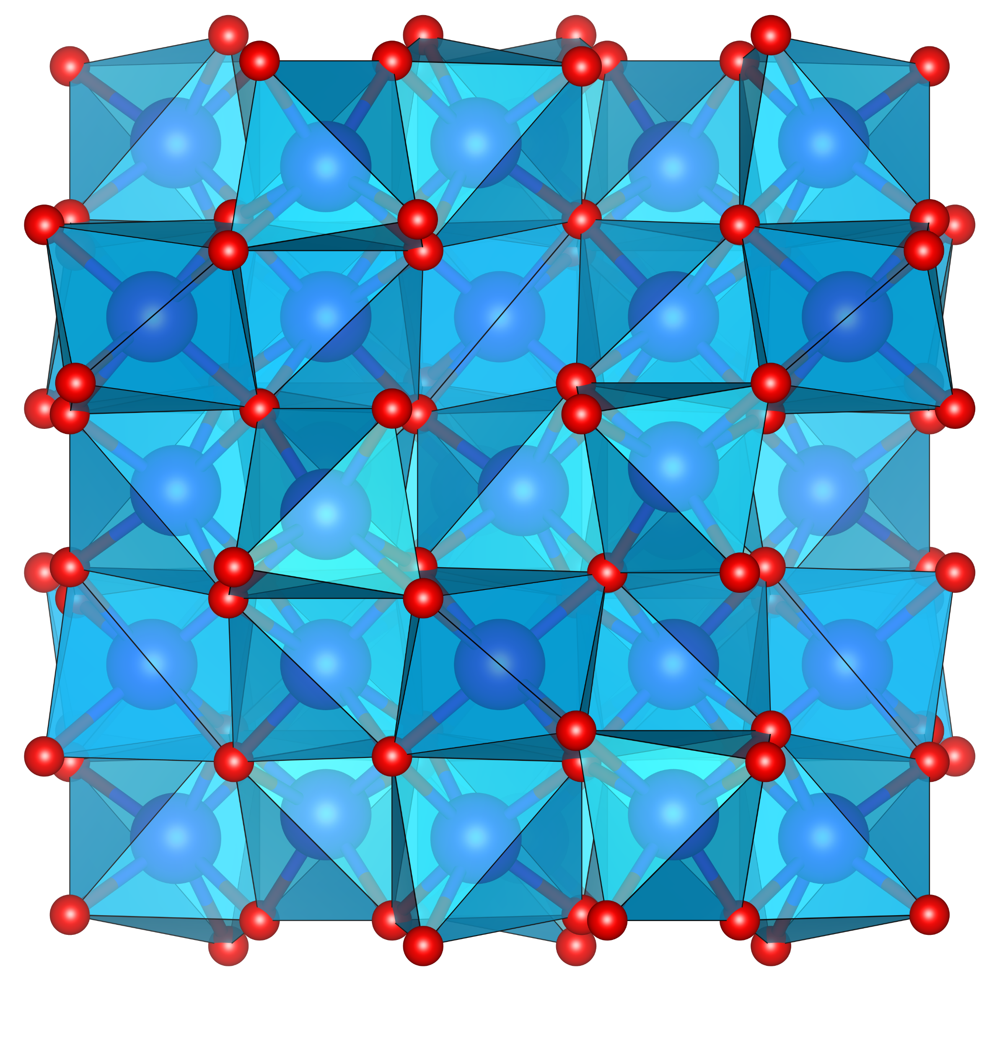
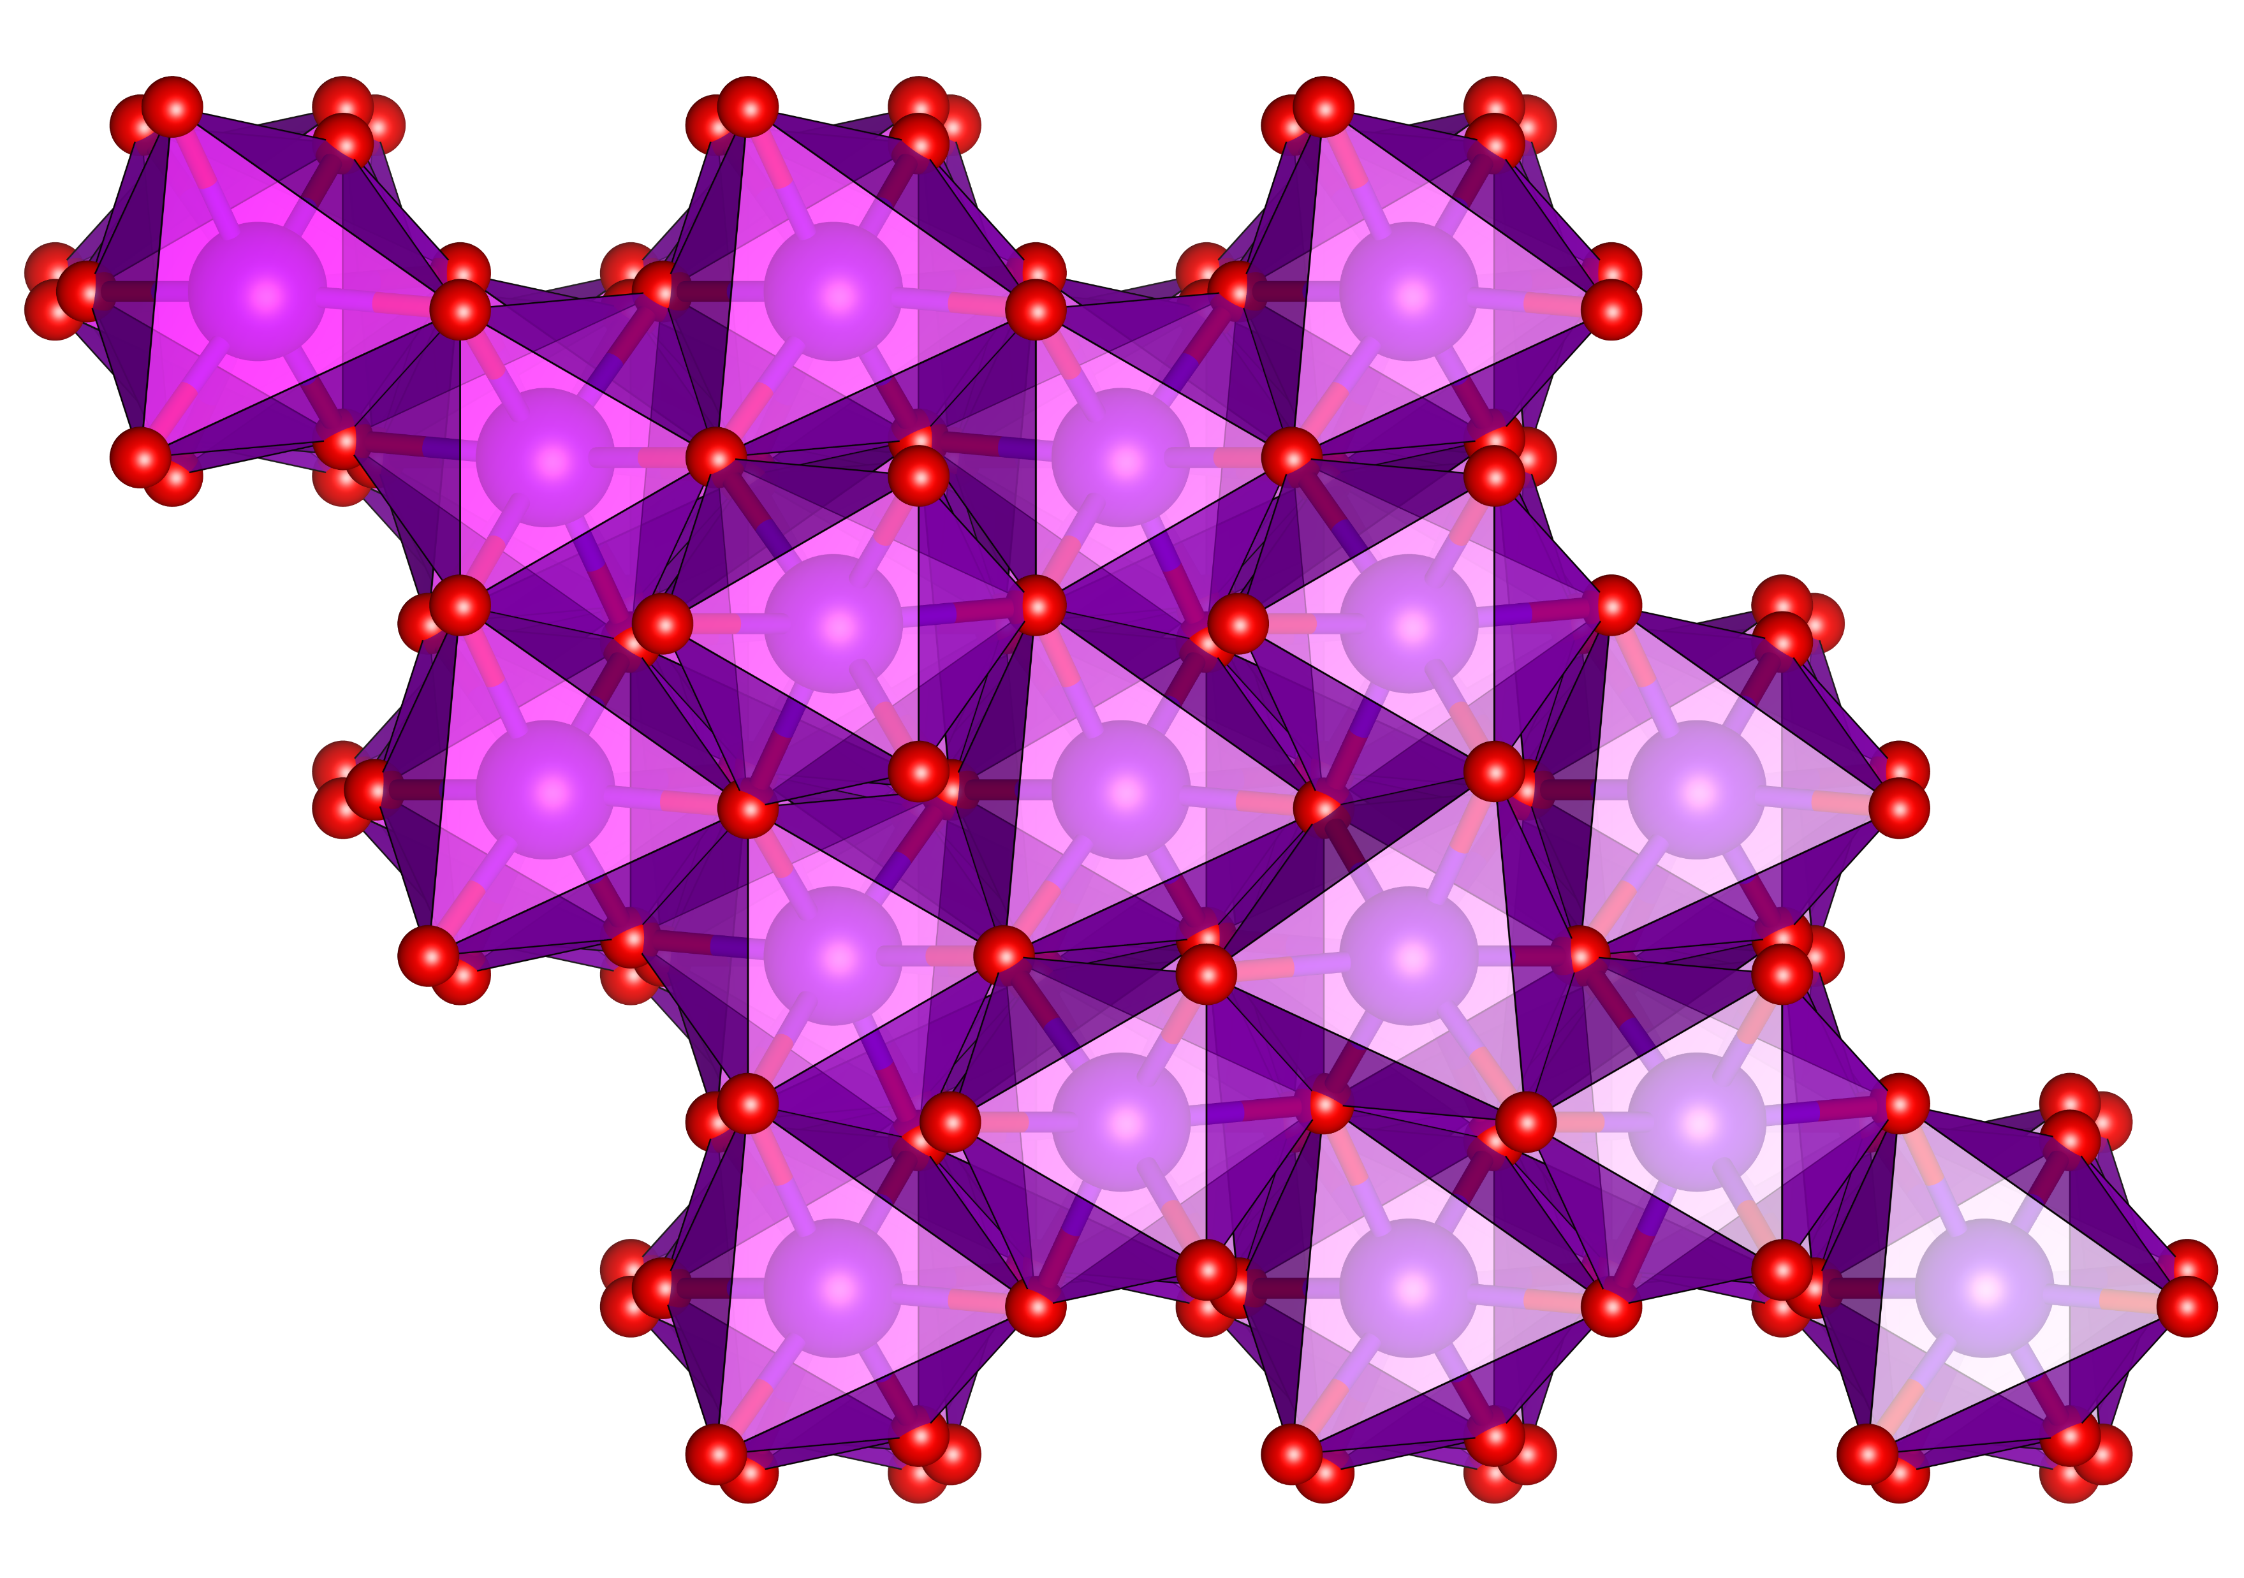
Published Works
Indium(III) oxide is an n-type SMO with a high band gap, excellent electrical conductivity, and strong adsorption of gaseous molecules;
It is widely employed in liquid crystal devices, solar cells, and gas sensors;
The stable crystal phase is the cubic bixbyite-type (bcc-In₂O₃ , E_{g} = 2.93 ± 0.15 eV), while the metastable is the rhombohedral corundum-type (rh-In₂O₃ , E_{g} = 3.02 ± 0.15 eV) (Li et al., 2014).
Indium(III) oxide
cubic bixbyite-type
(bcc-In₂O₃)
Rhombohedral corundum-type
(rh-In₂O₃)
9

Slide 10
Published Works
Santos et al., ACS Applied Nano Materials, 2025.

Slide 11
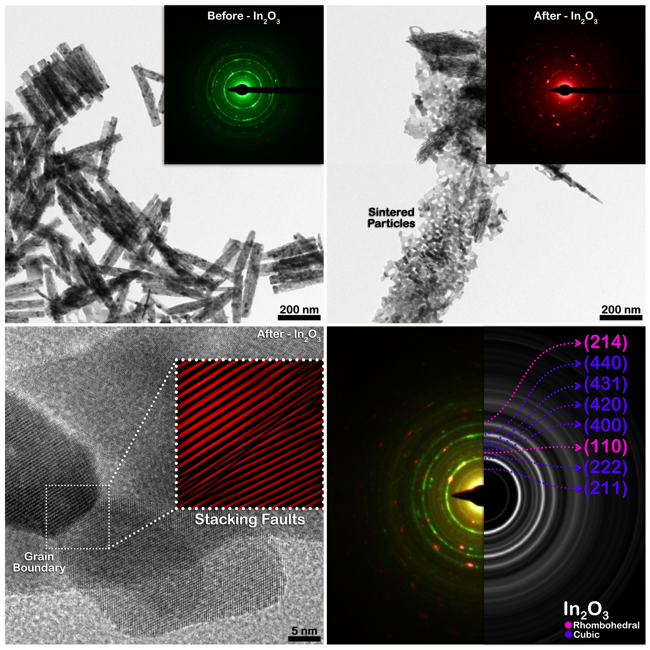
Published Works
Santos et al., ACS Applied Nano Materials, 2025.

Slide 12
Published Works
In₂O₃-500 showed the best ethyl acetate sensing performance, with a maximum response of 548 at 350 °C, much higher than the other samples.
The material also exhibited high selectivity, fast response time (1.8 s), and stable detection over 2–500 ppm concentrations.
A low theoretical detection limit of ~525 ppb was estimated from linear regression analysis.
The enhanced sensing behavior is attributed to the bcc–rh heterostructure and heterojunction effect.
Santos et al., ACS Applied Nano Materials, 2025.

Slide 13
Published Works
High sensitivity and selectivity toward ethyl acetate with a response of 548 to 100 ppm at 350 °C.
Fast response time (1.8 s), good repeatability, and potential applicability for ethyl acetate monitoring.
High operating temperatures (300-350 °C), limiting practical applications.
Long recovery time (1748.2 s).
Humidity significantly reduced the sensing performance.

Slide 14
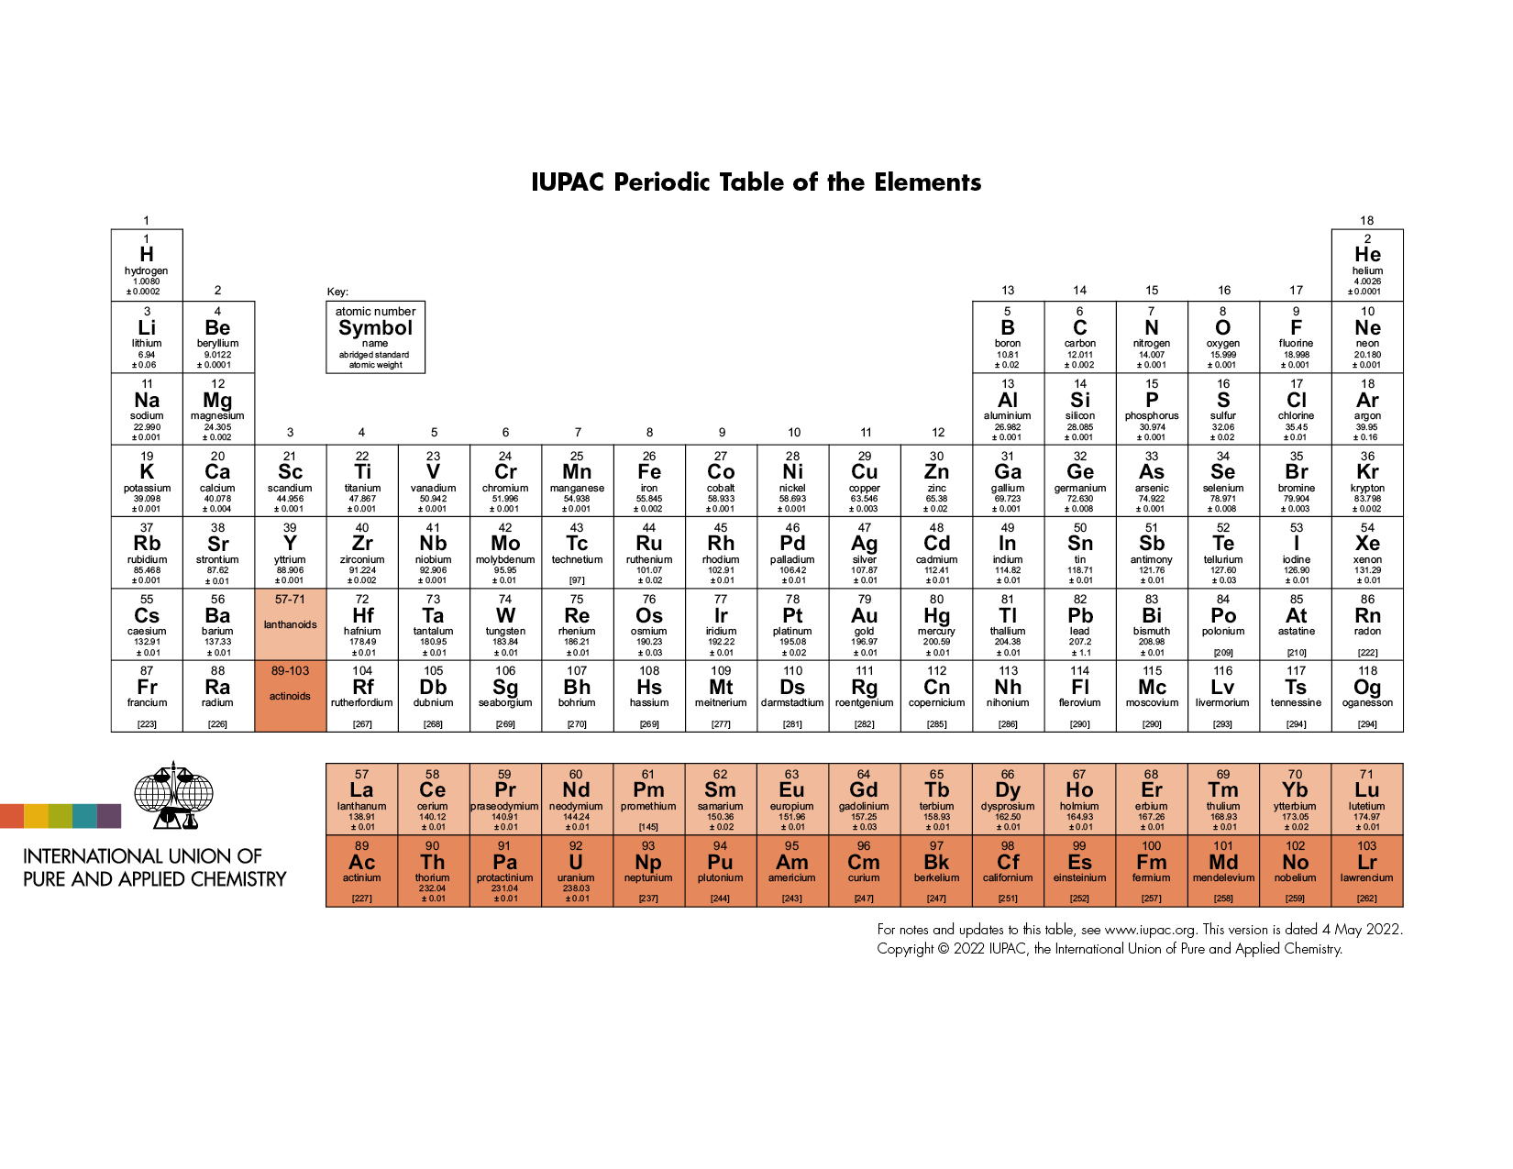
The deposition of noble metal nanoparticles strategy:
Noble metal nanoparticles (Ag, Pt, Pd, Au) enhance oxygen adsorption on the In₂O₃ surface, improving gas sensing performance.
Through the spillover effect, oxygen molecules dissociate into O⁻ species and spread across the surface, creating more active sites and electronic defects, and enabling better sensor response at lower operating temperatures.

Slide 15
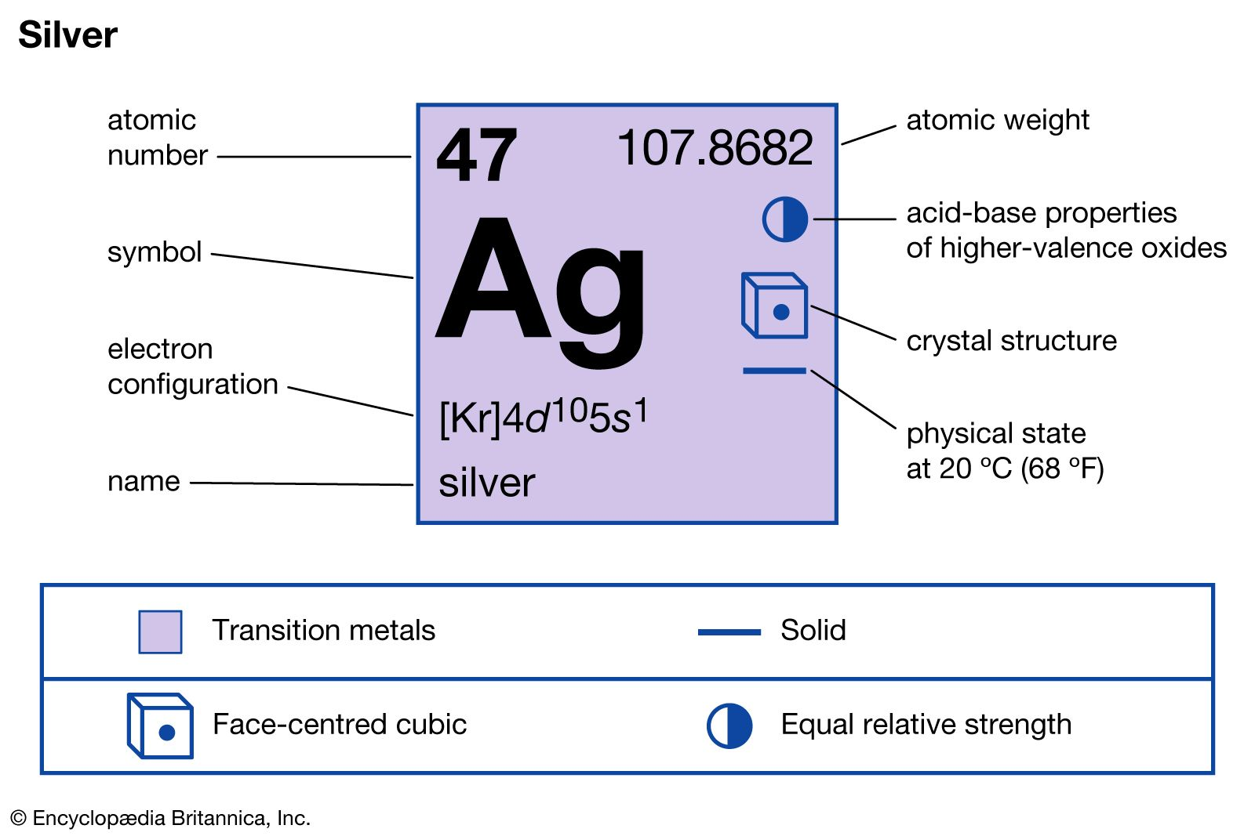
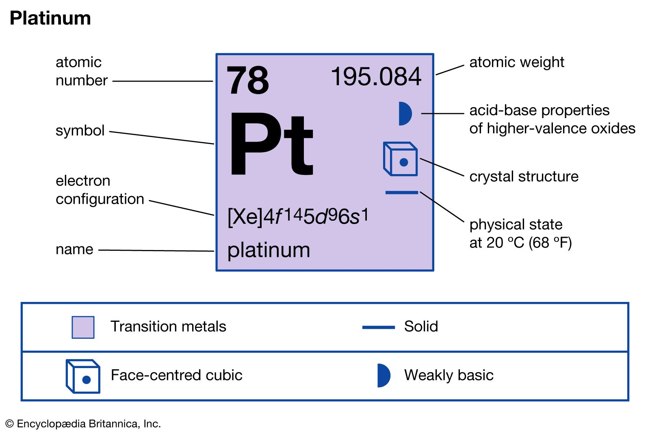
Source: Encyclopaedia Britannica

Slide 16
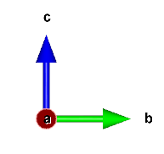
Ongoing Research Activities
Surface Modelling of Cubic In₂O₃
(222)
(222)
(222)
In₄₈O₇₂
In₆₄O₉₆
In₈₀O₁₂₀
(211)
(111)
In₆₀O₉₀
In₉₆O₁₄₄
Structures obtained from Materials Project and optimized using CRYSTAL.

Slide 17
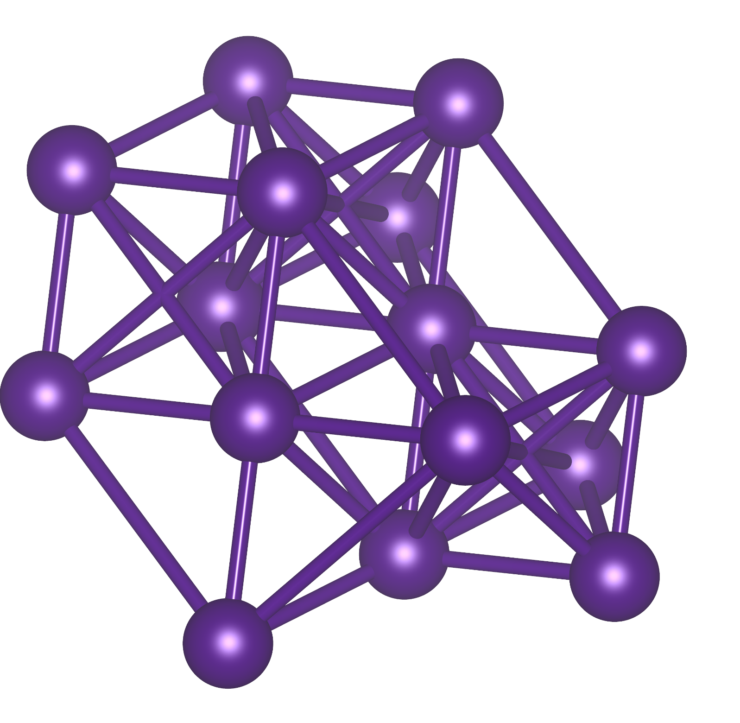
Ongoing Research Activities
Ag and Pt Loading Simulation on the In₂O₃ Surface
Pt loading
Ag loading
In₂O₃ surface
Structures obtained from Materials Project and optimized using CRYSTAL.

Slide 18
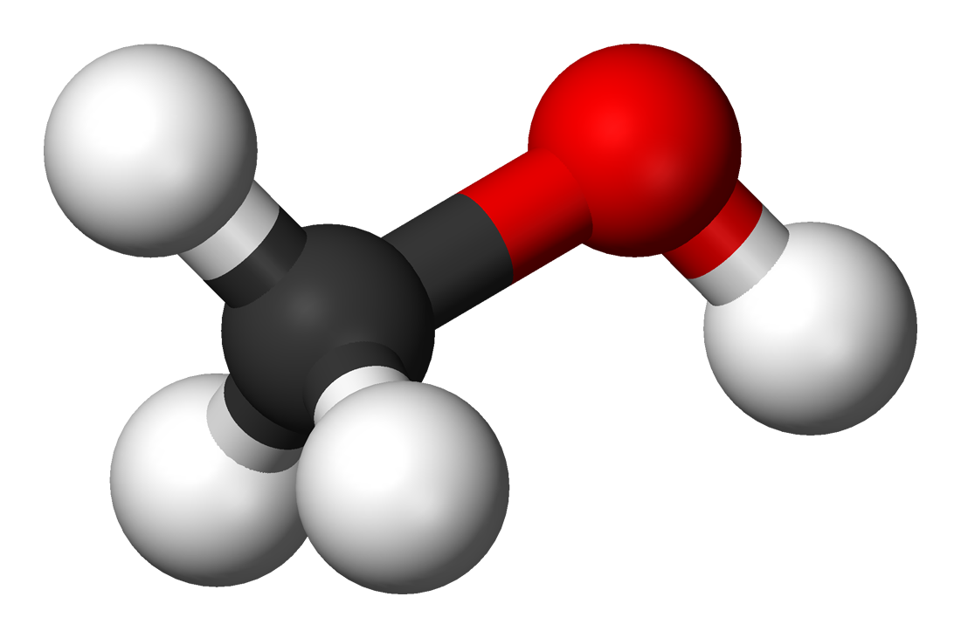
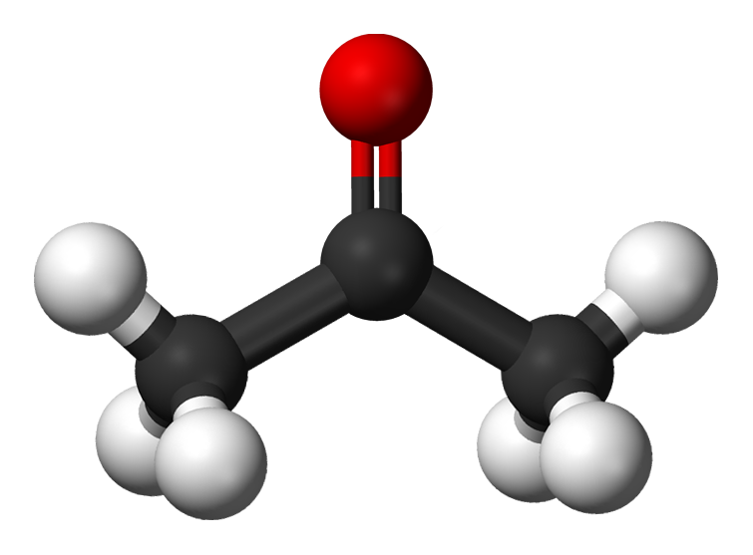
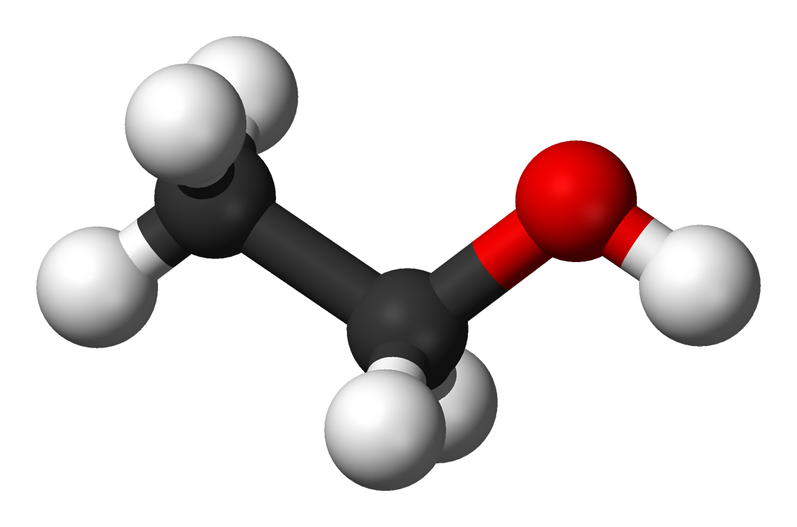
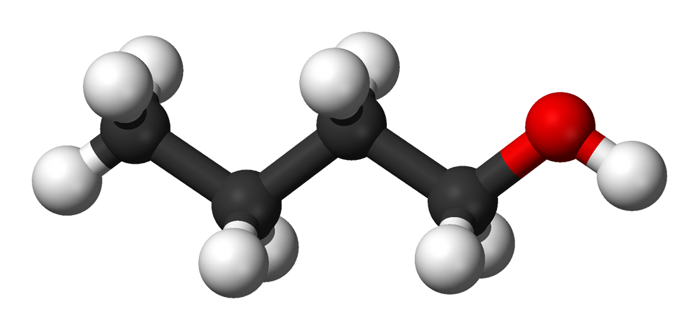
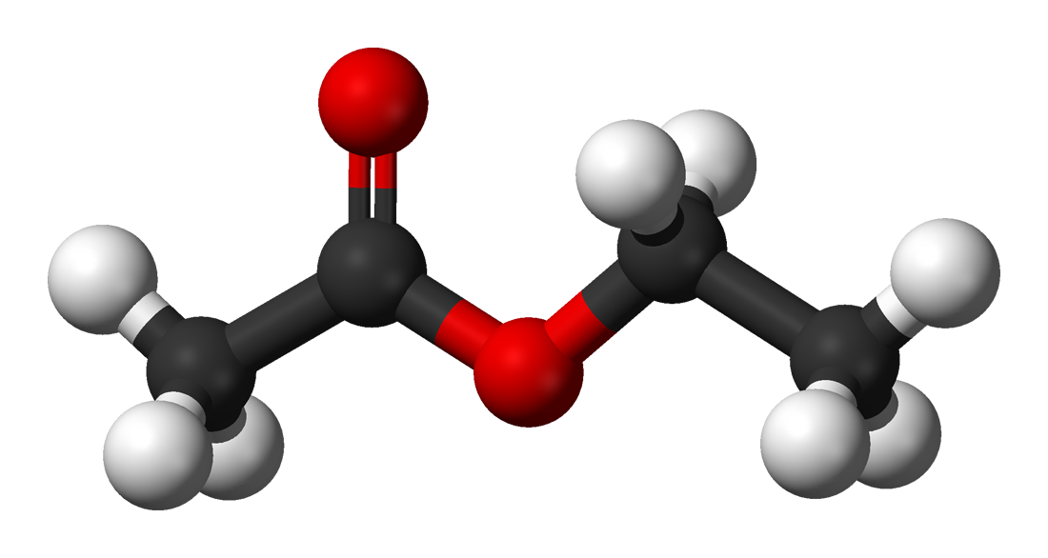
Ongoing Research Activities
Adsorption energy calculations of different mVOCs
In₂O₃ surface
E_{ads} ​= E_{surface}+_{gas}​− E_{surface}​− E_{gas}​
Structures obtained from Materials Project and optimized using CRYSTAL.

Slide 19


Final Remarks
Investigation of metal-decorated In₂O₃ heterostructures;
Advanced structural characterization (HRTEM, DRX, EPR);
Development of theoretical surface adsorption models;
Understanding gas sensing mechanisms at the atomic scale;
Combination of theoretical and experimental approaches regarding gas sensors, enabling the development of reliable point-of-care devices for early monitoring.

Slide 20
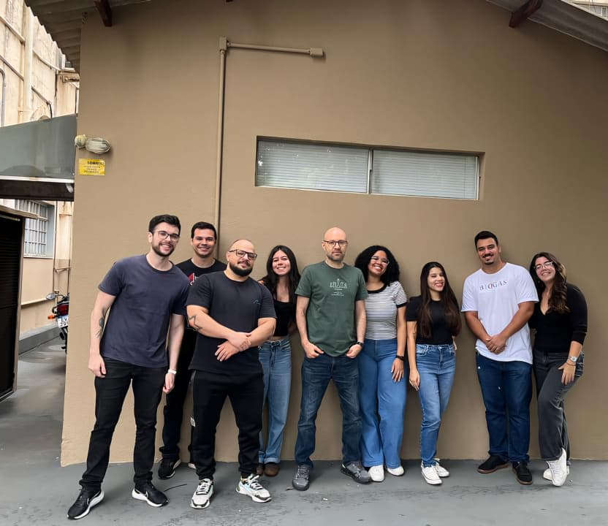
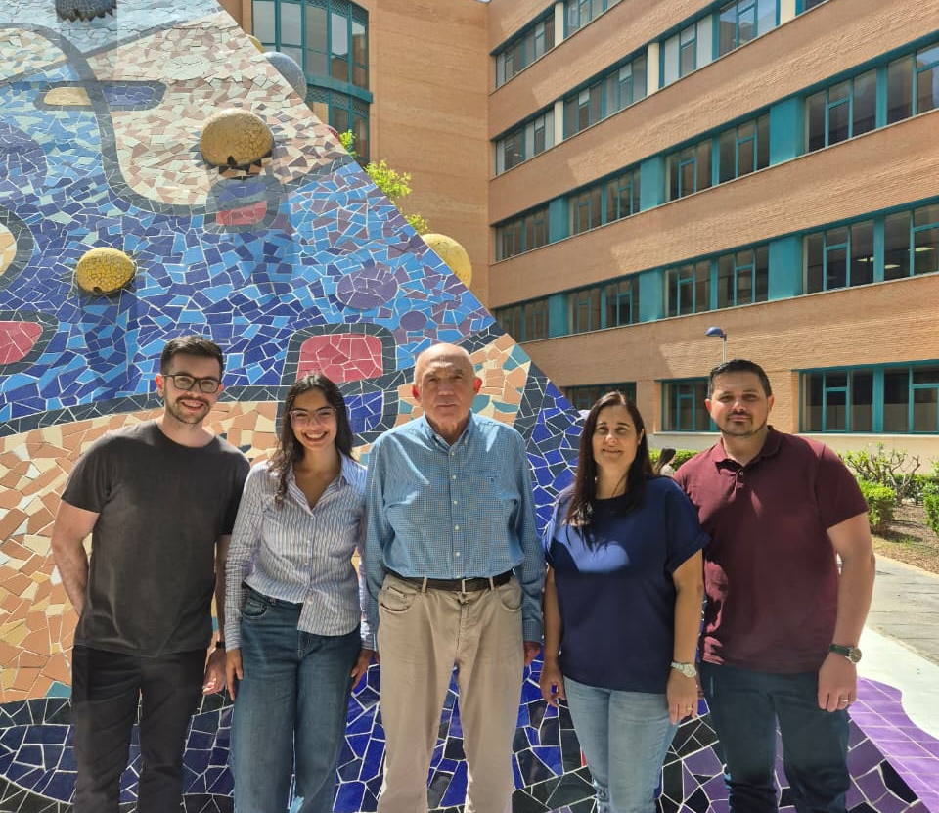
Acknowledgments
grants #2024/03388-4
#2025/23707-0

