Slide 1

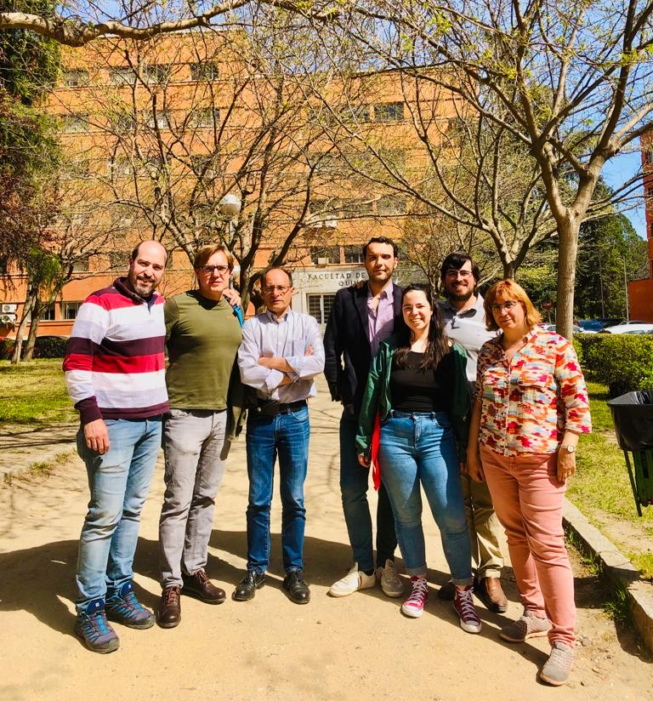

Universidad Complutense de Madrid Group
-Molecular systems
Carbon Based
Metal-Metal bonded
Cocrystals
H-Bonded Systems
-Solid State Materials
Energetic
Bidimensional
Geochemical
PDI
PhD
Álvaro Lobato
Javier Sánchez
Fernando Izquierdo
Irene Barba
Mercedes Taravillo
Valentín García
Paula Serrano
Miguel Morales
TFM
Experimental and Theoretical Group
Diego García

Slide 2
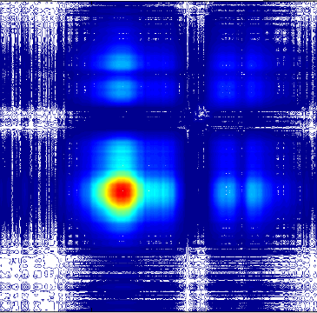
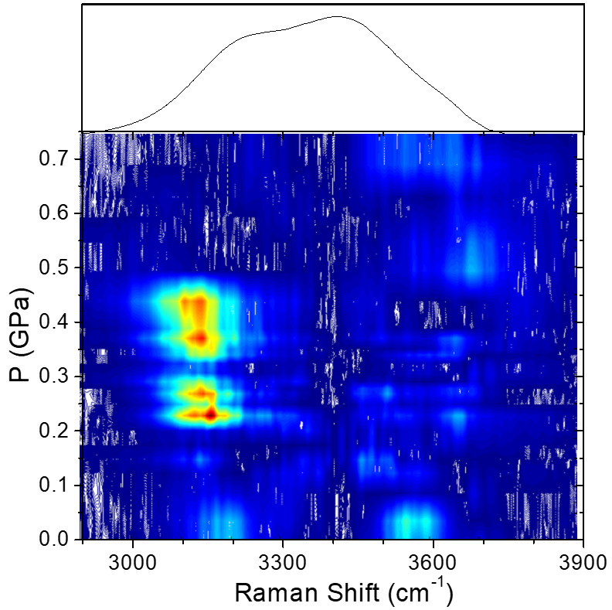
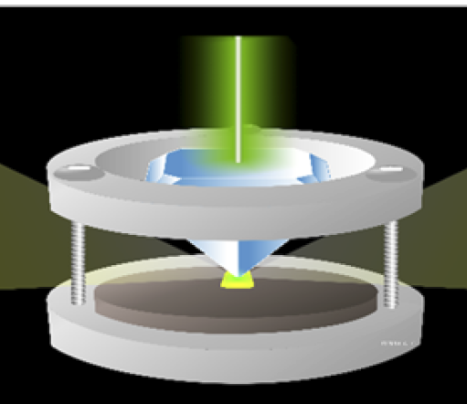

Experimental Developments and Capabilities
Raman Spectroscopy
High Pressure-High Temperature
Raman Mapping 2D-Correlation
Electrical Measurements
Uniaxial-Biaxial Experiments
Raman Bidimensional Spectroscopy
Uniaxial-Biaxial Set up and RDAC

Slide 3
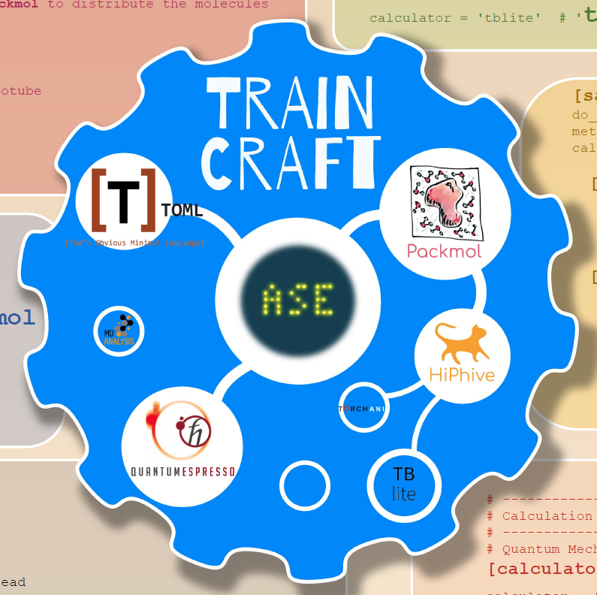
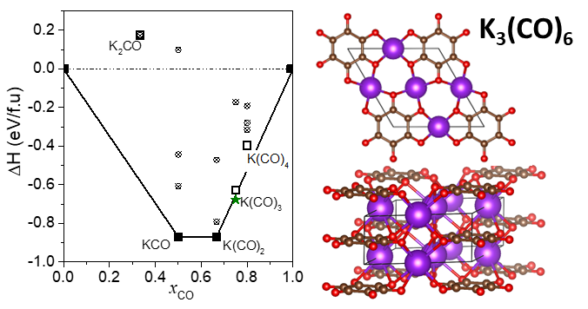
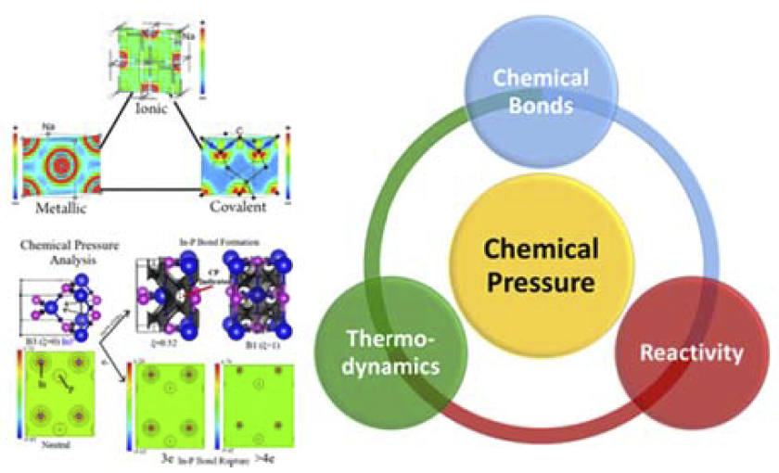
Theoretical Developments
ML Spectral Simulation
Chemical Pressure Analysis
Crystal Structure Prediction
Chemical Bonding
Pressure in Atoms and Molecules
Machine Learning
Molecular and Solid Structure Prediction
Chemical Pressure

Slide 4
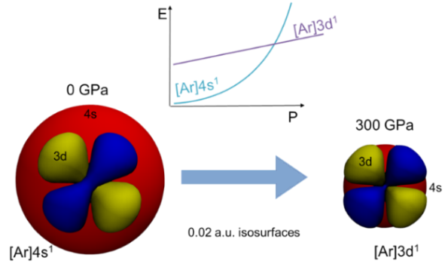
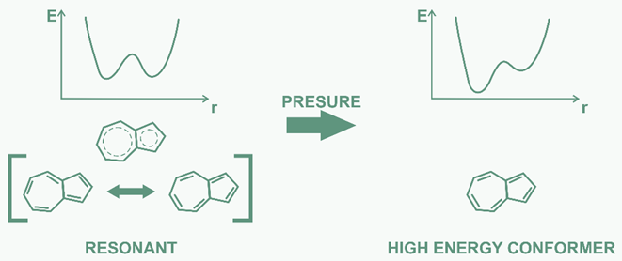
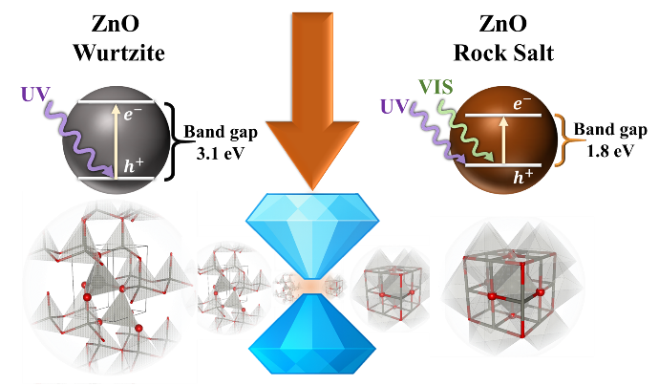
A Pressure Approach for Chemistry (APACHE)
WP1: Fundamental Electronic Control
Polary Inverted Bonds
A new transition Metal Chemistry
WP2: Molecular Level Modulation
Pressure-Modulated Acid–Base Organics
Access to High-Energy Resonance Forms
Pressure-Enabled Metal–Metal Bonding
WP3: Stress-directed metastability
Metastable Oxides via Axis-Selective Stress
Stress-Induced Metastability in Group IV

Slide 5
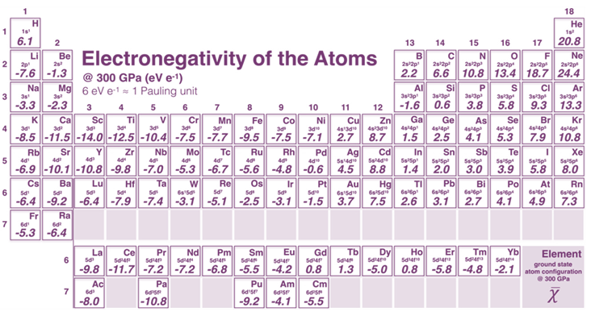
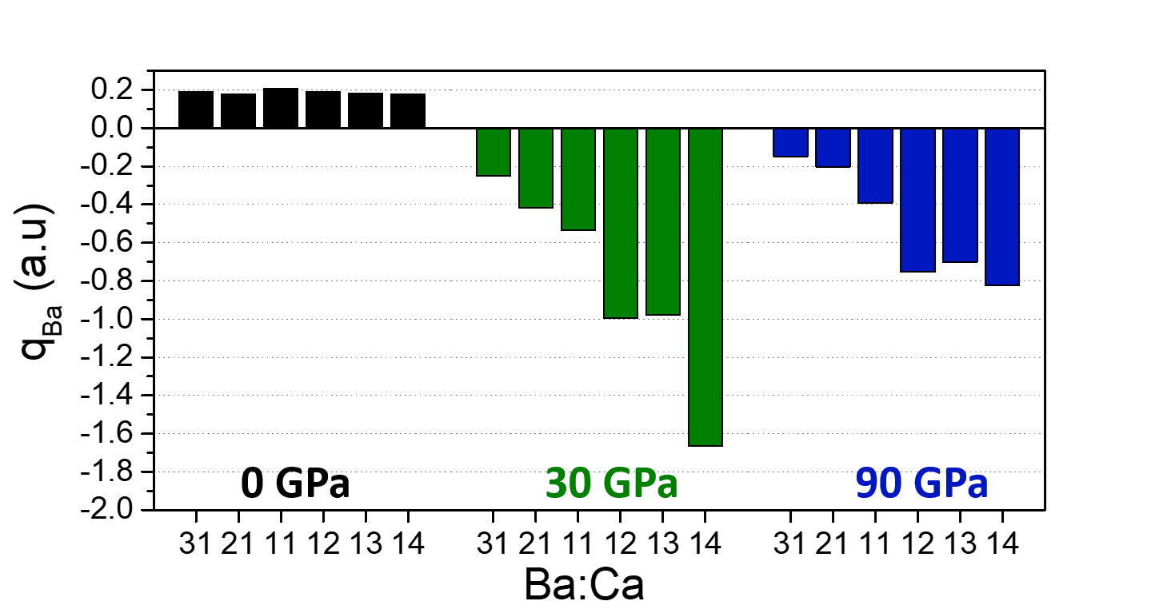
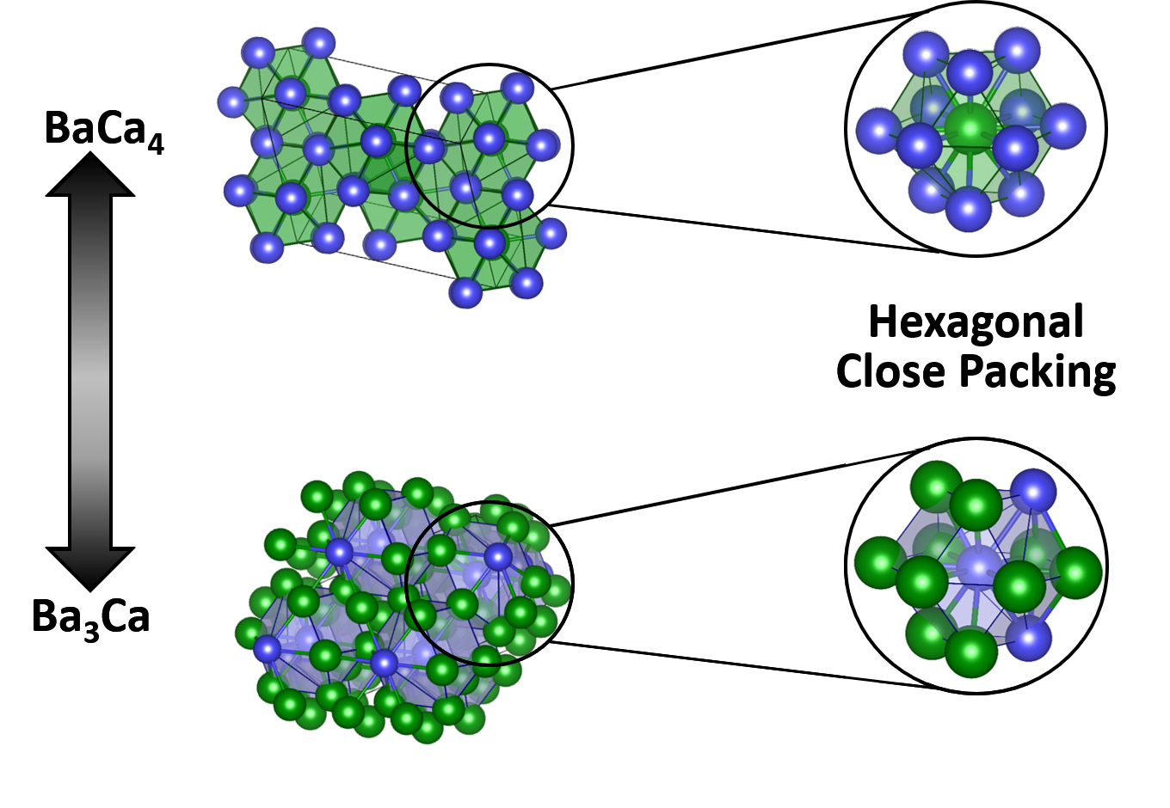
Fundamental Electronic Control

Slide 6
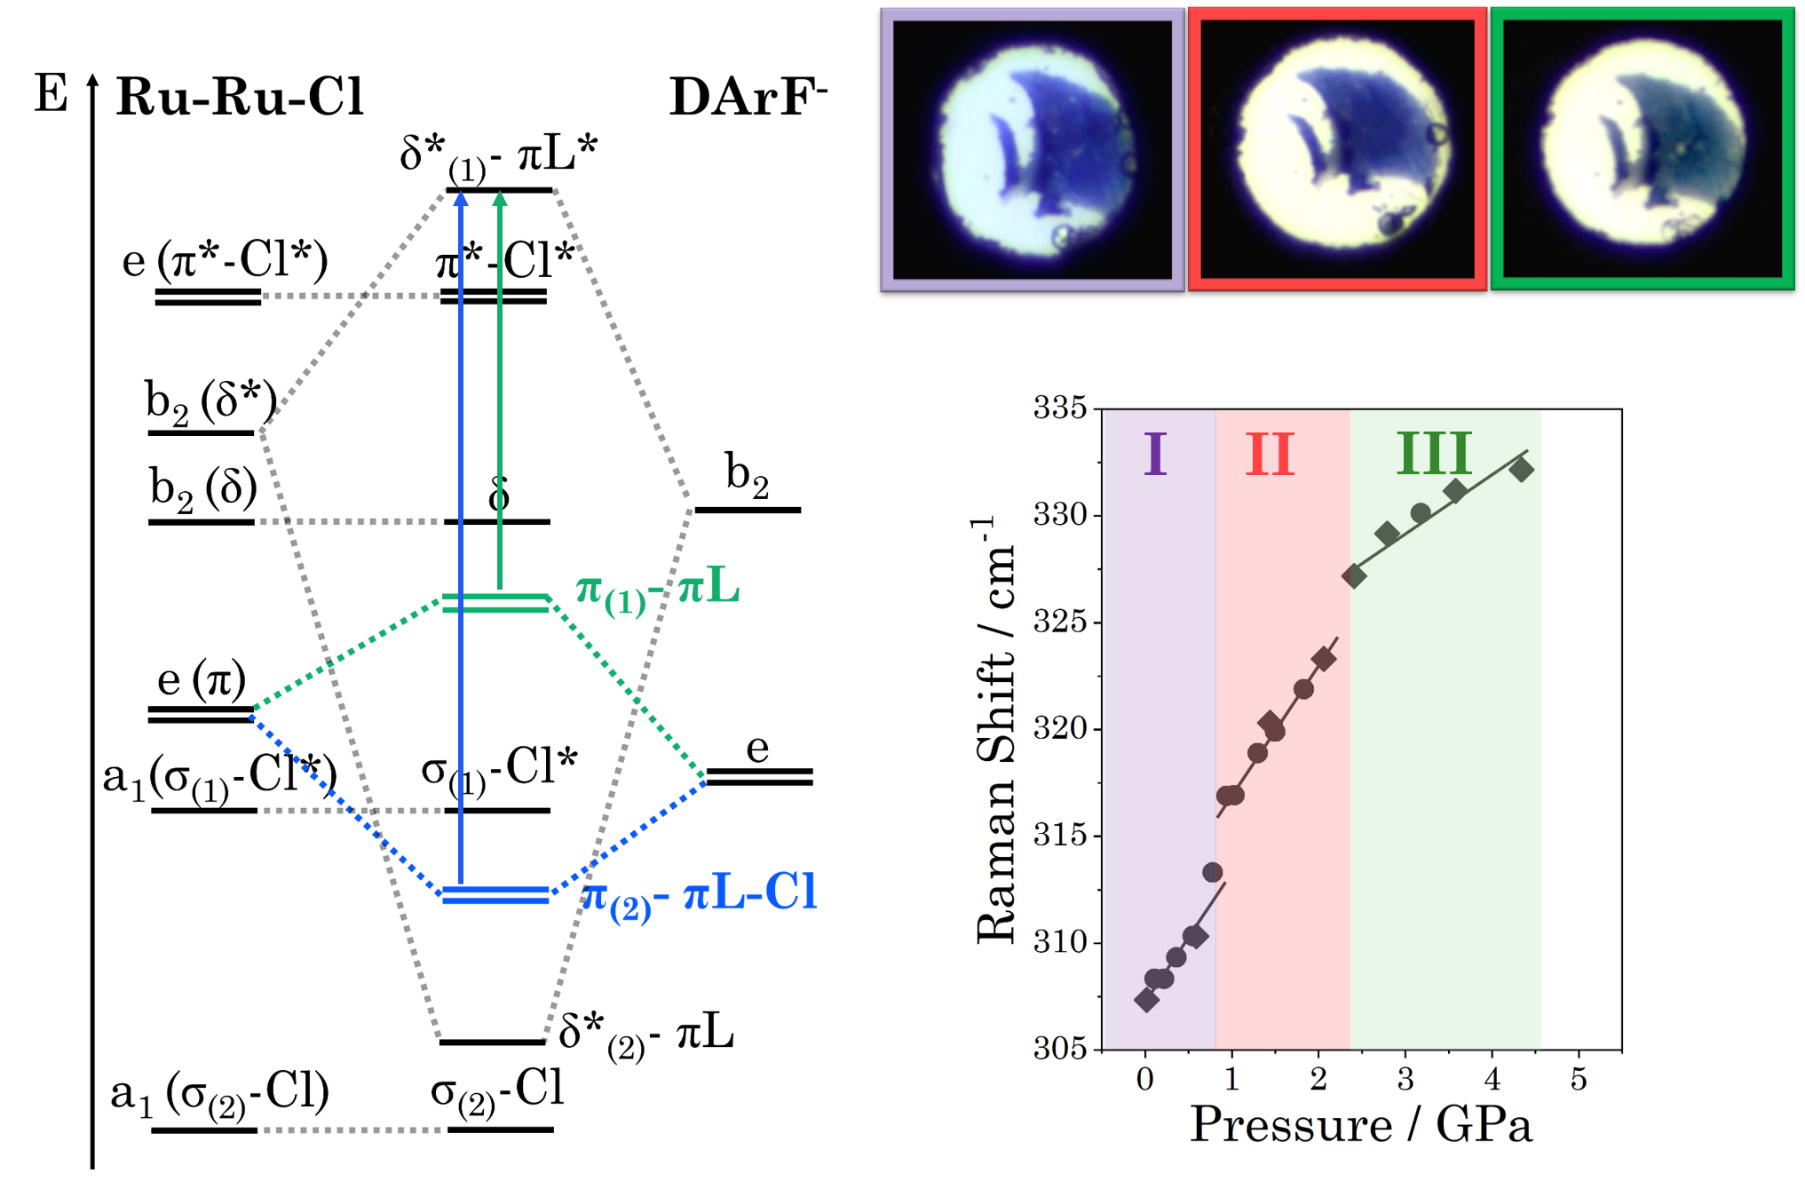
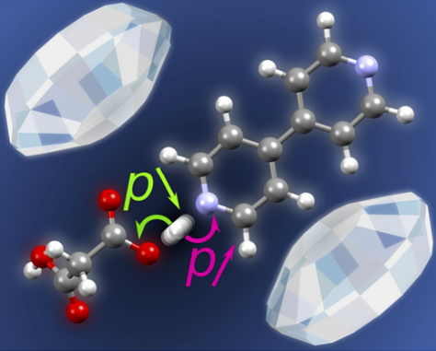
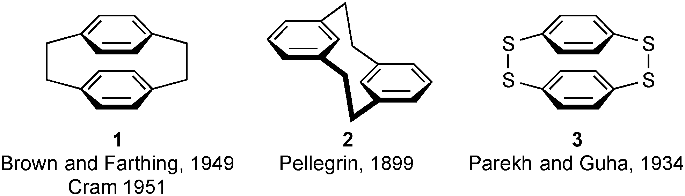
Molecular Level Modulation

Slide 7
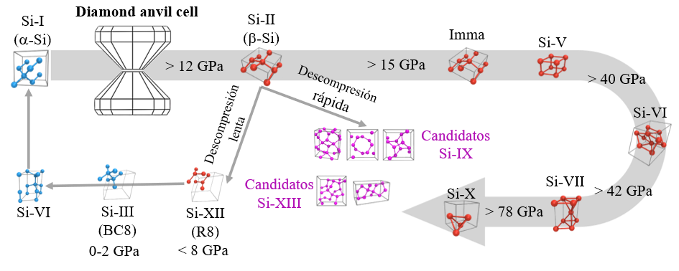
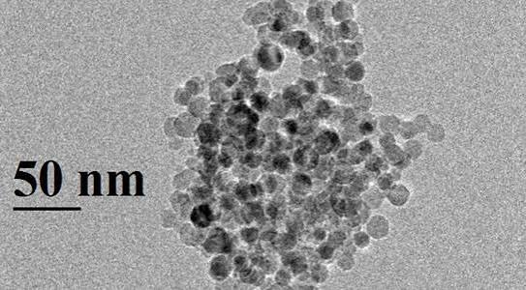
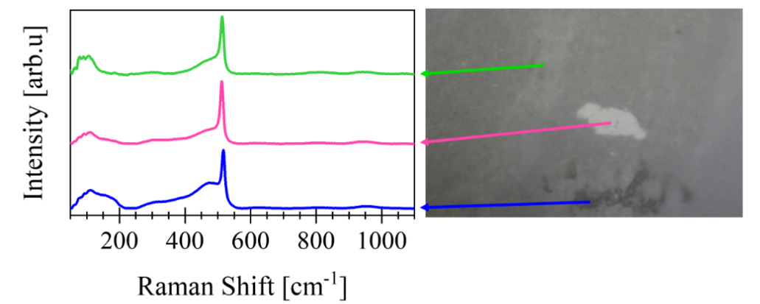
Stress-directed metastability

