Slide 1
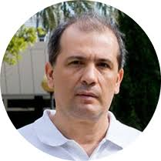

Daniel Errandonea – Universidad de Valencia - https://www.uv.es/~dae/
High-Pressure Physics and Materials Discovery
Research Topics
🔹 Materials Under Extreme Conditions
High-pressure and high-temperature studies using diamond-anvil cells and synchrotron techniques, Laser heating.
Structural, vibrational, and electronic characterization of solids under compression.
🔹 Pressure-Induced Structural Phase Transitions
Melting curve and pase diagram of metals
Mechanisms of crystal-structure transformations.
Equation of state, compressibility, metastability, and phase diagrams of materials.
🔹 Functional Oxides and Complex Inorganic Materials
Orthovanadates, tungstates, iodates, pyrochlores, scintillators, and related compounds.
Structure–property relationships under compression.
🔹 Electronic, Optical, and Vibrational Properties
Band-gap engineering, Raman spectroscopy, phonons, and luminescence under pressure.
Development of materials for photonics and energy applications.
🔹 Quantum Materials and High-Pressure
SuperconductivityTransition-metal dichalcogenides (TMDCs), layered semiconductors, and emerging quantum materials
Discovery of pressure-sensitive superconducting phases and their structural origins. Example: multiple superconducting states in HfS₂ up to 160 GPa.

Slide 2

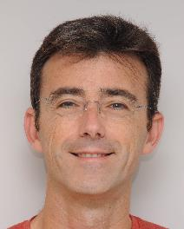
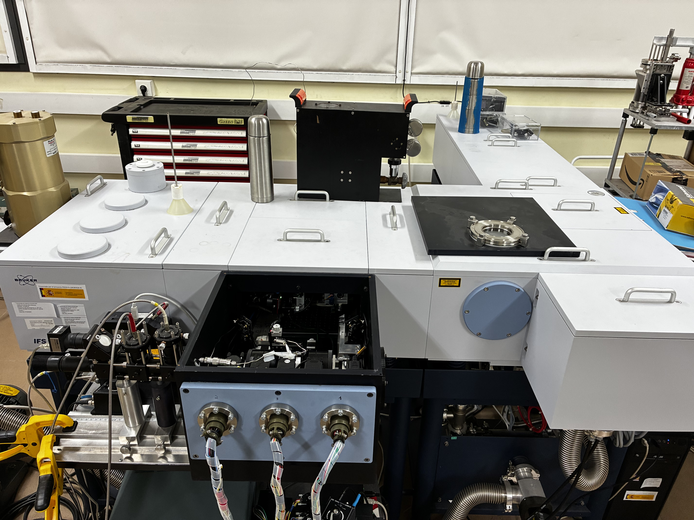

Julio Pelllicer Porres
Instituto de Ciencia de Materiales
Dpto. de Física Aplicada
Universidad de Valencia
Contacto: Julio.Pellicer@uv.es
- Materia bajo altas presiones
- Materiales : semiconductores, semiconductores laminares, óxidos transparentes conductores, piezoeléctricos, carbonatos, etc.
- Técnicas: XRD y XAS, espectroscopia Raman e IR, absorción óptica, índice de refracción.

Slide 3

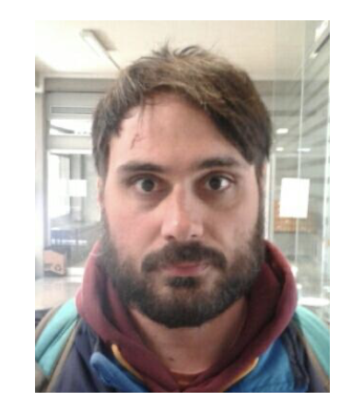
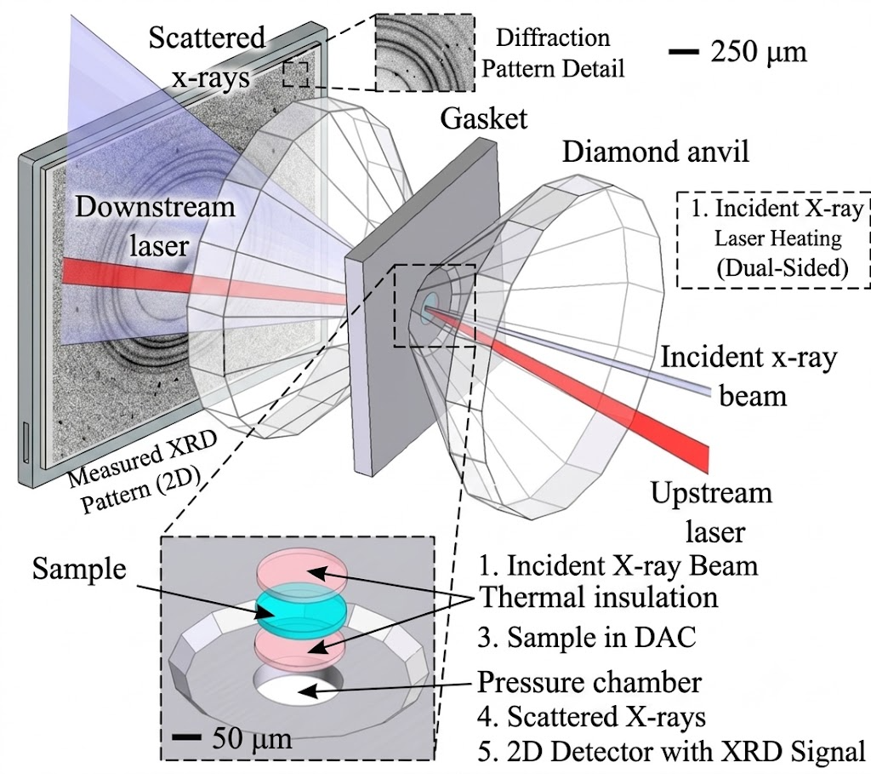
Simone Anzellini –Universidad de Valencia
Main Research Interests
• Phase diagrams and properties of transition metals
• Mechanical behavior of engineering materials
• Characterization of new materials
• Structure and evolution of the deep Earth matter at crystallographic and atomic scale
Main Techniques
In situ characterization of structural and electronic properties of materials under extreme P-T conditions via:
- Synchrotron X-ray Diffracrtion (XRD)
-Synchrotron X-ray Absorption Spectroscopy (XAS)
Combined with:
-laser-heated or resistively heated Diamond Anvil Cell
Main Projects
-Systematics of transition metals of the Pt group (phase diagram and
melting lines.
-Characterization of new thermoelectric materials

Slide 4
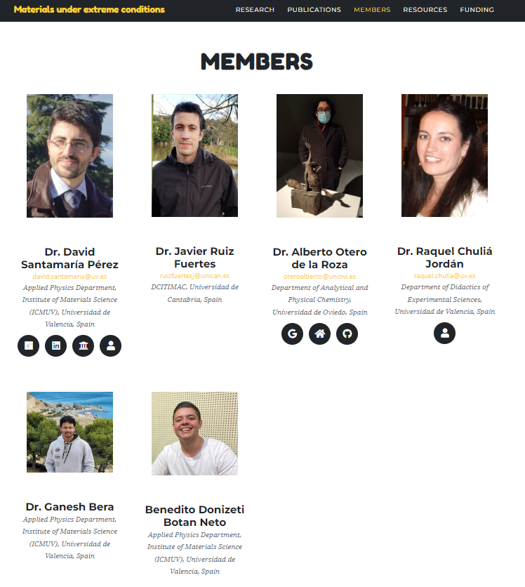


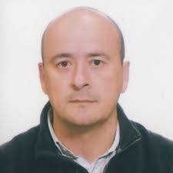
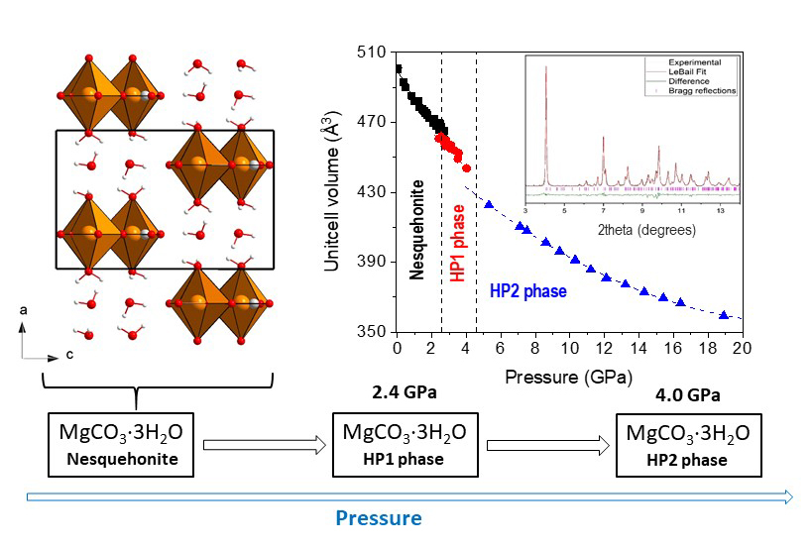
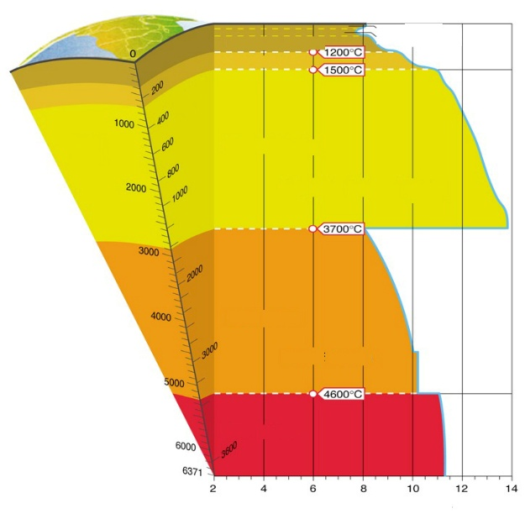
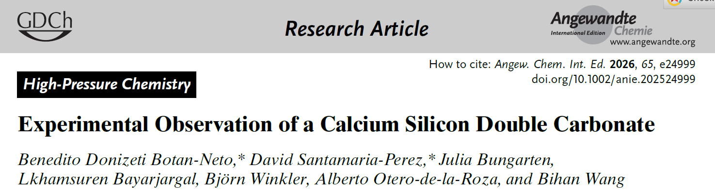
https://extreme-carbonates.github.io/
Dr. Neha Bura
Prof. Javier
González Platas
Carbonate minerals at extreme conditions
Dense hydrated carbonate phases
Formation of novel silicate-carbonate phases
CO₂ reactivity, carbon capture and storage via mineralization

